Slide 1
8:00am – 8:45am, Registration 8:45am – 8:55am, Openning remarks – Prof. Rebecka Lundgren, UCSD 8:55am – 9:10am, Keynote Address – Prof. Paul Bukuluki, MAK 9:10am – 9:25am, Presentation – Mr Michael Tugyetwena, CARE
WELCOME TO EALC CONFERENCE DAY 2
2023 Conference
15 June 2023
Fair Way Hotel
Connect via Zoom

Slide 2
Digitization and the Technology Impact on Gender and Social Norms
Eastern Africa Social and Gender Norms Learning Collaborative
2023 Conference
15 June 2023
Fair Way Hotel
Connect via Zoom

Slide 3
Opening Remarks Dr. Rebecka Lundgren University of California San Diego Center on Gender Equity and Health
15 June 2023
Fair Way Hotel
Connect via Zoom

Slide 4
Keynote Address Dr. Paul Bukuluki Makerere University- School of Women and Gender Studies.
15 June 2023
Fair Way Hotel
Connect via Zoom

Slide 5
Digitalization: Do social and gender norms matter?
Paul Bukuluki, SWSA Department, School of Social Sciences, Makerere University
CHUSS

Slide 6
Key points to issues to reflect on
Substantial increase in digital access, but significant challenges to overcome gender inequality in the transformation to a digital society and to enhance productivity and social development (Mariscal et al 2019)
Availability of new applications and more affordable handsets but why are specific social groups struggling to be part of the transformation to a digital enabled society…Why?
A stark and pervasive gender inequality in terms of access, ownership of digital devices, digital fluency, capacity to make meaningful use of the access to technology.

Slide 7
Key points to issues to reflect on
Are we having gender blind ICT policy reforms and programming interventions?
Gender-blind interventions: recognize no distinction between the sexes, and may make gender assumptions that lead to a bias in favour of existing gender relations.
To what extent are the policy reforms at global, regional, national and sub-national levels taking into account the gender and social norms that regulate access and use of ICT?
Where do we fall along the Gender continuum in relation to digitalization? Gender blind; gender neutral, gender transformative? (Population Reference Bureau (2017)

Slide 8
A ‘gender continuum’: typology of interventions
Type | Description of Intervention
Gender-discriminatory/ gender-blind | Ignores gender issues, gender roles and the gender gaps between men and women; may contain measures that discriminate against women and men, and/or reinforce gender inequalities.
Gender-neutral | Recognizes gender inequalities, but does not include specific measures to address gender discrimination and inequality
Gender-sensitive/ transformative | Recognizes specific needs and priorities of women and men, and purposefully and proactively tackles gender inequalities by questioning and challenging the structures, institutions and norms on which these inequalities are based, sustained, reinforced and reproduced over time. Take a gender transformative approach that addresses root causes of systemic inequalities and transform prevailing gender power structure to address gender related barriers at the household, community and institutional levels

Slide 9
Intersectionality
Intersectionality: Describes how individuals hold positionalities in society based on their race or ethnicity, class, culture, age, gender, sexual orientation, abilities, etc. (Crenshaw 2017 cited in Agency for All Gender Strategy), which intersect to reinforce inequalities or may afford an individual relative privilege (Sariola 2020).
Power is central to intersectionality; in any given context, one’s identity will afford them more or less power in position to another (Agency for All, 2023, Gender Strategy)

Slide 10
Social norms regulate what behaviour is “normal.”

Slide 11
Social Norms defined
+/-
Unwritten rules about what is acceptable in a given society or group of people (“reference group”)
Often maintained by positive and negative social sanctions
Notes:
Social Norms are group rules that define obligatory, recommended and acceptable behaviour in a group of people. [click]
Some examples are, for instance, exchange gifts at Christmas with family members, leave a tip to the waiter, open the door for someone with a physical disability. There is no law or regulation asking us to do these things, but if I don’t comply with them: 1) my family might gossip about us being stingy, 2) the waiter might come back angry and next time make me wait for ours before coming to my table, and 3) friends observing the door scene might consider low of myself. [click]

Slide 12
A working definition of social norms

Slide 13
Social Norms as Beliefs
What people believe others do
What people believe others approve and disapprove of
(Descriptive norms or empirical expectations)
(Injunctive norms or normative expectations)
Kallgren, C. A., et al. (2000). "A Focus Theory of Normative Conduct: When Norms Do and Do not Affect Behavior." Personality and Social Psychology Bulletin 26(8): 1002-1012.
Notes:
The second belief (what people believe others approve and disapprove of) is similarly based on indviduals perception and as such can be erroneous. Erronoeus beliefs of what members of a group approve can go as far as having all members of a group privately disapprove of something, but publicly endorsing on the belief that others do so.

Slide 14
Sanctions: What do people anticipate happens to (non) compliers in their group?
Notes:
sanctions:
admiration or contempt,
verbal approval or disapproval,
praise or rebuke,
compliment or insult,
prize or fine,
promises of physical reward or threats of physical punishment,
actual physical reward or punishment,
threats of death
or actual death
gossiped about;
forbidden from handling food or gathering firewood,
denied adult status in the community;
considered impure or untouchable.
rank an individual or a group above others
and disapproval rank an individual or group below others
or could be an act of acceptance including someone equally in a group
or an act of rejection excluding someone from a group of equals.

Slide 15
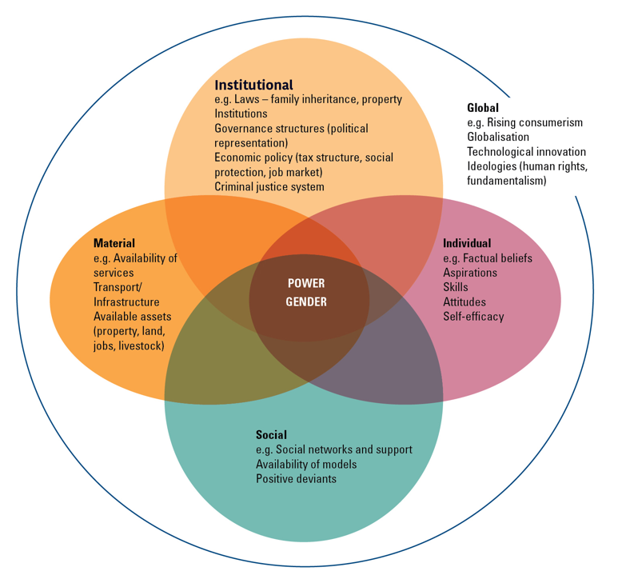
Norms are in a system of structural factors that intersect and sustain action.

Slide 16
Gender Norms
Gender norms are social norms defining acceptable and appropriate actions for women and men in a given group or society.
They are embedded in formal and informal institutions, nested in the mind, and produced and reproduced through social interaction.
They play a role in shaping women and men’s (often unequal) access to resources and freedoms, thus affecting their voice, power and sense of self.
Cislaghi B, Heise L (2019); Gender norms and social norms: differences, similarities and why they matter for prevention science. Sociology of Health and Illness. https://doi.org/10.1111/1467-9566.13008

Slide 17
Conclusion
Social and gender norms change are very crucial to addressing the digital divide (digital access and meaningful use) to foster digital inclusion and social development.
However, they do not work in isolation, we need to envision and design strategies that address the structural factors that work together with social/gender norms to reinforce the digital divide.
These factors are better understood by using the socio-ecological model mapping them at various levels.
Recognition that of the influence of intersectionality to reflect on other social identities that combine with gender identity to reinforce inequality in access to and meaningful use of the digital tools.
Recognition that gender norms affect agency of women and men in access and use technology. Agency is the power to work towards the achievement of self-determined goals, and is a tripartite construct comprising “can”, “act”, and “resist”. (Agency for All, 2023)

Slide 18
PRESENTATIONS ON RESEARCH ON TECHNOLOGY & SOCIAL NORMS Gender Based Violence
Day 2: Research Sessions
15 June 2023
Fair Way Hotel
Connect via Zoom

Slide 19
Mr. Michael Tugyetwena - Operations Director Care International Uganda
Exploring the Dark side of Digitalization: The Role of Technology in Gender Based Violence
15 June 2023
Fair Way Hotel
Connect via Zoom

Slide 20
"Exploring the Dark Side of Digitization: The Role of Technology in Gender-Based Violence"
CPA Michael Tugyetwena, CPFAcct
Operations Director, CARE International in Uganda

Slide 21
Introduction
Digital platforms have introduced new and complex dynamics into human interaction.
The role of technology in exacerbating gender-based violence is often overlooked.
Technology-assisted abuse is a significant and urgent issue.

Slide 22
Study Objectives
To investigate the extent and mechanisms by which technology contributes to gender-based violence.
To identify the various forms of technology-facilitated gender-based violence and discuss their implications.
To explore the role of online platforms in supporting survivors, as well as in perpetuating victimization.
To underscore the need for and inform effective policy interventions and collaboration amongst stakeholders to prevent and respond to technology-assisted gender-based violence.

Slide 23
Literature Review: Understanding Gender-Based Violence (GBV)
Definition: The United Nations defines GBV as any action that could result in physical, sexual, or mental harm to individuals, mainly impacting women and girls.
Causes: Power inequalities, deep-rooted societal norms, and gender-based stereotypes are the main drivers of GBV.
Role of societal norms and stereotypes: These create gender-based behaviour expectations and roles, influencing the power dynamics in society, and can lead to GBV when they are oppressive or violent.
Socio-ecological model: Violence is the outcome of an integral of elements at individual, relational, community, and societal level. Each level affects the others, increasing the likelihood of GBV victimization or perpetration

Slide 24
Literature Review: The Digital Dimension of GBV
Digital transformation: The emergence of digital technology and the internet has broadened the scope of GBV. Technology-facilitated GBV is now a major issue, with societal norms and stereotypes contributing to online violence.
Forms of technology-facilitated GBV: Cyberstalking, online harassment, and the unauthorized distribution of intimate images are common forms, with the internet's anonymity, accessibility, and wide reach escalating GBV.
Technology as a support mechanism: Despite being a source of harm, technology also provides assistance for GBV survivors through online communities and social media platforms, helping with mutual aid, information exchange, and advocacy.
Secondary victimization: Survivors may endure criticism, victim-blaming, or further harassment online, adding an additional layer of complexity to the relationship between GBV and technology.
Research implication: The intricate connection between societal norms, gender stereotypes, GBV, and technology highlights the need for in-depth research to gain a better understanding of these dynamics.

Slide 25
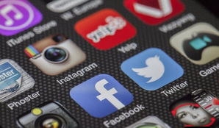
Conceptual Framework
Societal Level: How societal norms and gender stereotypes foster an environment that perpetuates TAGBV.
Community Level: How online communities and platforms, as virtual communities, either encourage or mitigate TAGBV.
Relational Level: The role of relationships (personal, professional, etc.) in the digital space and how these relationships can either foster or inhibit TAGBV.
Individual Level: How individual behaviours, facilitated by the anonymity, accessibility, and broad reach of technology, contribute to the perpetration of TAGBV.

Slide 26
Methodology Overview
Approach: This study utilized a desk research methodology, taking advantage of existing literature and materials to comprehend the role of technology in gender-based violence, without the necessity for primary data collection.
Resources: A variety of materials were reviewed, including scholarly articles, research and technical reports, and policy documents, all sourced from various online databases and digital libraries.
Data Collection: A systematic search was conducted using relevant keywords. Each material identified was evaluated based on its relevance to research objectives, credibility, and the quality of the original study's methodology.
Data Analysis: A thematic analysis approach was used. Key points were extracted from each material and organized into themes reflecting different aspects of technology-facilitated gender-based violence.
Goal: The study aims to provide a comprehensive, evidence-based understanding of the intersection of technology and gender-based violence, basing its findings in scholarly and policy literature.

Slide 27
Key Findings
Role of Internet
Mirroring Societal Structures
Role of Online Communities
Forms of Technology-Assisted GBV
Notes:
Mirroring Societal Structures: Digital spaces replicate offline social norms and structures, including those that uphold gender-based disparities. Digital interactions often include harmful behaviours contributing to gender-based violence.
Role of Internet: Internet can act as a platform where women are objectified, demeaned, and subjected to sexist commentary, reinforcing harmful societal norms.
Forms of Technology-Assisted GBV: Primary forms include cyberstalking, non-consensual dissemination of intimate images (revenge porn), and online harassment. These acts mirror offline power dynamics and aim to harm and control victims.
Role of Online Communities: These platforms can offer support, solidarity, and empowerment for survivors but can also foster secondary victimization through victim-blaming, ridicule, and further harassment

Slide 28
Implications and Discussion
Inherent Nature of Technology
Double-Edged Sword
Towards Solutions
Notes:
Technology’s Inherent Nature: Anonymity, accessibility, and the broad reach of technology can aggravate the impact of technology-assisted GBV. This troika intensifies the harm, making GBV a particularly deceptive form of abuse.
Double-Edged Sword: Technology can amplify harm while also serving as a platform for survivor support, showcasing a critical dichotomy in understanding and addressing technology-assisted GBV.
Towards Solutions: Understanding the relationship between technology and gender-based violence is crucial for developing effective strategies to counter it.

Slide 29
Recommendations for Addressing TAGBV
Robust policy responses are necessary, including legislation and mandates for digital platforms.
Comprehensive strategies to protect victims and prevent further abuse are needed.
Awareness and education initiatives should be aimed at raising public awareness and promoting online etiquette and respect.
Multi-sector collaboration is crucial to formulate and implement effective solutions.
Notes:
Comprehensive Strategies: Develop strategies involving technical measures such as improved reporting, stricter content moderation, and better privacy protection tools. Supportive measures should include online support networks, accessible resources for digital safety, and legal assistance for survivors.
Increase Awareness and Education: Raise public awareness about technology-assisted GBV, dispel victim-blaming attitudes, and promote online respect. Incorporate digital citizenship and online safety courses into school curricula to educate youth about respectful online interactions.

Slide 30
Further Recommendations and Conclusion
Policy Intervention: Develop legislation recognizing and penalizing technology-assisted GBV. Mandate digital platforms to take action against such violence and keep laws updated to protect individuals from emerging online harms.
Foster Collaboration: Advocate for multi-sector collaboration between technology companies, policymakers, and civil society organizations to formulate and implement effective solutions.
Conclusion: Addressing technology-assisted GBV requires understanding the problem and a committed, concerted effort to fight it. This paper provides a foundation for such efforts, and hope the recommendations guide future action in this vital area.
Notes:
Policy Intervention: Develop legislation recognizing and penalizing technology-assisted GBV. Mandate digital platforms to take action against such violence and keep laws updated to protect individuals from emerging online harms.
Foster Collaboration: Advocate for multi-sector collaboration between technology companies, policymakers, and civil society organizations to formulate and implement effective solutions.

Slide 31
Thank you for your time 😊

Slide 32
References
Barak, A. (2005). Sexual harassment on the Internet. Social Science Computer Review, 23(1), 77-92.
Bessenoff, G. R. (2006). Can the media affect us? Social comparison, self-discrepancy, and the thin ideal. Psychology of Women Quarterly, 30(3), 239–251. https://doi.org/10.1111/j.1471-6402.2006.00292.x
Chung, J. E., & Cho, J. (2017). Objectification and violence against women in advertising: A content analysis of advertisements from the United States, Mexico, and South Korea. Journal of Sex Research, 54(3), 327–337. https://doi.org/10.1080/00224499.2016.1142492
Citron, D. K., & Franks, M. A. (2014). Criminalizing Revenge Porn. Wake Forest Law Review, 49, 345-391.
Duggan, M. (2017). Online Harassment 2017. Pew Research Center. https://www.pewresearch.org/internet/2017/07/11/online-harassment-2017/
Edwards, E. (2016). Cyberstalking and harassment. National Center for Victims of Crime. https://victimsofcrime.org/docs/default-source/src/cyberstalking-factsheet-2016_eng.pdf
Heise, L. (1998). Violence against women: an integrated, ecological framework. Violence Against Women, 4(3), 262-290.
Henry, N., & Powell, A. (2018). Technology-facilitated sexual violence: a literature review of empirical research. Trauma, Violence, & Abuse, 21(2), 261-283.
Henry, N., Powell, A., & Flynn, A. (2018). Technology-facilitated sexual violence: A literature review of empirical research. Trauma, Violence, & Abuse, 19(2), 195-208.
Herring, S. C., Job-Sluder, K., Scheckler, R., & Barab, S. (2015). Searching for safety online: Managing “trolling” in a feminist forum. The Information Society, 31(2), 171–184. https://doi.org/10.1080/01972243.2015.1005463
Lenhart, A., Ybarra, M., & Price-Feeney, M. (2016). Online harassment, digital abuse, and cyberstalking in America. Data & Society Research Institute. https://datasociety.net/wp-content/uploads/2016/05/DS_CyberMisogyny_Final-1.pdf
Lopez, E., Deane, K. L., & Sivakumar, S. (2018). Technology abuse as a form of interpersonal violence: A systematic review of the literature. Violence and Victims, 33(1), 3-28.
Mantilla, K. (2013). Gender trolling: Misogyny Adapts to New Media. Feminist Studies, 39(2), 563-570.
McKinnon, S., & Holder, A. (2016). Survivor-defined success: A new paradigm for posttrauma research. Journal of Aggression, Maltreatment & Trauma, 25(6), 600-618.
Rennison, C. M., & Planty, M. (2010). Nonlethal intimate partner violence: Examining race, gender, and income patterns. Violence and Victims, 25(5), 607-621.
United Nations. (1993). Declaration on the Elimination of Violence against Women. General Assembly resolution 48/104 of 20 December 1993.

Slide 33
Mr. Joseph Nyende and Mr. Monja Minisi
15 June 2023
Fair Way Hotel
Connect via Zoom

Slide 34
Learnings from FOME’s Online Project titled “Prevention of Gender-Based Violence against Women and Girls using Social Media during COVID-19”
A Presentation at the Gender and Social Norms
Conference
Joseph Nyende jnyende@fomeug.org www.fomeug.org Twitter @FomeUganda

Slide 35
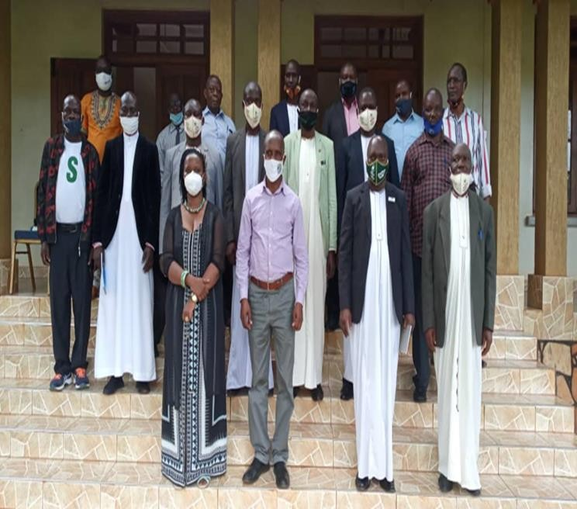
Outline of the Presentation
About FOME
Background of the Abstract
Description
Key Learnings
Conclusion

Slide 36
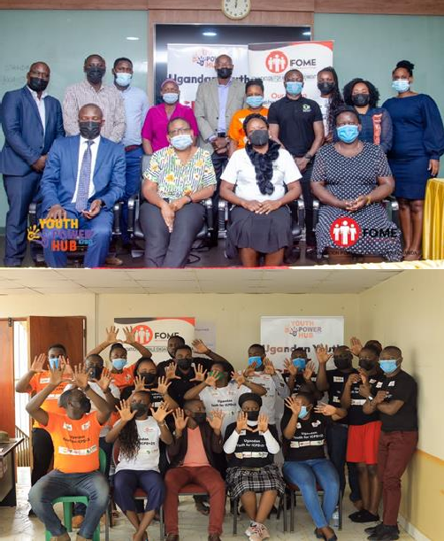
About FOME
Foundation for Male Engagement Uganda (FOME) is a national pro-feminist organisation working with men and boys for gender equality for women and girls, and addresses the poor health seeking behaviours of men and boys.
FOME works with men and boys to prevent gender- based violence, child marriages, child pregnancies, and addresses social and gender norms and practices that affect women and girls.
Our goal is to galvanise efforts to foster positive caring masculinities at individual, household, group and community levels.
Our dream is a violent free Uganda for both men and
women.

Slide 37
Abstract Title
Learnings from FOME’s Online Project titled “Prevention of Gender-Based Violence against Women and Girls using Social Media.
Project Description
The Prevention of Gender-Based Violence (GBV) against Women and Girls using Social Media was implemented by FOME in 2020 at the peak of COVID19. The focus was to increase male engagement in the prevention of GBV during COVID19.
FOME with support from UNFPA through the civil society coalition for integrated SRHR/GBV/HIV in Uganda implemented a project called preventing violence against women and girls.

Slide 38
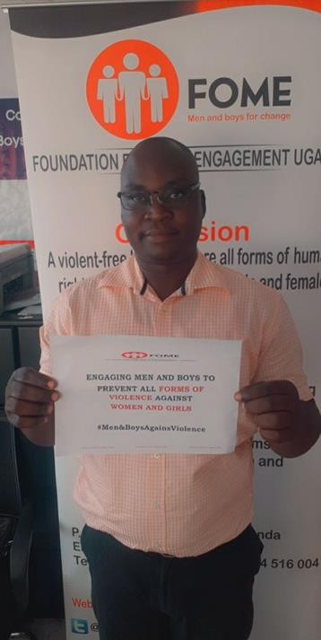
The project aimed to involve key players in the prevention of gender- based violence in Uganda and around the world by leveraging internet technologies like Twitter, Facebook Live, Zoom, Google Meet, WhatsApp, and Facebook.
The panelists came from Uganda, Kenya, South Africa, and America, including well-known gender activists, government actors, UN officials, male engagement experts, regular men, students, civil society actors, and law enforcement authorities.
Each week had a different topic and was covered in-depth for two hours by three to four panelists. Short videos were made and shared in WhatsApp groups set up to combat sexual and gender-based violence.
Staff members had to walk several miles to the office during the lockout in order to discuss emerging trends and print messages for dissemination, among other things.

Slide 39
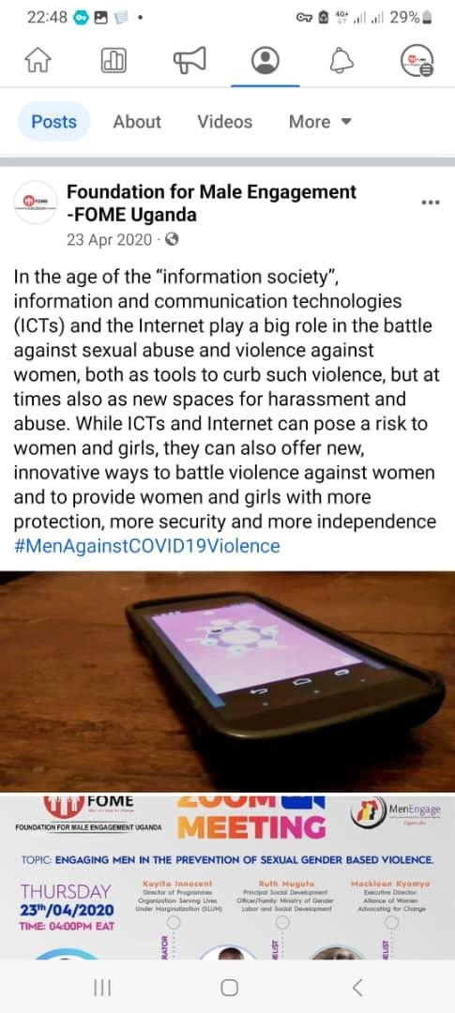
Key Project Findings/Learnings
Traditional norms and beliefs that promote violence against women and girls based on their gender can be challenged if men are given enough information.
GBV is a form of power play used by men to demonstrate their dominance
over their wives.
Men predominated at many zoom meetings during the lockdown, which meant that women were primarily engaged in unpaid care work while men were not much engaged.
Males predominated the conversations that depicted masculine dominance.
Engage boys as early as possible to prevent violence when they grow up.
Some males refused to participate in the campaign because they believed it
was aimed at promoting women while demeaning men.
There is need for programmes targeting specific cultures to create awareness among men since some men culturally assume that they are more superior and can be on top of others.
Because they would be judged as not being manly enough, other men didn’t participate in the discussion about gender based violence perpetrated against women and girls by men and boys.

Slide 40
Key Project Findings/Learnings
WhatsApp groups formed promoted networking and the sharing of knowledge,
experiences, and lessons learned.
Social media is an extremely effective tool for sharing information about
reducing gender-based violence.
Increased call for men and boys' involvement in the prevention of sexual and
gender-based violence.
The president had to speak about gender-based violence at one of his addresses
on COVID-19 as a result of our online campaign.
Increased awareness on the reporting of incidences of sexual and gender-based
violence to the authorities.
FOME received invitations to speak about male engagement at different houses
and zoom meetings.
The short videos were a powerful and effective method of behavior change
communication.
-Several men testified about how they changed after watching the short videos on
their phones through WhatsApp.

Slide 41
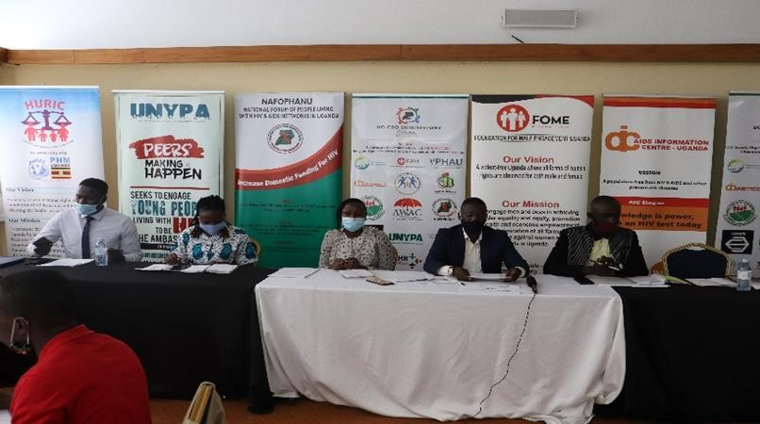
Challenges faced during project implementation
Participating in online events like Zoom, Google Meetings, and Facebook Live took a lot of mental capacity at first, but this eventually waned.
Our meetings were frequently interrupted by live
pornography thanks to cyber hackers.
Meetings multiplied, but we all had the same audience in
mind.
Due to the ongoing lockdown, it was difficult to communicate with some of the target audience because they weren't using social media.

Slide 42
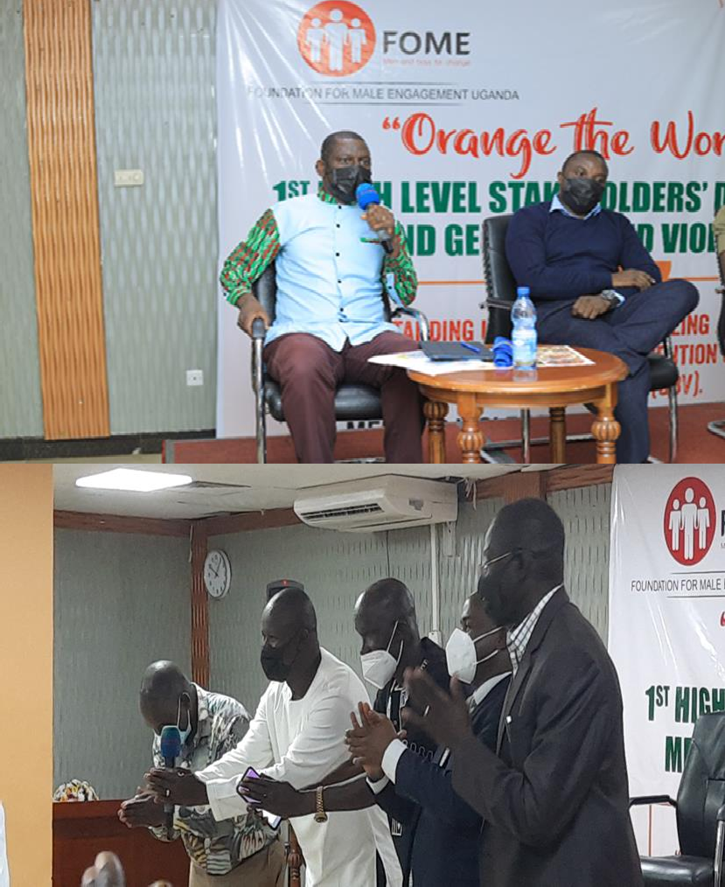
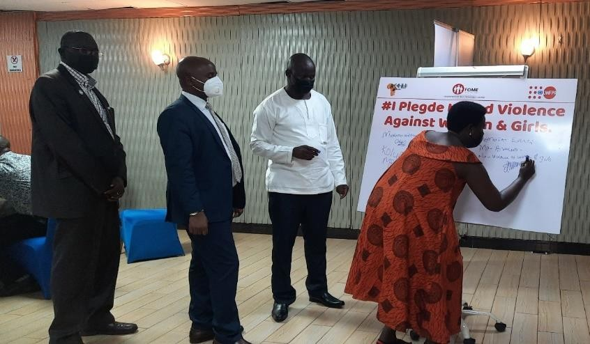
Project Next Steps
FOME to reachout to partners to organise the first annual high level stakeholders dialogue on men and GBV in Uganda, with an aim of men agreeing on actions to be done to prevent GBV against women and girls.
In a symbolic gesture, male parliamentarians apologized for all the violence
on women and girls that occurred during COVID19.
They made a commitment to intensify the conversation about establishing
the Uganda Male Parliamentary Association (UWEPA).
Hon. Brandon Kintu is the chairperson of the association, while the deputy speaker serves as patron.
The association is awaiting the launch.
Finally, it has been established that using social media to prevent sexual and gender-based violence against women and girls is an extremely effective strategy. However, be combined with other conventional strategies to reach those that don't use social media.

Slide 43
Thank you to our partners who supported the campaign

Slide 44
Ms. Goretti Amuriat Zaavuga Digital Woman Uganda
15 June 2023
Fair Way Hotel
Connect via Zoom

Slide 45
The Use of Technology to Assist in Addressing Gender-based Violence in Uganda.
By Goretti Z. Amuriat
Digital Woman Uganda

Slide 46
Out line
Definition of Gender Based Violence ( GBV)
Use of technology to address Gender Based Violence
Examples of technology used in addressing GBV in Uganda and how they are transforming social norms
What are challenges / gaps in using technology to address gender based violence
Recommendations
6
Conclusion

Slide 47
Definition of Gender Based Violence (GBV)
Gender-based violence is violence directed against a person because of that person's gender
Gender based violence is deeply rooted in gender inequality and it is a violation of human rights in societies. It is directed at a person because of their gender.
Both men and women experience gender based violence but majority of victims are women and girls and happens partly because of gender and social norms.
This violence can be facilitated by use technology or with out use of technology. It is experienced both in offline spaces ( physical ) and online spaces (virtual)

Slide 48
Definition cont’d
Gender based violence can manifest in the following forms:
Physical violence, sexual, psychological or economic violence, harassments or sexual harassments, domestic violence or intimate partner relationships or suffering to women, including threats of such acts, coercion or arbitrary deprivation of liberty, whether occurring in public or in private life
Online Gender Based Violence manifest in forms of online sexual harassments, cyberstalking, non consensual intimate messages commonly known as revenge porn, trolling and doxing

Slide 49
Gender Based Violence in Uganda
Gender Based Violence in Uganda is rampant and it happens both offline and on line.
GBV is an everyday threat for Ugandan women and girls. National demographic data from 2020 reveal that 56% of married women aged 15-49 reported having suffered physical and/or sexual violence by a husband (Uganda Bureau of Statistics, 2021).
More than one in three women (36%) experienced sexual violence, most often from a partner.

Slide 50
Gender Based Violence in Uganda …..cont’d
Covid-19 Pandemic with its measures of lock down in 2021 and 2022 led to an increase in gender based violence resulting from women and men forced to stay at home without work or work from home.
The same period saw many people access internet to use it for work and also to communicate with their families and friends.
This increased the number of people who were accessing and using the internet to 14% between 2020-2021.
The Internet penetration stood at 26.2% in January 2021 (DWU Policy Brief 2021). This led to increase in online gender based violence.

Slide 51
How technology has been used to address Gender Based Violence
Technologies are converging in new ways to change how we live, work and organize hence changing social norms in societies.
Attempts are being made to use technology to make women’s access to services safer, reducing the risk of sexual harassment, a form of gender-based violence (GBV).
It can be used to ensure easier, more comprehensive access to information and services, including survivors of violence
Technology is being used to report incidences of gender based violence

Slide 52
How technology has been used to address Gender Based Violence
Technology can offer support services e.g. linking the survivors to support organization, organization providing shelters and counselling to Victims
Technology assisting GBV initiatives such as use of hotlines, online platforms/web based platforms assist in accessing information on victim and also during emergency, the victim can relay information to another person.
The tools available provide a means for survivors to report incidents anonymously and receive immediate assistance.

Slide 53
How technology has been used to address Gender Based Violence
Through technology the survivors/victims can access counselling services, receive legal assistance , obtain medical care ,and emotional support
The tools help in collecting data on victims/survivors and this data can be analyzed and trends of GBV cases established and more information on the victim ascertained for better planning and handling
The technology tools are used to raise awareness on the GBV and its effects and help in changing peoples perception on the GBV and societal norms

Slide 54
How technology has been used to address Gender Based Violence
During the 16 days of activities against Gender based Violence sensitization happen through radio talks, mobile phones, and TV that disseminate information that impact on behaviors and beliefs of individuals in communities.
The tools collect data and help in developing targeted interventions that help design inclusive applications.
The tools are used to document information and produce reports on the victims and survivors.

Slide 55
Examples of Technology used in addressing Gender based Violence in Uganda
In Uganda there are technology initiatives such as call centers where the victims can call for free and report cases of gender based violence. Example of organization that own such is UMWA.
The Uganda Police has toll free line 08001991195 where victims report cases of GBV
There is a Chat bot owned by Plan International, where Victims log in and are guided on what to do in case they need help.
SMS platforms ( Bulk SMS) have been deployed to disseminate information on Gender Based Violence and raise awareness on the vice especially during the 16 days of activism

Slide 56
Examples of Technology used in addressing Gender based Violence in Uganda
Radio and TV have been used in raising awareness on the gender based violence and also help impact and change social norms in communities.
U-Report an initiative by UNICEF is used to collect data on gender based violence and also report cases of gender based violence
Social media campaign's on Twitter through twitter chats/ twitter spaces, face book, whats up/tiktok have been conducted to raise awareness on Gender Based Violence.
The use of video, cameras, CCTV, digital stories have been used to record incidences of GBV and disseminate to provide evidence and support reported cases of survivors.

Slide 57
Other Platforms used to end gender based violence
Use of safetipin a mobile application that crowd sources and maps real time data users to provide public safety information. The app utilizes location safety scores to help users, primariry women and girls to plan their routes and find safe places to stay in. It has been used widely in Jarkata, Indonesia.
Artificial intelligence Chatbot have been used to address risks of sextortion and online harassments
Tech as a safe place (virtual safe space) facilitates access to information and services in away that is safe, culturally appropriate and accessible to users even when physical services are limited. Virtual Safe spaces have been piloted for girls in emergence effected locations with information on GBV, sexual reproductive health and self care.

Slide 58
Other Platforms used to end gender based violence
Tech as guide: This GBV e- pocket guide app provides humanitarian practitioners with information on how best to support survivors when there are no GBV expert in communities. This guide is also disability accessible.
Tech as a response: This offers great opportunity for improved GBV service provision, helps reach response quality. The system has a mobile app and improves quality care for survivors in Emergence situation, including Covid-19
Rosa provides training and Knowledge exchange for staff supporting people with Gender Based Violence
Victim voice: enables survivors to record incidences of abuses in way that is safe.

Slide 59
Gaps/ Challenges in Using Technology to address Gender Based Violence
Digital divide: Technology not being available in some areas such as the rural areas.
There are inadequate resources to purchase technology/tools to be used. Majority of the victims do not own the technology or can not access the applications.
There is lack of digital skills; most gender based violence victims especially women and girls lack knowledge and skills on how to use the technology to obtain support services.
The issue of data and privacy. Reporting the incidences of GBV through use of technology may not provide privacy and protection to the victims and this could result in more violence incidents.

Slide 60
Gaps/ Challenges in Using Technology to address Gender Based Violence
Digital Security: majority of victims do not know how to protect themselves while using the digital tools. Especially those that access and use the internet.
The lack of the ICT Infrastructure especially in rural areas / communities discriminates some survivors. This also goes with absence of connectivity/unreliable connectivity and poor network which may not allow you to call or send information.
The social cultural issues, where men in the rural areas are the owners of technology, the mobile phones. Making it difficult to use it for reporting GBV. In some places technology is accessed in far places like Cafes and information and yet women are not freely able to access, due limited movements

Slide 61
Gaps/ Challenges in Using Technology to address Gender Based Violence
There is lack of gender inclusive designed initiatives/tools/platforms specifically to be used to address women issues such as gender based violence.
Women and girls doing STEM subjects are very few. This is because the society believes that science subjects and mathematics are too hard for girls The norm is sciences are for men not women. This has caused women to lag behind in technology innovations and are not able to use the applications.
Most technology tools available discriminate against survivors of GBV women and girls with disability. They have not been able to use them to access support services.

Slide 62
Recommendations
There is need to collaborate and work together with women and girls to design technology tools that address GBV. Their rights, needs and wishes of survivors need to be put at the center of technology design.
The tools designed should protect the privacy of women and girls especially those that are reporting cases of GBV e.g. the mobile phone history of survivors who are reporting GBV should be hidden
Technology Solutions must be built upon extensive social foundation of ethical standards and protocols of GBV community, while meeting digital safety and privacy.
Technology assisted GBV initiatives should be inclusive and accessible to all survivors

Slide 63
Conclusion
Technology assisted GBV initiatives have emerged as an important tool in addressing GBV.
In Uganda technology has contributed to survivors/victims accessing support and service delivery
Technology has led to better data collection and analysis and increased awareness among communities on the negative effects of GBV which has led to transforming social norms.

Slide 64
Conclusion
However, in some communities it has been hard to access and use technology to fight Gender based Violence.
The need to address challenges that lead to survivors not being able to access technology is critical in ensuring that the tools are affective in supporting survivors and contributing to efforts to end GBV in communities
Continued use of technology to raise awareness provides an opportunity to transform society beliefs and norms in community.

Slide 65
REFERENCES
https://www.unicef.org/eap/blog/six-ways-tech-can-help-end-gender-based-violence
https://www.svri.org/sites/default/files/attachments/2019-11-20/TechnologyandGVB.pdf
DWU 2021, Policy brief on Structuring protective policies for women, girls and children on line.

Slide 66
Contacts:
Email: zgamuriat@gmail.com
info@digitalwomanuganda.org
Web: www.digitalwomanuganda.org
twitter:@uganda_digital

Slide 67
Questions & Answers
15 June 2023
Fair Way Hotel
Connect via Zoom

Slide 68
HEALTH BREAK 15 minutes
15 June 2023
Fair Way Hotel
Connect via Zoom

Slide 69
Rogers Tumusiime Save The Children
15 June 2023
Fair Way Hotel
Connect via Zoom

Slide 70
Lessons Learned from a Mixed-Method Pilot of a Norms-Shifting Social Media Intervention to Reduce Teacher-Perpetrated School-Related Gender-Based Violence in Uganda
Jasmine Uysal, Rogers Tumusiime, Catherine Kennedy, Pooja Chitle, Pam McCarthy, Marilyn Akinola, Leslie Gautsch, Rebecka Lundgren
Social & Gender Norms Conference 2023

Slide 71
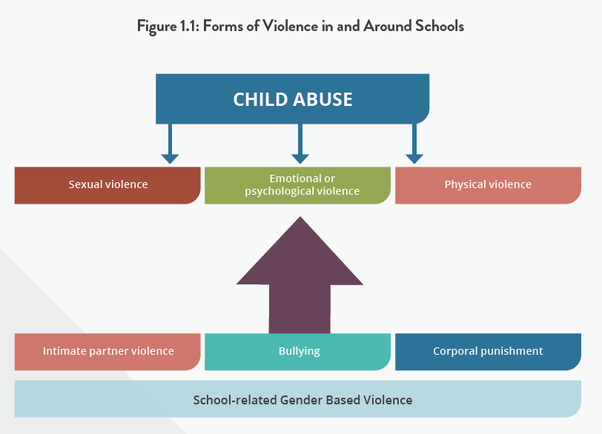
VIOLENCE AGAINST CHILDREN IS A GLOBAL EPIDEMIC
More than ONE HALF (one billion) children experience violence or neglect annually (Hillis et al., 2016)
Child abuse is associated with poor health outcomes and is transmitted through generations (Hillis et al., 2016; Hillis et al., 2017)
School-related gender-based violence is common worldwide and has devastating costs, estimated to equal over $11 billion lost in lifetime earnings (Wodon et al., 2021)

Slide 72
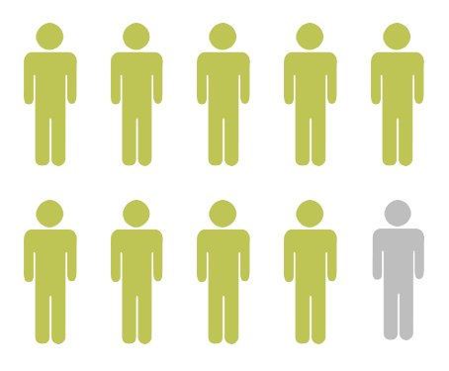
SCHOOL-RELATED GENDER-BASED VIOLENCE IN UGANDA
More than 9 in 10 Ugandan students report experiencing physical, sexual or emotional violence from teachers or staff (Devries, Child et al. 2014, Devries and Naker 2021)
Female students report experiencing gender discrimination in class which can be detrimental to education (Lubaaie, 2020; Nabbuye, 2018; UNICEF, 2020)

Slide 73
SOCIAL NORMS SUPPORTING CHILD ABUSE
Support for corporal punishment
Justification of sexual harassment and victim blaming
Justification of gender inequities and unequal treatment of genders in the classroom
To comprehensively address and prevent teacher-perpetrated violence against children in schools, norms shifting approaches are required but rarely available.
(Corboz et al., 2019; Haylock et al., 2016; Lundgren et al., 2019)
Notes:
- Child abuse is upheld by social and gender norms that support abusive behaviors, gender norms a subset of social norms

Slide 74
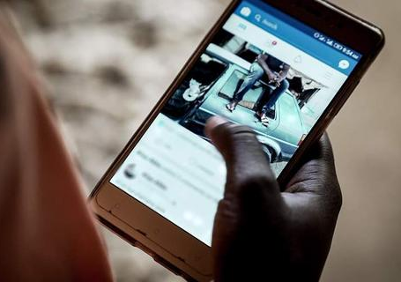
SOCIAL MEDIA IS A PROMISING STRATEGY FOR SOCIAL NORMS SHIFTING
Studies show social media can change knowledge, attitudes, norms and even behavior (e.g. #MeToo) (Lewis et al., 2018; Iskarpatyoti et al., 2018; Fairbairn, 2020)
Social media may also increase the number of people reached by interventions and are less resource intensive offering opportunity for scale (Lutkenhaus et al., 2023)
Only a handful of social media norms-shifting interventions have been evaluated for violence prevention (Lewis et al., 2018; Liou, 2013)
This study describes implementation and lessons learned from a pilot social media intervention designed to shift norms and SRGBV behaviors by Ugandan teachers.
Notes:
Studies show social media can change knowledge, attitudes, norms and even behavior across a variety of disciplines
Social movements such as #MeToo have also supported the power of social media to shift norms at a societal level
Social media may also increase the number of people reached by interventions and are less resource intensive offering opportunity for scale
Only a handful of social media norms-shifting interventions have been evaluated for violence prevention, though those that have show promising results
This study seeks to describe implementation and lessons learned from a pilot social media social and behavior change intervention seeking to shift norms and behaviors among Ugandan primary school teachers to promote positive student-teacher relationships and reduce key SRGBV behaviors such as corporal punishment, name calling, gender inequity, and sexual harassment and abuse

Slide 75
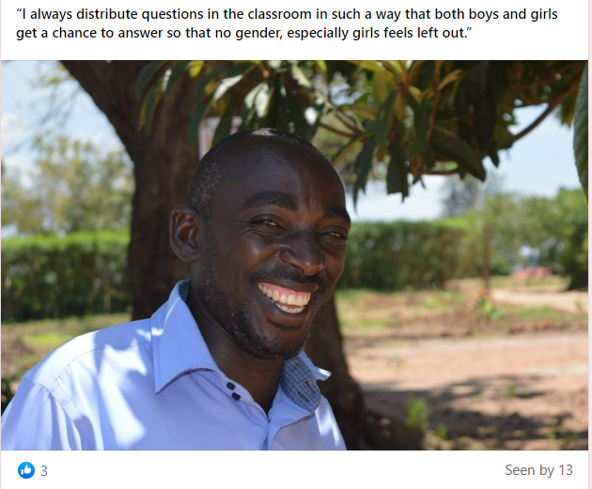
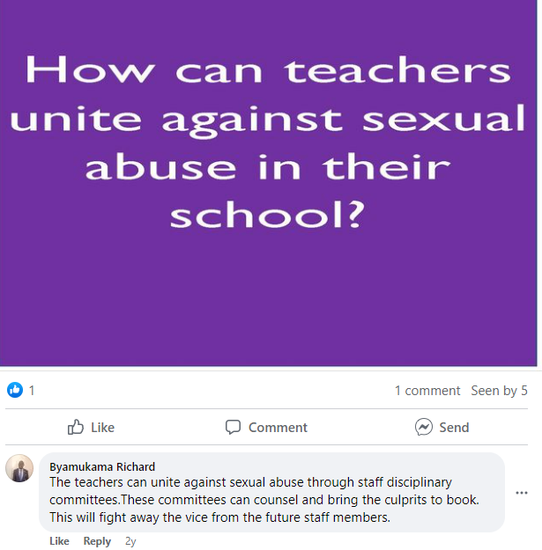
THE INTERVENTION: Everyday Heroes Social Media Groups
Social media component of a social and behavior change intervention by Save the Children implemented on Facebook and WhatsApp
Content posted by admin several times per week for 6 months to encourage teacher discussion and shift norms on key SRGBV topics (corporal punishment, sexual harassment, gender discrimination)
Posts informed by formative qualitative research and Robert Cialdini’s six principles of interpersonal influence
Topics posted in modules arranged from less sensitive to more sensitive topics
Notes:
Implemented on three groups - open Facebook page, closed Facebook group, closed WhatsApp Group
In groups program admin posted content several times per week to get teachers to engage in discussion on key SRGBV topics of interest to shift norms and encourage positive behavior change
Posted content included conversation starters to prompt teacher discussion and photos/quotes from teachers (see pictures as examples)
Key SRGBV topics of interest included corporal punishment, gender equity, name calling, and sexual harassment – also posted on positive topics including positive discipline and perceptions of a good teacher
All content, including SRGBV behaviors, were informed by formative research, posts were created based on Robert Caldini’s six principles of interpersonal influence (reciprocity, scarcity, authority, commitment, liking, consensus) to shift norms and behavior
Topics posted in modules arranged from less sensitive to more sensitive topics
Teachers could also post topics and information relevant to them

Slide 76
PILOT STUDY METHODS
Aims | Data Collection Method
 | Quantitative Social Media Tracking | Qualitative Social Media Listening | Post-Implementation Interviews
1. Describe the intervention’s reach and engagement | Yes | No | No
2. Explore the social norms and attitudes voiced by teachers on Everyday Heroes social media groups | No | Yes | No
3. Report on acceptability, challenges, and lessons learned from implementation and adaptation | Yes | Yes | Yes
Data collection informed by aims
Teachers recruited by Save the Children through schools originally targeted for in-person behavior change intervention (closed during COVID-19) and teacher’s unions
Weekly team debrief and process evaluation to make modifications in real time based on results
Notes:
Three methods of data collection
1. quantitative social media tracking to assess the number of posts, number of people who viewed posts (reach) and number of engagements on posts (likes/comments)
2. qualitative social media listening conducting thematic analysis on all teacher comments on posts related to the intervention/SRGBV behaviors of interest to explore norms of teachers and acceptability/implementation challenges
3. Post implementation interviews with 8 teachers participating in Facebook and WhatsApp groups to inform acceptability and lessons learned
Teachers recruited by Save the Children through schools originally targeted for in-person behavior change intervention (closed during COVID-19) and teacher’s unions
Weekly team debrief and process evaluation to make modifications in real time based on results of social media tracking and process evaluation

Slide 77
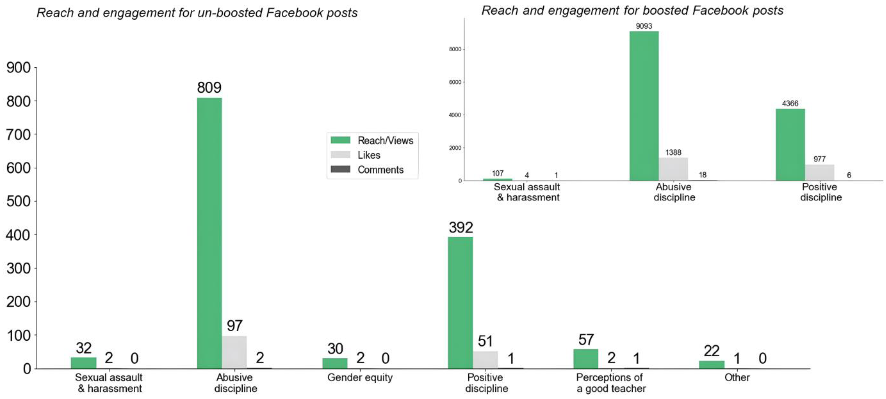
RESULTS: INTERVENTION REACH & ENGAGEMENT
1606 teachers joined Facebook page, 142 Facebook group, 242 in WhatsApp group
Nearly 2000 posts tracked across the 3 groups
Notes:
The number of people who joined groups varied based on group type – most teachers joined the Facebook page, with ~200 in the Facebook and WhatsApp groups; however teachers engaged in the most active discussion and debate on WhatsApp
Tracked nearly 2000 posts and 8000 teacher comments across the 6 months of implementation
Corporal punishment was the topic with the most views and engagement by teachers, followed by positive discipline
On Facebook a small number of posts were “boosted” through paid advertisements that greatly increased their reach and engagement

Slide 78
RESULTS: SRGBV SOCIAL NORMS AND ATTITUDES OF TEACHERS
Corporal punishment: Strong norms that upheld and justified corporal punishment for students but varied attitudes which, at times, prompted active debate
Sexual harassment: Strong norms that sexual harassment was unacceptable and not tolerated however also found commonly voiced attitudes of victim blaming
Gender discrimination: Overall teachers voiced attitudes reinforcing the importance of gender equity in the classroom
Respondent 1: “Beating a child is not a good idea to help him or her come out of trouble but instead have a serious talk with that child”
Respondent 2: “Beating is the most effective way”
“It’s poor upbringing of the child. There are those girls who like seducing our male teachers also. So, they end up making false accusations.”
“Teachers should focus on the ability of learners, however they should also be gender sensitive and treat all learners equally..”

Slide 79
RESULTS: IMPLEMENTATION LEARNING
Implementation Challenge | Implemented Solution
Teachers requested educational content on how to implement positive discipline techniques. | Posted links to educational information on positive discipline.
Some men voiced they felt attacked by posts on sexual harassment. | Revised posts to largely focus on the positive impact teachers can have and how they can prevent and report sexual harassment and abuse.
Participant burnout and fatigue related to posts on sexual harassment and abuse. | Varied content instead of posting repeated days of content on this topic.
Posts directly confronting harmful norms often had the unintended effect of reinforcing harmful norms. | Revised posts to focus on positive norms and positive influence of teachers. Included peer-influencers to comment on posts and shift discussion to focus on positive norms.
Some teachers posted content that graphically depicted child abuse. | Careful content moderation and removal of problematic teacher posts.
Notes:
- Through the weekly social media tracking, we found implementation challenges that occurred and made real-time modifications to address those (follow table above)

Slide 80
KEY TAKEAWAYS
Strong norms upholding corporal punishment and blaming girls for sexual abuse highlighting need for norms-shifting intervention
Implementation learnings highlight need for application of holistic social-behavior change framework to online norms shifting interventions
Mitigation strategies (focusing on positive norms, employing peer-influencers) are needed for online norms-shifting approaches
Notes:
1.
2.
3.

Slide 81
LIMITATIONS
STRENGTHS
Limitations
One of only a handful of studies to report on lessons learned from social media social norms shifting for violence prevention, only one for SRGBV
Mixed-methods design with real time monitoring and updates based on results
Social and behavior change approach based in formative research and theory
Inclusion of multi-level analysis and aims to understand several research questions
Unable to implement in-person component of intervention due to COVID-19 school closures; online approaches may be most effective when coupled with in-person programming
Unable to complete formal randomized evaluation due to COVID
Only analyzed teachers comments from those who chose to comment, potential for social desirability and selection bias
Notes:
Complete case analysis, assumes MAR

Slide 82
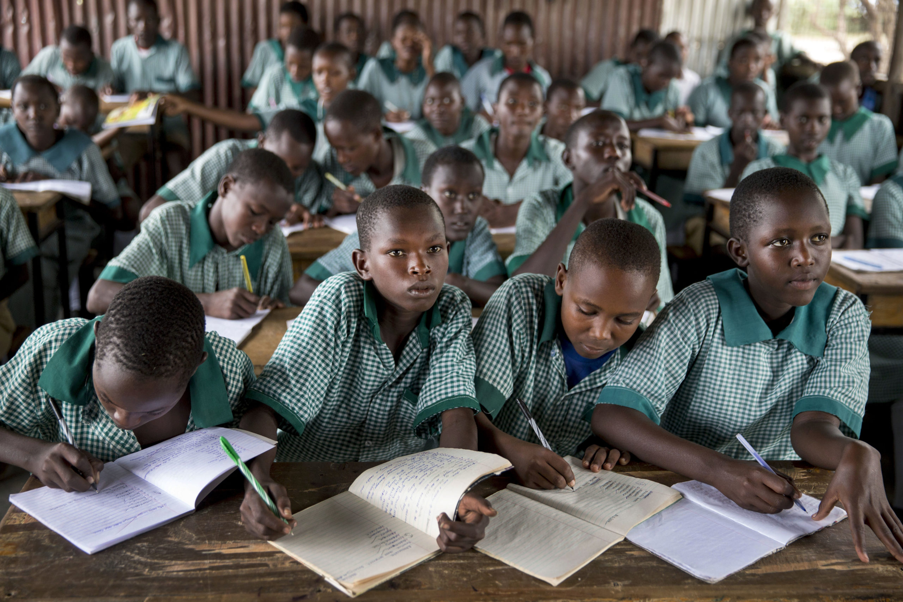
FUTURE DIRECTIONS
Further research is needed to…
Evaluate social media strategies to shift SRGBV norms and behaviors are over time (randomized trials)
Evaluate implementation and effectiveness of online coupled with in-person approaches
Assess teacher social networks and tap into peer-influences for online norm-shifting approaches

Slide 83
REFERENCES
Devries, K. M., Child, J. C., Allen, E., Walakira, E., Parkes, J., & Naker, D. (2014). School violence, mental health, and educational performance in Uganda. Pediatrics, 133(1), e129-137. https://doi.org/10.1542/peds.2013-2007
Devries, K. M., & Naker, D. (2021). Preventing teacher violence against children: the need for a research agenda. The Lancet Global Health, 9(4), e379-e380. https://doi.org/10.1016/S2214-109X(21)00093-0
Hillis, S., Mercy, J., Amobi, A., & Kress, H. (2016). Global Prevalence of Past-year Violence Against Children: A Systematic Review and Minimum Estimates. Pediatrics, 137(3), e20154079. https://doi.org/10.1542/peds.2015-4079
Hillis, S. D., Mercy, J. A., & Saul, J. R. (2017). The enduring impact of violence against children. Psychology, Health & Medicine, 22(4), 393-405. https://doi.org/10.1080/13548506.2016.1153679
Lewis, S.P.; Seko, Y.; Joshi, P. The impact of YouTube peer feedback on attitudes toward recovery from non-suicidal self-injury: An experimental pilot study. Digit Health 2018, 4, 2055207618780499.
Iskarpatyoti, B.; Biehl, H.; Spencer, J. Using Social Media Data to Understand Changes in Gender Norms; Measure Evaluation, University of North Carolina at Chapel Hill: Chapel Hill, NC, USA, 2018.
Lutkenhaus, R.; McLarnon, C.; Walker, F. Norms-Shifting on Social Media: A Review of Strategies to Shift Norms among Adolescents and Young Adults Online. Rev. Commun. Res. 2023, in press.
Fairbairn, J. Before #MeToo: Violence against Women Social Media Work, Bystander Intervention, and Social Change. Societies 2020, 10, 51.
Liou, C. Using Social Media for the Prevention of Violence against Women: Lessons Learned from Social Media Communication Campaigns to Prevent Violence against Women in India, China and Viet Nam; Partners for Prevention: Bangkok, Thailand, 2013.
Lubaaie, G. (2020). Gender imbalances among students in Kyambogo University of Uganda and development implications. Direct Research Journal of Social Science and Educational Studies, 7(1), 7-14.
UNICEF. (2020). Gender Dimensions of Violence Against Children and Adolescents (Strategy Paper).
Wodon, Q., Fèvre, C., Malé, A., Nayihouba, H., & Nguyen, H. (2021). Ending Violence in Schools: An Investment Case.

Slide 84
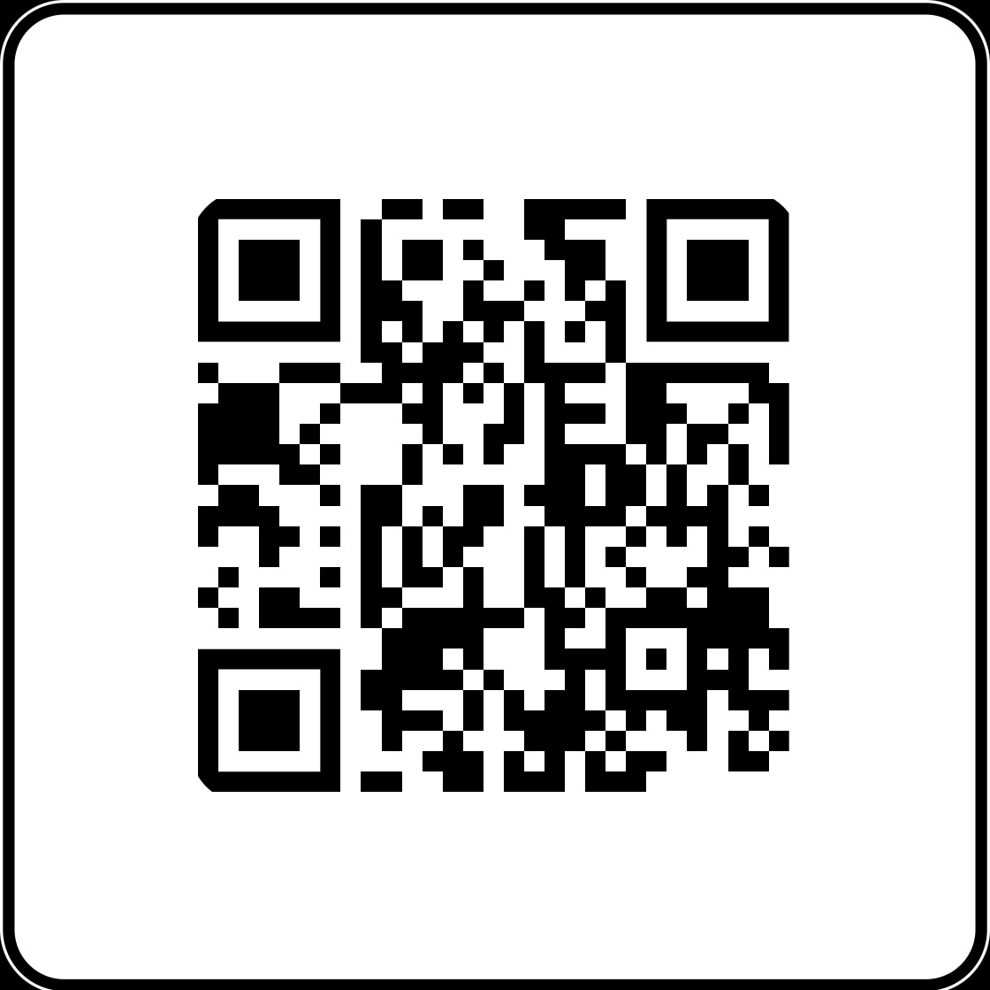
CONTACT US!
For questions about this study:
rogers.tumusiime@savethechildren.org
juysal@health.ucsd.edu
Read our publication!
Uysal J, Chitle P, Akinola M, Kennedy C, Tumusiime R, McCarthy P, Gautsch L, Lundgren R. Lessons Learned from a Mixed-Method Pilot of a Norms-Shifting Social Media Intervention to Reduce Teacher-Perpetrated School-Related Gender-Based Violence in Uganda. Adolescents. 2023; 3(2):199-211. https://doi.org/10.3390/adolescents3020015

Slide 85
WOUGNET
Amplifying Voices: The Extent of Online Gender Based Violence in Uganda
15 June 2023
Fair Way Hotel
Connect via Zoom

Slide 86
The extent of Online Gender Based Violence (OGBV) in Uganda.

Slide 87
OUTLINE
-About WOUGNET
-The extent and trends of OGBV in Uganda
Definition
Forms, Types and spread of OGBV
-Key findings / Gaps
-Relevant social media policies
-Online Platforms
-Legal and Policy Frameworks
-Strategies for Prevention and Response
-Recommendations
-Conclusion

Slide 88
About WOUGNET
Women of Uganda Network is a non-governmental organization initiated in May 2000 by several women’s organizations in Uganda to develop the use of information and communication technologies (ICTs) among women as tools to share information and address issues collectively.
WOUGNET envisions an inclusive and just society where women and girls are enabled to use ICTs for sustainable development.
WOUGNET’s membership is a loose coalition that is open to all like-minded women’s rights organizations and individuals in Uganda with over 100 member organizations that are strategically operating nationwide.

Slide 89
The Extent of OGBV in Uganda
What is OGBV?
Online Gender-based violence (OGBV) refers to acts of violence that are committed, abetted, or aggravated in part or fully by the use of information and communication technologies (ICTs) such as mobile phones, the internet, and social media platforms.
From the research, WOUGNET conducted: it states that 53% of the respondents defined online gender-based violence correctly as the violence committed either against women or men online and the majority of those who knew were from Kampala

Slide 90
The extent of OGBV cont.…
A survey by Plan International of over 14,000 young women and girls found that 58% of respondents have experienced online harassment including abusive language and cyberbullying.
In Uganda, 1 in 3 women online has experienced some kind of gender–based violence online,
and yet the majority are unaware of any policies or laws they can turn to for protection.
In 2020 during the COVID-19 outbreak, WOUGNET conducted a survey to find out the extent of Tech Assisted Violence Against Women and girls. The data collected clearly indicates that in the months of (March, April, and May) 2020, 50% of women had either faced Tech Assisted Violence, heard from a friend, or social media including Radio and TV while others were not even sure.
The trend is escalating and it is important to improve the status of women’s rights online
Gender-Based Violence has gone online in Africa -Report

Slide 91
Cont…..
The leading factors for the spread of online gender-based violence in Uganda included exposure of personal information, male dominance of the online space (15%), and jealousy from the intimate partner in case of any misunderstanding.
The root causes of this violence across the districts of the study included; revenge from jilted lovers, misogyny in physical spaces, surveillance, and monitoring, being a woman in public life, and being visible online.
https://wougnet.org/website/publications/publicationsingle/41

Slide 92
Types of OGBV
NB: Forms of OGBV include; Psychological/emotional, social economic and sexual violence
Online Sexual Harassment | Cyber Stalking | NCII (Revenge Pornography) | Trolling | Cyber bullying
A harasser shares abusive, messages, pictures or videos | Repeated surveillance by an Individual with the intention to cause harm e.g Hon Sylvia Rwabogo | Distribution of intimate images without a person’s content. e.g Desire Luzinda Anita Fabiola | Posting messages, images, videos to annoy or provoke someone. These are usually anonymous accounts | use of electronic communication to bully a person, typically by sending messages of an intimidating or threatening nature. e.g body shaming

Slide 93
Impacts of Online Gender-based Violence
Emotional and Psychological Consequences:
Victims may experience feelings of fear, anxiety, depression, and low self-esteem. The constant harassment, threats, and online abuse can lead to long-term trauma and mental health issues.
While OGBV primarily occurs in the digital realm, it can have physical health implications from stress and anxiety. This manifests in physical symptoms such as headaches, sleep disturbances, and others.
Physical Health Consequences:
Social Isolation and Stigmatization:
Survivors of OGBV may withdraw from online platforms and social interactions due to fear of further abuse or public humiliation. This isolation can lead to feelings of loneliness, social exclusion, and a reduced sense of belonging. Severely survivors may face stigmatization and victim-blaming from others, which can exacerbate their emotional distress.
OGBV can compromise an individual's privacy and personal safety. Non-consensual sharing of intimate images or personal information can lead to humiliation, harassment, and threats. Victims may fear for their physical safety, as online perpetrators may escalate their actions to offline harassment or stalking.
Privacy and Safety Concerns:
Digital Exclusion and Online
Silencing
OGBV can contribute to digital exclusion, particularly for marginalized groups. When individuals experience OGBV, they may self-censor or limit their online presence to protect themselves. This silencing effects can hinder their ability to express themselves, participate in online discussions, or access information and opportunities available online.

Slide 94
Online Platforms

Slide 95
Social media Platforms
Social Media Platforms
Facebook
Twitter
Instagram
Messaging Apps:
WhatsApp
Telegram
Online Forums and Discussion Boards:
Such as Reddit, or specialized platform focused on specific topics, can be spaces where OGBV occurs. These platforms
allow for anonymity, which can embolden perpetrators to engage in abusive behavior.
Dating Apps:
Dating apps and online platforms designed for meeting new people can sometimes be misused for OGBV. It is important to note that consensual and respectful interactions are the norm on these platforms, but instances of harassment or abuse can still occur.

Slide 96
Relevant Social media Policies
Facebook launched a victim support hub called Not Without My Consent, with the aim to assist people report intimate images shared without permission on Facebook, Instagram or Facebook messenger.
Twitter has a Hateful Conduct Policy which recognizes free expression as a human right and acknowledges that some groups of people are disproportionately targeted with abuse online including women. This policy provides guidelines on the type of behavior not allowed on Twitter and encourages the reporting of hateful content.
Social communication platforms also provide privacy settings that we need to be vigilant about and interest ourselves in learning.

Slide 97
Legal and Policy Frameworks

Slide 98
Laws and Policy Frameworks
Existing laws, policies, and regulations that address various aspects of gender-based violence, including offline and online gender-based violence (OGBV).
The Computer (Amendment) Misuse Act, 2022:
Section 24: Addresses cyber harassment and makes it an offense to use a computer system to disturb or
threaten another person.
Section 25: Criminalizes the distribution of intimate images without consent, often referred to as "revenge porn."
The Anti-Pornography Act, 2014:
This law focuses on regulating and combating pornography, including explicit content shared online. However, it has been criticized for its broad and ambiguous definitions, leading to concerns regarding freedom of expression.
The Data Protection and Privacy Act, 2019:
This legislation aims to protect individuals' personal data and privacy rights. It imposes obligations on organizations and individuals regarding data collection, storage, and sharing. It can be applied to cases involving the unauthorized sharing of personal information in OGBV incidents.

Slide 99
Cont…
The Penal Code Act (Cap. 120):
Section 13: Prohibits the publication or distribution of obscene materials, including explicit content, with the intent to corrupt public morals.
Section 141: Criminalizes the intentional and unlawful publication of defamatory matter, which includes
false and damaging information about an individual.
National Policy on Elimination of Gender-Based Violence, 2016:
This policy provides a framework for addressing gender-based violence in Uganda, including online violence. It emphasizes prevention, protection, prosecution, and provision of comprehensive services for survivors
Cyber Laws and Regulations:
The Uganda Communications Act, 2013, and its subsequent regulations empower the Uganda Communications Commission (UCC) to regulate communications services and address issues related to cybercrime, including online harassment and abuse

Slide 100
Recommendations
Government and relevant MDAs should strengthen the implementation and monitoring of existing international and national laws governing access to and use of ICTs to ensure the laws are inclusive and up to date with the changing and current trends in technologies
Social media companies should develop effective strategies to prevent and report OGBV
incidences in a timely manner to avoid negative consequences.
The media should be careful and gender-sensitive in reporting cases of OGBV to avoid inflicting further harm on the victims.
The communities should be sensitized about the negative effects of OGBV so that they consciously stop harassing women online.
Civil Society Organizations like WOUGNET should continue to advocate for the government to
formulate gender-specific laws and policies that enhance the efforts that tackle OGBV.

Slide 101
Strategies for Prevention and Response:
Research: Reports produced and disseminated
-Digital Security trainings conducted using ToTs
-Produced Policy briefs, manuals, and blogs on OGBV
-Advocacy and campaigns using Social Media, Radio, Television, Print media, and workshops
-Adopted Toll-free Number to report Online Harassment: 0800200510

Slide 102
Conclusion
It is important to note that while the laws and policies exist, their effectiveness and enforcement vary. Challenges may include limited awareness, gaps in implementation, and the need for further development to address the evolving nature of OGBV.
Efforts by all stakeholders in Uganda should contribute to addressing OGBV through awareness campaigns, capacity building, and supporting survivors. Furthermore, collaborative efforts between government agencies, law enforcement, and stakeholders are crucial to ensure comprehensive protection and response to OGBV incidents.

Slide 103
THANK YOU
Esther Nyapendi
Technical Support Officer Email: enyapendi@wougnet.org
Twitter: @NyapendiEsther
www.wougnet.org

Slide 104
Feven Dejene Dr. Mirgissa Kaba Dr. Maereg Wagnew Dr. Ann Nolan Dr. Kristien Hadefiled Dr. Mulugeta Tamire
15 June 2023
Fair Way Hotel
Connect via Zoom

Slide 105
Exploring social norms affecting adolescents’ SRH intervention and girls’ decision making
By: Feven Dejene
Dr, Mirgissa Kaba
Dr, Maereg Wagnew
Dr, Ann Nolan
Dr, Kristien Hadefiled
Dr, Mulugeta Tamire
Kampala, Uganda
June 15,2023

Slide 106
Outline
Background
Objective
Method
Finding
Discussion

Slide 107
Background
Over the last few decades, Ethiopia has made significant progress in improving Adolescents’ SRH problems, where
proportion of FGM/C has sharply decreased by 24 percentage points (from 71 to 47%) and early marriage has declined by 31.4 percentage point in Amhara region between 2000 and 2016 while prevalence of child marriage is still quite high at 40.3% in 2016 (Ethiopia demographic and health survey 2016).
Improving Service delivery (Youth friendly services )
But still low SRH service utilization specially within unmarried adolescents because of different level of barriers (Wakjira DB and Habedi D, 2022).

Slide 108
Cont.…
Yet, adolescents’ SRH problems remain a public problem including child marriage, teenage pregnancy, unplanned pregnancy, HIV and STIs, and unmet needs for family planning and contraceptive, risky sexual practice, among others, are major concerns (Admassu, TW., Wolde, YT & Kaba, M, 2022)
Under the influence of the challenges of gender inequality such as child marriage, female circumcision, unintended pregnancy, abortion sexual violence and less decision making power girls are more vulnerable to social harms than boys (ILO & UNICEF, 2018).
As different literatures justified rural areas have less contraceptive use and SRH problems are prevailed than urban areas because of different reasons.

Slide 109
Objective
Explore social norms that affect SRH intervention
Explore social norms that affect girls’ decision making on SRH service use.
Identify entry point for adolescent girls’ engagement in SRH decision making

Slide 110
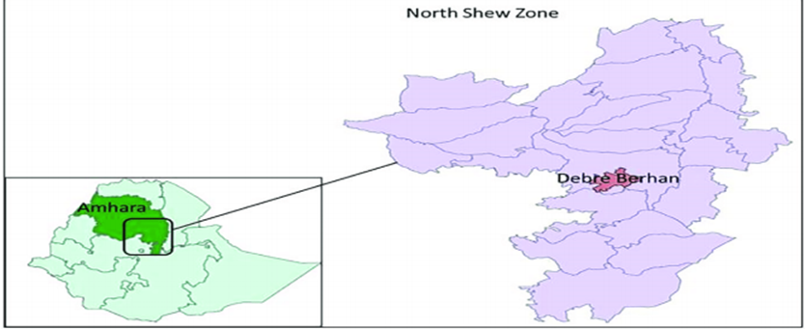
Method
Study setting
Urban (Shewarobit town), rural (Yelen kebele) and pastoral features Abiy Atir kebele.
The major ethnic groups of the North Shoa zone people are Amhara with predominantly Orthodox-Christian by religion followed by Muslim.
Kewote
Shewarobit city
Site | Kewet woreda | Shewarobit
Population size | 93,329 | 62,352
Population (10-14) | 14,192 | 8,119
Population (15-19) | 10,070 | 7,977

Slide 111
Cont.….
Study design
Qualitative participatory action research
Methods of data collection
Data was collected after informed consent using semi-structured, open-ended guiding questions.
9 session of FGDs with adolescents that were selected following rigorous process
(10-14 and 15-19) age groups
SRH club member and none
In school and out of school
21 KIIs (parents, community leaders, religious leaders, health providers, teachers)
Purposive sampling ( using maximum variation)

Slide 112
Cont.….
Method of data analysis
Recorded audio was transcribed verbatim in Amharic and then translated to English.
Transferred to Atlas ti version 9 software and coded
Based on the objectives and data patterns, a code book was developed.
Thematically analyzed

Slide 113
Finding I - social norms that affect SRH intervention
SRH problem | Norm about child marriage | Norms influencing child marriage | Believes influencing norms
Child marriage | A girl should marry young (injunctive norm) Girls get married before the age of 18 (descriptive norm) | Girls should be virgin before marriage A girl should obey her parents over timing/ choice of marriage partner Most adolescent girls are sensitive for sanction A responsible parent should ensure their daughter's virginity and therefore marry her off at an early age. | Beliefs about the importance of female sexual purity Beliefs about marriage as key route to social and economic protection Beliefs that parents and elders have prime authority over children’s life

Slide 114
Cont.…
“Parents are concerned that their daughters will become pregnant without their knowledge, marry, and join families with which they do not know or don't want to associate.” Mother p130, Abayatir
“Families believe that if girls do not marry young, they will lose their virginity, hence they urge their children to marry young to preserve their honor.” Female p45, Yelen

Slide 115
Cont.…
SRH problem | Norm about female genital cutting | Norms influencing female genital cutting | Believes influencing norms
Female genital cutting | A girl should be circumcise (injunctive norm) Girls are circumcise in secret (descriptive norm) | Girls should be virgin before marriage Girls should be obedient for her parents/ husband A responsible parents should ensure their daughter purity | Beliefs about the importance of female sexual purity Beliefs that parents have prime authority in their daughter controlling her sexuality to promote premarital virginity and marital fidelity

Slide 116
Cont.…
"The society mutilates the female because they believe that if she is not mutilated, she will have high sexual desire, but if she is mutilated, she will not engage in those sexual activities at an early age, allowing her to retain her virginity." FGD female p67 yelen
“My mother used to tell me that if I had done circumcision like them, I would have followed all of my mother's instructions at home.” FGD female p90 shewarobit

Slide 117
Finding II - social norms that affect girls’ decision making on SRH service use
Norm about girls’ SRH service use | Norms influencing girls’ decision making on SRH service use | Believes influencing norms
Unmarried girls should not use contraceptive (injunctive norm) Most unmarried girls get afraid to use contraceptive Most married girls use contraceptive (descriptive norms) | Sexual activity before marriage is inappropriate Speaking about sexuality is taboo Girls should give birth immediately after getting married Most girls are sensitive for sanction | Beliefs about the importance of sexual purity (virginity before marriage) Beliefs about speaking sexuality promote adolescents to be engaged in sexual activities Beliefs about the importance of fertility

Slide 118
Cont.….
“In society, it is considered impolite for a girl to take contraception before marriage, therefore she will be ashamed. If she is seen coming to the health center for contraception, it will be assumed that she is looking for sex.” community leader, Abay Atir
“First of all, if unmarried adolescents go for an injection, they need to convince health providers that they are older than 18 or get married; otherwise, they will not get the services. Girls under the age of 18 only use post pills or condoms.” FGD female p 96, shewarobit
“If I tell my mother that I am discussing sexuality in this much detail, she may even prohibit me from going there because it is not our norm.” FGD female p 92, shewarobit

Slide 119
Finding III - Entry point for adolescent girls’ engagement in SRH decision making
Adolescents have an interest in and know the importance of engaging in their SRH decision-making process.
Regardless of age, different NGOs’ attempts and lack of understanding of how to engage adolescents social norms play a major role in hindering adolescents engagement in SRH decision-making.
Under the influence of gender inequality (gender norms), girls have less power over decision-making in their SRH.

Slide 120
Cont.…
Who are the more influential groups for those norms?
religious leaders – community opinion leaders – family - peers
Who prevents adolescent girls’ from engaging in SRH decision-making?

Slide 121
Discussion
The result shows child marriage, female genital cutting, and low SRH service use are still continuing as adolescents’ SRH problems due to persistent social norms.
Girls and parents conformity to empirical and normative expectations was held in place by anticipated sanctions and high sensitivity to the sanction.
Lack of discussion with the family influences the adolescent's ability to gather information and engage in decision-making on their SRH.

Slide 122
Cont.…
Triangulated data reveals that social norms operate at different level
Adolescents are under pressure not to be engaged on their SRH decision making process
They are afraid to refuse their parents will ( fear of being cursed)
They have fear to use contraceptive before marriage (because using contraceptives before marriage is a sign of indecency, and they will be humiliated as a result.)
Because of these social norms adolescents forced to travel far for SRH services.

Slide 123
Cont.…
Community level
Parents beliefs that they know what is best for their children and do not let their daughter to discuss and decide on their SRH
To ensure virginity there is parental control and no speaking about sexuality which hiders to access information and engage on decision making.

Slide 124
Cont.…
Institutional level
Religious institutions strongly condemn engaging in sexual activity before marriage, and there is sanction (isolation) for those who deviate from this rule.
Health service providers are under pressure from social norms and are challenged to provide contraceptive services for unmarried adolescents, especially for early and mid-age adolescents.
Teachers are also under pressure (They don’t support comprehensive SRH education for early adolescents).

Slide 125
Cont.…
Policy
In the Ethiopian context, marriage before 18 years is legally prohibited (Emurugat CA, 2019).
Community leaders and Law enforcement agencies are under pressure of the social norm.
Different strategies and measures are employed to skip law enforcement that are implementing following child marriage and female genital cutting.

Slide 126
Comparison
Child marriage and FGM are less prevalent in urban areas than rural areas, which have better SRH service access, but still, girls in urban areas prefer to use private health facilities for contraceptive use.
Boys have better freedom to access SRH services and make decisions.

Slide 127
Conclusion
Social norms still anchoring SRH interventions from bringing the desired change and gender norms affecting girls from accessing SRH services and engage in decisions making.
Religious leaders, community leaders, and families play the most important roles; so, the intervention should focus on these groups as well and also use them as an entry point for engaging girls in decision-making.

Slide 128
Acknowledgment
I would like to extend my deepest appreciation to Irish Research Council for financing the project
I would also like to thank
My supervisors, Dr. Mirgissa, Dr. Maereg, Dr. Mulugeta, and Kalkidan,
My fellows Meron, Yewudar, and Birkutawit (data collectors)
Study participants

Slide 129
Reference
Central Statistical Agency/CSA/Ethiopia and ICF. Ethiopia demographic and health survey 2016. Addis Ababa: Central Statistical Agency and ICF International, USA; 2016.
Wakjira DB, Habedi D. Barriers to access and utilisation of sexual and reproductive health services among adolescents in Ethiopia: a sequential mixed-methods study. BMJ Open. 2022 Nov 16;12(11):e063294. doi: 10.1136/bmjopen-2022-063294. PMID: 36385042; PMCID: PMC9670917.
Admassu, T.W., Wolde, Y.T. & Kaba, M. Ethiopia has a long way to go meeting adolescent and youth sexual reproductive health needs. Reprod Health 19 (Suppl 1), 130 (2022). https://doi.org/10.1186/s12978-022-01445-3
International Labour Organisation (ILO) United Nations Children's Fund (UNICEF). GirlForce: skills, education and training for girls now. 2018. Available from: https://www.unicef.org/sites/default/files/2018 -10/Unicef_DayoftheGirl_Brochure_R7.pdf
Emurugat CA. Investigating the legal and policy framework on child marriage in Niger: a comparative study of Kenya and Ethiopia. Central european University. 2019.

Slide 130
Health Break We Return at 2:30pm
15 June 2023
Fair Way Hotel
Connect via Zoom

Slide 131
WILD CARD
15 June 2023
Fair Way Hotel
Connect via Zoom

Slide 132
Ogara Collin
Commonwealth Alumina Research Officer FAWE Uganda
15 June 2023
Fair Way Hotel
Connect via Zoom

Slide 133
Eastern Africa Social and Gender Norms Learning Collaborative Conference. Date: - 14th - 15th June 2023. Theme: “Digitization and Technology Impact on Gender and Social Norms”.

Slide 134
OGARA Collin Commonwealth Alumina Research Officer FAWE Uganda
THEME: Digitization and Technology Impact on Gender and Social Norms”.
Social and Gender Norms Learning Collaborative Conference

Slide 135
Title: Exploring Technology and Gender Responsive Pedagogy Intervention Models to Popularize Positive Social Norms, Improve Access, Retention and Completion of School for Adolescent Girls.
Ogara Collin, Adiama Joseph, Opok Susan
FAWE Uganda Chapter. P. O. Box 24117 Kampala Email: ogaracollin@gmail.com

Slide 136
Introduction and background
FAWE Uganda is implementing Community Action to prevent VAC in 3 districts: Kasese, Bundibugyo and Ntoroko
Generated evidence on how to address social norms that affect children’s access, retention and completion of schools using technology.
The intervention also leveraged on creation of safe environments in schools and surrounding communities (30 school Communities( now 60)
The study used the (GRP) model; teachers trained to be more gender aware, equipping them with the skills in gender sensitivity, understand and address specific learning needs of girls and boy using technology.

Slide 137
Problem statement
Child marriages and preference of boys over girls accessing education identified as key drivers to teenage pregnancies and school dropouts
A 22.3% teenage pregnancy rate resulting in school dropout among girls aged 14 to 18 years (source/date)
These hinder access, retention and completion of education for girls.
Negative social norms rooted in patriarchy, give priority to male children.
Statistical models predict a learning deficit of 2.8 years in Uganda between March and June 2020
Technology adoption as a means through which negative cultural norms can be shifted especially for girls
Lack of infrastructure and access to digital resources affects use of technology in social norms shifting.
Digital divide and its’ impact on marginalized communities. Especially for teachers (SW&M Teachers)
Only 56.3% of teachers have had adequate access to GRP training in Uganda
Inadequate availability of technology in schools, especially for GRP training for teachers.

Slide 138
Methodology Study Design
Experimental Setting: 30 Selected schools or communities representing diverse socio-economic backgrounds.
Duration: Study conducted over a 12 months’ period to evaluate long-term effects.
Sample Selection:
Target Schools: 30 schools - 11 secondary 19 primary schools.
The teachers 5 per school (150).
Control and Experimental Groups: Randomly assign schools to either the control or experimental group.
Control Group: Receives standard education without GRP-technology interventions.
Experimental Group: Received the GRP technology-based interventions for SW&M teachers).

Slide 139
Intervention
Teacher Training: Conduct workshops to enhance teachers' capacity to integrate technology effectively.
Create safer teaching and learning environments.
Use of language
School environment
Create awareness at community level & Promote social justice:
Using road drive technology.
Spot messages, TV & Radio shows
Use of social media
Promoting positive social norms for girls’ education.

Slide 140
Key results :
A shift in social norms, beliefs/attitudes and practices around violence against children in target schools and communities.
Different technologies used effectively changed the negative social norms like:
Early marriages(defilement), there is pride in producing many children and polygamy .
ALL the 30 intervention schools, the PTA’s, SMC acknowledged use of technology in supporting GRP training.
The different stakeholders had roles and responsibilities in creating a safe school environment.
There was a positive role of the community initiatives in addressing negative social norms affecting education for girls.
70% increase in number of girls accessing, retaining and completing school as a result of BCC using the different technology applications.

Slide 141
Lessons and implications
The Technological and GRP resulted into a shift in the social norms that affected VAWG
Supported the adoption of positive norms that encourage children’s access and retention in schools
Improved the legal and justice system associated with cultural barriers to VAC (negative social norms)
These models(Technology &GRP) demonstrate strength in addressing multidimensional aspects of VAC
The intervention showed the ability to create safe nurturing environments for children (retention and completion)

Slide 142
Conclusion
Need to broaden the scope for impact studies on the models(technology, GRP and social norms shifting)
FAWE Uganda needs to contextualize and harmonize norm shifting in a wider context using different technological approaches.

Slide 143
Dr. Tatu Nyange, Mwalimu Nyerere Memorial Academy, Tanzania
Commonwealth Alumina Research Officer FAWE Uganda
15 June 2023
Fair Way Hotel
Connect via Zoom

Slide 144
Gender Issues on Top Administrative Leadership Positions: Influencing Impediments in Zanzibar, Tanzania 15th JUNE, 2023
EASTERN AFRICA SOCIAL AND GENDER NORMS LEARNING COLLABORATIVE CONFERENCE
NAME OF PRESENTERS:
Dr. Tatu M. Nyange

Slide 145
Presentation Outline
Introduction
Study areas
Methodology
Key findings
Conclusions and Recommendations

Slide 146
Introduction
Women have been under-represented in top administrative leadership positions around the world.
Globally, several initiatives to promote women’s rights and empowerment have been implemented (e.g. UDHR (1945), CEDAW (1979) & Beijing platform for action (1995).
However, worldwide; only 21% of government ministers and 26% of national parliamentarians are women (Holoniq, 2023).

Slide 147
Introduction Cont…
Tanzania is currently led by female president (Dr. Samia S. Hassan) but the representation of women in top leadership positions in Tanzania and other African countries is still minimal.
The Gov. has ratified various conventions and declarations related to Gender Equality (GE) and Women Empowerment (WE) (e.g. CEDAW of 1979 and the BPA of 1995).

Slide 148
Introduction Cont…
Zanzibar is partner state of URT, to fulfill its commitment towards attaining GE and WE Since 1990s the Gov. has launched various initiatives & signed international declarations, conventions to put women in decision-making organs
Yet, representation of women in administrative, political decision-making bodies and other leadership positions in Zanzibar reported to be an issue of gender concern since post- revolution of 1964 (ROCS, 2019; Salim, 2020; HoRZ, 2020).
Notes:
International declarations, conventions, resolutions, and treaties have been ratified and accommodated in the country’s legal framework system Zanzibar Gender Policy, 2016 [33], and Gender and Social Inclusion Policy, 2015 Constitutional amendments. The Zanzibar Constitution has amended several time so as to create space for women to participate in politics and governance of the State.

Slide 149
Introduction Cont…
Majority of women in Zanzibar are found in informal sectors, engaging themselves in petty businesses, small farming, seaweed farming, pottery and handcrafting of which economic returns are low
While, Most men are reported to have engaged in Gov. top officials compared to women

Slide 150
Problem Statement
GI is still existing in Zanzibar particularly in top leadership positions (ROCS, 2019; Salim, 2020; HoRZ, 2020)
In 2019 among 16 Ministers only 5 were women; while only 1/3 of Gov. Agency Administrators were women (ROCS, 2019)
By 2020 in HoRZ. women occupied 36%; in Central Gov. women occupied 30% while in Regional and Local Gov. Administration women occupied 20%

Slide 151
Research Gap
Relevant studies have been conducted (e.g Salim, 2020) focused on women participation and representative in politics and governance in Zanzibar
While Maseko (2013) and Said (2016) examined challenges faced by women in leadership and public sector
Yet, little is known on gender issues and influencing impediments causing poor participation of women in administrative top leadership positions in Zanzibar

Slide 152
Justification of the Study
GE particularly in leadership positions is essential to the health of any nation as well as to social and economic development
The promotion of GE is one of the SDGs agenda; which underscores the importance of WE as essential to international development efforts
it is worth to consider participation of women in top leadership posts as the key steppingstone towards achieving SDGs by 2030

Slide 153
Theoretical Framework
This study was guided by Liberal Feminist Theory (Lorber, 1997)
The theory believed that gender differences are not biological based, men and women are not different, therefore they can not be differently treated (Greer & Greene 2003; Lorber, 1997)
Gender inequality originate from traditions and social norms that have created impediments to women progress
Notes:
LAS is a fundamental human rights that aim at improving womens access to justice, regardless of this attemt

Slide 154
Theoretical Framework Cont…
The theory asserted that Women should be empowered and encouraged to acquire skills and knowledge to foster transformation of power relation as advocated by empowerment theory
The empowerment theory advocates for transformation of society and organizations on women’s relative position to men
Feminist advocates that Women as leaders can be empowered via transformation approach through digital space
Notes:
LAS is a fundamental human rights that aim at improving womens access to justice, regardless of this attemt

Slide 155
Power of Digital Space Towards Gender Equality
Digital space provides an important means for women to access information, share views, visibility and networking.
Digital space can considerably reduce inequality since it help to generate and harness ideas which are crucial for enhancing women capacity and visibility.
Also young women and girls can be connected to various leadership opportunities within the country and at the international level.
Notes:
LAS is a fundamental human rights that aim at improving womens access to justice, regardless of this attemt

Slide 156
Study Objectives
Main Objective of the Study
The study mainly aims to examine the influencing impediments causing underrepresentation of women to acquire top leadership positions in Zanzibar, Tanzania
Specific objectives
To examine status of gender based representation in top leadership positions in Zanzibar, Tanzania.
ii) To analyze impediments factors influencing gender based representation in top leadership positions in Zanzibar, Tanzania

Slide 157
Individual Factors
Family status/Political Background
Marital Status, Ethnicity, Education and Age
Societal Factors
Stereotyping and Biasness
Cultural norms
Administrative factor
Appointment and Promotion Procedures
Search Committee and Mentorship
Gender Policy
Inspirations and Support
Gender Gap in top Administrative Leadership Positions
Figure 1: Conceptual Framework

Slide 158
Research Design & Sampling Procedures
Research design: Cross sectional
Sampling procedures, population & sample size
Purposive sampling – Zanzibar
Simple random sampling; A total of 80 respondents were selected
Sampling unit: Staff employees and retired officers (women and men) from selected Ministries; Government agencies and Leaders from political parties

Slide 159
Data Collection
Qantitative data
Structured questionnaire
Primary data
FGDs
Qalt. data
Interview guide
KIIs
Books, reports
Structured questionnaire
Secondary Data
Journals
Google search
Notes:
Content Analysis was used to reduce and categorize collected information into meaningful themes based on historical events and strong held opinions

Slide 160
Key Findings
Findings of this study have shown under representation in top administrative leadership positions in Zanzibar, currently in the Cabinet ratio is 5:13; RC 1:4; DC 4:7; DED 2:9; and DAS 2:11 for women and men respectively.

Slide 161
Table 1: The Status of Gender and Top Leadership in the HoRZ
Post | 2005-2010 |  | 2010 - 2015 |  |  | 2016 - 2020
 | Total Position | Female | Total Position |  | Female | Total Position | Female
Speaker | 1 | 0 | 1 |  | 0 | 1 | 0
Deputy Speaker | 1 | 0 | 1 |  | 0 | 1 | 1
House Chairman | 1 | 0 | 2 |  | 1 | 2 | 1
House Secretary | 1 | 0 | 1 |  | 0 | 1 | 1
Other Members | 76 | 19 | 77 |  | 26 | 83 | 30
Total | 81 | 19 | 83 |  | 27 | 89 | 33
Women % |  | 23.50% |  |  | 32.50% |  | 36%
Source: House of Representatives Zanzibar, 2020
Findings in Table 1 depict representation of women and men from 2005 to 2020. Somehow the results indicate good progress, though no woman has held position of a speaker which represent the highest leadership position in the HoRZ. This imply underrepresentation of women in the highest law making organ and budget approval body in Zanzibar

Slide 162
Status of Gender and Top Leadership in the HoRZ Cont..
Results in Table 1 aligned with KII highlighted that “According to the Zanzibar politics, I agree that there still a challenge for women to occupy top positions. It is clear that women are many compared to men but their representation in the HoRZ and other top leadership positions in Gov. are still low. I conquer that our communities still embrace cultural norms which victimize women to have equal opportunities…” (KII former Speaker – HoRZ, Unguja)
Women in FGDs suggested that: “ In this digital era women in top leadership positions who are considered to be role modals to many young leaders and women aspiring to be leaders should make use of digital spaces to mentor them in gaining new perspectives, fresh ideas and enhance their confidence…..” (Women FGDs- Chakechake)

Slide 163
Table 2: The Status of Gender and Top Leadership in Adm. Post
Administrative Post |  | 2005-2010 |  |  |  | 2010 - 2015 |  |  |  | 2016 - 2020
 |  | Total Position |  | Female | % of Women | Total Position |  | Female | % of Women | Total Position |  | Female | % of Women
Regional Commissioner |  | 5 |  | 0 | 0 | 5 |  | 1 | 20 | 5 |  | 0 | 0
District Commissioner |  | 10 |  | 2 | 20 | 10 |  | 2 | 20 | 11 |  | 2 | 18%
M. Mayor |  |  | 3 | 0 | 0 | 3 |  | 0 | 0 |  | 3 | 0 | 0
D. C. Chairman |  | 9 |  | 0 | 0 | 9 |  | 0 | 0 | 5 |  | 0 | 0
T. C. Chairman |  | 3 |  | 0 | 0 | 3 |  | 0 | 0 | 3 |  | 1 | 33%
Other Councilors |  | 168 |  | 53 | 31,5 | 168 |  | 53 | 31.5 | 153 |  | 59 | 38.70%
Sheha |  | 303 |  | 14 | 4.6 | 332 |  | 14 | 4.2 | 388 |  | 51 | 13%
Grand Total |  | 501 |  | 49 | 13.5% | 530 |  | 70 | 13.2% | 569 |  | 113 | 20%
Source: Ministry of State President Office, Regional Administration, Local Government and Special Depertment (2020)
Findings in Table 2 indicate highly male dominance representation in most of top leadership administrative positions from 2005 to 2020. The results aligned with KIIs ”there is no fairness in appointing top administrative leaders, mostly men are given more priority than women. For attaining GE in top leadership positions, mechanisms used for appointment should be transformed...”(KII-Administration officer, Second Vice President Office Unguja)

Slide 164
Table 3: Status of Top Leadership Positions at Regional
Administrative and Local Government in Zanzibar in 2022
REGION (RC) | DISTRICT (DC) | DED | DAS
Mjini Magharibi (M) | Mjini (M) | (M) | (M)
 | Magharibi A (F) | (M) | (M)
 | Magharibi B (F) | (F) | (M)
Kusini Unguja (M) | Kati (F) | (M) | (M)
 | Kusini (M) | (M) | (M)
Kasikazini Unguja (M) | Kaskazini A (M) | (M) | (M)
 | Kaskazini B (M) | (M) | (M)
 | W/ndogo Tumbatu |  | (M)
Kusini Pemba (M) | Chakechake (M) | (M) | (M)
 | Mkoani (M) | (M) | (F)
 | Wete (M) | (F) | (F)
Kaskazin Pemba (F) | Micheweni (F) | (M) | (M)
 | W/ndogo Kojani |  | (M)
Source: Second Vice President Office Zanzibar 2022
Note: M = Male, F= Female;
RC = Regional Commissioner; DC =District Commissioner;
DED = District Executive Director; DAS= District Administrative Secretary

Slide 165
Key Findings Cont…
Table 4: Impediments factors Influencing Gender Representation in Top Leadership Position (n = 80)
Impediments | N | % Cases
Education Level | 68 | 85
Lack of financial support | 60 | 75
Political Background | 57 | 71.25
Cultural norms | 55 | 68.75
Gender stereotyping | 52 | 65
Existence of Patriarchal System | 46 | 57.5
Lack of Confidence | 45 | 56.25
Male chauvinism | 44 | 55
Lack of mentorship | 42 | 52.5
Corruption e.g sexual corruption | 40 | 50
Inferiority Complex | 30 | 37.5
Ethnicity | 30 | 37.5
Biasness in appointment and search committee | 12 | 15
Religion | 10 | 12.5
Note: Figures in (%) represent multiple responses;

Slide 166
Impediments factors Influencing Gender Based Representation in Top Leadership Positions
Likewise FGDs and KIIs highlighted that:
“Barriers causing poor representation of women in top leadership administrative positions in Zanzibar is mostly contributed by: inferiority complex, existing of stereotypes, corruption, education level, political background, patriarchal system and performance in our communities…” (FGDs and KIIs from Pemba and Unguja)

Slide 167
Conclusion and Recommendation
Conclusion
Gender inequality exists in occupying leadership positions in both Unguja and Pemba islands. Mostly men are reported to occupy top gov. leadership and political positions compared to women.
Education level, Cultural norms, lack of financial power, male chauvinism, and political background are among the most impediments factors influencing women occupying top leadership position in Zanzibar. The liberal feminist theory proposes that Gender inequality originate from traditions that have created impediments to women progress.Transformational approach through the use of digital spaces was suggested to be used as a means of empowering future women leaders.
.

Slide 168
Recommendation
Based on the findings, the study recommends that persistent initiatives to address impediments factors and promote GE are critical for achieving gender fairness in top leadership.
Role modals should make use of digital spaces to mentor young leaders and women aspiring to be leaders.

Slide 170
Questions & Answers
15 June 2023
Fair Way Hotel
Connect via Zoom

Slide 171
Dr. Venance E. Kalumanga
15 June 2023
Fair Way Hotel
Connect via Zoom

Slide 172
EASTERN AFRICA LEARNING COLLABORATIVE (EALC) CONFERENCE AT FAIRWAY HOTEL, KAMPALA UGANDA
14th – 15th June, 2023
Paradigm Shift of Gender Norms from Communal Society to the Contemporary Digital World in Tanzania: Using a Food Security Lens
Dr. Venance E. Kalumanga (Ph.D.)
The Mwalimu Nyerere Memorial Academy- Tanzania

Slide 173
Introduction
Globally, there are fundamental changes on how people access and utilize food based on gender in most parts of the developing countries including Tanzania.
These changes occur because gender norms have been changing over time across societies and culture.

Slide 174
Introduction Cont…
Gender norms are; unwritten rules governing power on decision making, opportunities, access, ownership and control of resources that exist between the societies (Kalumanga et al., 2020; Bicchieri, 2006).
Gender norms also impede food production (Ragin, 2008).

Slide 175
Paper Objectives
The aim of this paper is to analyze the Paradigm Shift of Gender Norms from Communal Society to the Contemporary Digital World in Tanzania using a food Security lens.
The study analyzed the paradigm shift basing on four eras:
Before colonialism
During colonialism
After colonialism
Contemporary digital world

Slide 176
Problem Under Study
To date, little is known on how digitalization and technology in developing countries including Tanzania might have shifted gender norms across societies and culture. To what extent has gender norms shifted? What are reasons for shifting of gender norms? What are the consequences in societies where shifts are happening?
The study analyzed all these questions based on food security in Tanzania

Slide 177
Methodology
Study Area
Research Approach
The study was conducted in Tanzania because of many ethnic groups existing in the county and changes have been seen fueled by digitalization and technology
Qualitative approach was adopted because of its emphasis in studying the in-depth and subjective experience of the participants
How data were Collected.
Research Design
Data Generation Methods
A comparative design was used to compare the shifting of the gender norms from the communal era to the digital world of the contemporary
Documentary reviews, interviews and Focus group discussion

Slide 178
Theory guiding the study
Steward, J.H. (1955) Multi-Liner Theory of Culture Change
This theory was developed because of some weakness in Uni-linear model of social change: The Theory acknowledges that change are diversified in nature and it also recognize the role of technology towards changes
25%
75%

Slide 179
Organizations Working to support Gender via Digital systems in Tanzania.
TGNP
TAMWA
CARE International
FSDT
DARE WOMEN FOUNDATION
MWENDO
UN-Women
Etc

Slide 180
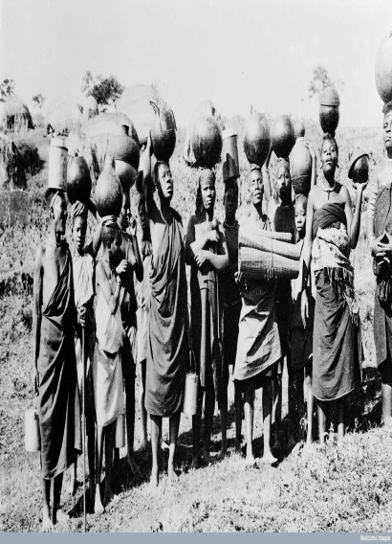
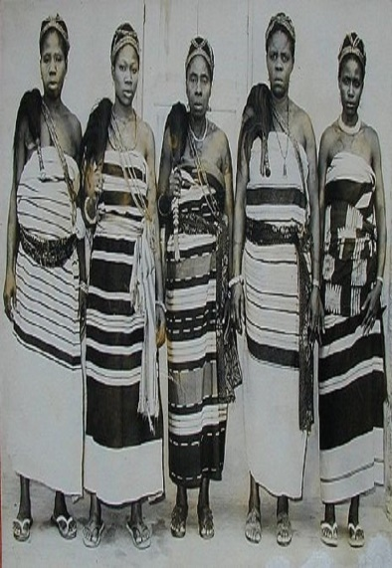
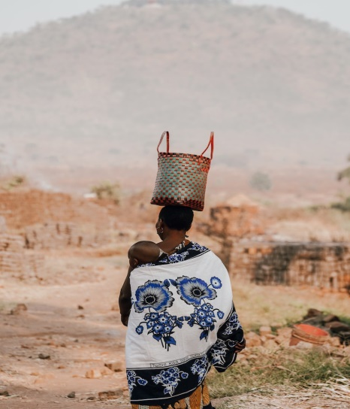
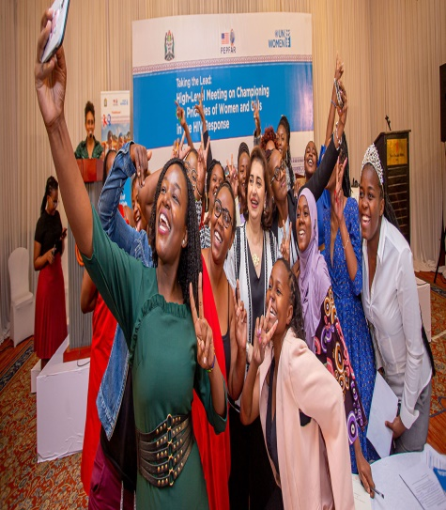
Findings…. Gender Norms Shifting to Digital Eras
Before colonialism
Below 1880
During colonialism
1880-1960
After Colonialism
1961-1990
In the Contemporary period
1991 to date

Slide 181
Before Colonialism
Societies were very communal. People lived together and maintained their traditional values and cultures
Very local technologies were used
Endogamy system (High polygamy systems,
Wild and Natural food
Decision making and power was under cultural orientations where men had more power

Slide 182
During Colonialisms
The food type in this time is a blend of Portuguese, Arabic, Germany, British and others including India, Turkish, Persian etc.
Trade roots & Mixed food
Language changes
Tribe movement and change
Cash crops
Industries started and mainly for processing food

Slide 183
After Colonialism
Intermarriage
Industries
Communication
Kiswahili Language was highly emphasized
Union among culture
Internal migration

Slide 184
In the Contemporary Period
Women are empowered through different development angles eg. Entrepreneurship and petty trading (Beijing Conference 1995)
There is new social systems, apps, soft wares, applications eg (Facebook, What Sapp, Instagram
M-Pesa, Tgo- Pesa, Hallo-Pesa, Z-Pesa etc.
Different techniques, methods on how to cook
Food preferences, varieties, choices,
Genetic Modified Food (GMO)
Technology makes to have gender shared roles eg cooking because nowadays cooking is becoming luxury- You tube can guide cooking

Slide 185
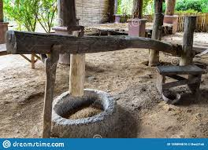
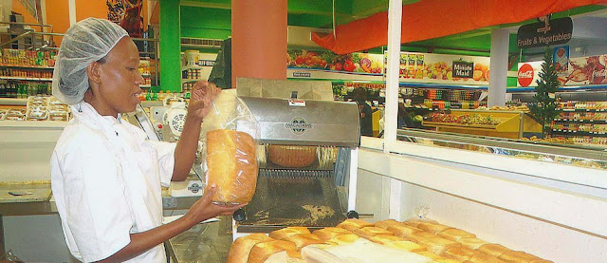
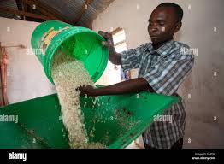
Food Processing Technology shifting/Norms
History matters in explaining the differences in gender norms observed today under the existing technology

Slide 186
Technology and Production

Slide 187
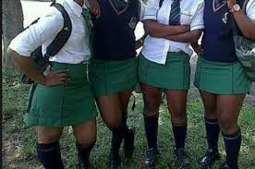
QUESTION:As we enjoy digital life, are we prepared to cope with every situation? (positive/negative)

Slide 188
Role of Digitalization and Technology in Agriculture
Weather Forecast
Trade route and market
Financial services to support production
Information on agriculture inputs

Slide 189
Effects of the GN Shifting from CL to DW in Social Context
Massive Cohabitation (45% of marriage)
Massive Divorce (30%)
Exogamy
Patriarchy &Matriarchy societies….How do they move towards shifting
Increase of Single parent families
Increase of parent without children
Increase of Lesbians and Gay relationship
(Do we need to fight for the changes?)

Slide 190
As we try to discuss the shift towards digitalization and technology advancement in relation to digital gender divide
What exactly we need to inform our societies /research with regards to gender norms?
Which gender norms (elements ) should be looked up at separate angle?
We are still documenting all norms which have shifted evidently in both patriarch and matrilinear
.

Slide 191
THANKS

Slide 192
DR. EDNA HARRIETH MTOI
15 June 2023
Fair Way Hotel
Connect via Zoom

Slide 193
EASTERN AFRICA LEARNING COLLABORATIVE (EALC) CONFERENCE, KAMPALA, UGANDA
14TH AND 15TH JUNE, 2023
WOMEN EMPOWERMENT AND MATERNAL HEALTH SEEKING BEHAVIOUR: A CASE OF BAGAMOYO DISTRICT, TANZANIA
DR. EDNA HARRIETH MTOI
DEPARTMENT OF GENDER STUDIES
MWALIMU NYERERE MEMORIAL ACADEMY

Slide 194
Background Information
Since 1990, the world has seen a decline in the maternal death ratio, which signifies an enormous achievement in the general population’s health.
In spite of these achievements, some 830 women still die from causes related to pregnancy or childbirth.
In Tanzania's mortality rate is still one of the highest in the world, with most deaths occurring during labor (World Bank, 2020).

Slide 195
Literature Review
Empowering women is an important subject in today’s world.
Studies have reported that increased women's empowerment is likely to increase their ability to seek and use medical services, thus meeting their own reproductive health goals. Examples:
Bangladesh: low fertility desire was observed among women with higher autonomy.
In Malaysia, the Philippines, and Thailand, women's reproductive health seeking behavior was associated with freedom of movement and decision-making power.
In Tanzania, the situation of women's empowerment and maternal health seeking behavior is not well established.

Slide 196
The Role of Social and Gender Norms
Underlying factors in determining whether women can seek SRH service – types and how.
Influential and unspoken barriers to SRH seeking behaviors. Examples:
Norms that emphasize women’s submissiveness, which limit women decision making, shape fertility choices and influence access to SRH services.

Slide 197
Study Methods
Study Areas: Bagamoyo District in Coastal Region
Research design: cross-sectional and descriptive – allowed more then one method to be used, therefore both qualitative and quantitative data were collected
Sample size: 250 respondents
Sampling unit: women of reproductive age between 15 – 49 years.
Research instruments: Household questionnaires and interviews for KIIs.

Slide 198
Data Analysis
Objectives | Data Analysis Techniques
1. To establish the status of women empowerment in Bagamoyo District, Tanzania. | (PAI), where 7 variables related women’s decision making were used. Was computed in 1/7 variables (0=husband, jointly=0.072, respondent=0.143.
 | (DMI), 1/8 variables (0=husband, 0.062=jointly, 0.125 jointly.
 | (FVI), 1/6 variables in dummy 0=not experience violence, 0.166 experience violence
 | (FMI), 1/5 variables (0=never, 0.1=accompanied, 0.2= always alone.
 | CEI=1/4 indices (PAI+DMI+FVI+FMI)
 | Final cut-off empowerment was classified into four levels ranging from value of 0 to 1 (UNDP, 2014).
 | Value 0 – 0.549 =low, 0.550 – 0.699=medium, 0.7 – 0.799 =high and 0.8 – 1= very high empowerment.

Slide 199
Objective | Data Analysis Techniques
2. Examine the influence of Women Empowerment on maternal health seeking behavior. | OLR was performed to determine the influence of women empowerment on access to health.
 | OLR was used because the dependent variable had three ordered categories of empowerment (low, medium and high).
 | P(Y) = e^{α+β1X1+…………+βkXk} 1⁺e^{α+β}₁^{X}₁^{+……..+βkXk} (Agrest and Finlay, 2009; Nyange et al., 2016).
 | P(Y)=Outcome variable (Levels of empowerment), e= natural log, α = interpretation of equation, β_{1 to} β_{k =} coefficient of predictor variables, X₁ to X_{k} = independent variables entered in regression model.
 | Analysis of results focused on the interpretation of p_value for testing the significance of relationship, β coefficients for measuring the direction of relationship from higher to low category, and wald statistics for measuring the strength of the influence (Pallant, 2007).

Slide 200
Statuses of Women Empowerment
Table 2: Reliability statistics of decision-making construct
The overall decision-making index is 0.66, which is a medium level of empowerment.
The parameter that was performing poorly was household decision-making on various matters (0.590); they prefer making decisions with their spouses.
The final CEI indicated that women in Bagamoyo district (61.6%) were classified as having a medium level of empowerment.
Study Indicator | No. of Statements | Cronbach alpha value
Personal Autonomy on Health issues | 7 | 0.851
Household Decision Making | 8 | 0.706
Freedom From Violence | 6 | 0.627
Freedom of Movement | 5 | 0.783

Slide 201
Table 3: Health care seeking behaviour among women (n = 250)
Variable | No. of participants answered Yes | Percent
Did you attend ANC clinic during your last pregnancy | 220 | 88.8
Preferred Health Facility for child delivery | 197 | 78.8
Preferred home delivery assistance | 53 | 21.2
Preferred Health professional for child delivery assistance | 171 | 68.1
Preferred Traditional Birth Attendance for child delivery assistance | 79 | 31.5
Do you make your own decision regarding use of family planning. | 118 | 47
Do you make your own decision of getting pregnant. | 106 | 42.4
Do you make your own decision for seeking medical treatment. | 133 | 53
Less than 50% of women had the freedom to make decisions about using Family Planning
42.4% of respondents have to decide with their spouse on getting pregnant.
Thus, women's autonomy for their own health is minimal, and their decisions are likely to be made with their spouses.

Slide 202
The Influence of WE on Health Seeking Behavior
Table 4: Factors influencing women empowerment and health seeking behaviour (n=250).
Variables | Coefficient (B) | S.E | Wald | Sig.
Marital Status | 1.423 | 0.424 | 28.291 | 0.001
Age at first child birth | -0.176 | 0.308 | 0.326 | 0.568
Decision on family planning use | -1.450 | 0.551 | 6.911 | 0.009
Decision on getting pregnant | 0.746 | 0.465 | 2.575 | 0.109
Decision on getting medical treatment | -1.763 | 0.398 | 19.615 | 0.000
Decision on child care practices | 0.926 | 0.420 | 4.850 | 0.028
Experience sexual violence | 1.844 | 0.446 | 17.109 | 0.000
Victim of FGM | 2.064 | 0.442 | 21.822 | 0.000
p = 0.000; Goodness of-Fit =1; Cox and Snell = 0.461, Nagelkerke = 0.548; Test of Parallel line = 0.238
Women's experiences with FGM are correlated with their level of empowerment. Less empowered women expressed more support for FGM than empowered women.

Slide 203
The FGM practice is rooted in social norms, cultural beliefs, and economic incentives.
Although FGM is less practiced in Bagamoyo, due to local migration, the likelihood of local communities adapting to external social norms is high.
“"It was in our culture's belief that a woman could not become pregnant without being circumcised, and if it happened, the baby would die or be cursed. (A Masai woman leader migrated from Manyara regions to Kidomole Village in rural Bagamoyo.)

Slide 204
Conclusion and Recommendations
Study findings revealed a positive relationship between decision-making indicators and empowerment.
Women's empowerment increases their health-seeking behavior.
Thus, women's empowerment should be recognized as a social norm and an important component in the design of the health policies.
Cultural beliefs and social norms that embrace these behaviors should be discouraged.
Women need to be encouraged to join self-help groups and NGOs to stand against ill-conceived cultural practices and social norms that undermine their ability to make decisions.

Slide 205
Thank you for your attention

Slide 206
Mr. Edton Babu
Women Economic Outcomes in SACCOS and Savings Groups
15 June 2023
Fair Way Hotel
Connect via Zoom

Slide 207
WOMEN ECONOMIC OUTCOMES IN SACCOs and SAVINGS GROUPs Edton Babu edton.babu@care.org

Slide 208
Presentation Outline
Background
Study objectives
Methodology
Key study findings
Policy Recommendations

Slide 209
Background
A large proportion of the rural population in Uganda has little or no access to financial services
The Government of Uganda (GoU) through the Ministry of Finance Planning and Economic Development (MoFPED) with support from the International Fund for Agricultural Development (IFAD) launched a five-year project for financial inclusion in rural areas (PROFIRA).
Main goal was to strengthen approximately 453 Savings and Credit Cooperative Organizations (SACCOs) to:
enable them to become sound and financially sustainable organizations
targeted to benefit approximately 225,000 households.
Also, intended to support the establishment of 14,500 Community Savings and Credit Groups (CSCGs), and strengthening of a further 3,250 CSCGs - targeting to benefit 443,750 people focusing on the poorest areas of the country.

Slide 210
PROFIRA’s Components
Component 1: SACCOs strengthening and accountability
SACCO strengthening
Developing a sustainable SACCO Union.
Component 2: Community Based Financial Services
Establishment of new CSCGs
CSCG Strengthening, Innovation, and Partnerships.
Component
3. Policy and Institutional Support and Project Management

Slide 211
Overall WEE Study Objective
To determine the women economic empowerment outcomes from the SACCOs and CSCGs supported under PROFIRA (Promoting Financial Inclusion in Rural Areas)

Slide 212
Specific objectives
Specific objectives:
To determine the levels of outreach of SACCOs and CSCGs
To determine the factors that influence participation of women in SACCOs and CSCGs,
To establish the role of SACCOs & SGs in women economic empowerment focusing on:
To establish the effect of COVID-19 on the role of SACCOs & CSCGs on women economic empowerment.

Slide 213
The WEE framework
Power and Agency
Output
Outcome
Outcome
Impact
Impact
Increased self-efficacy, ability to make decisions
Women’s participation in activities
Increased bargaining power
Increased control of household resources
Increased financial dependence
Women’s participation in activities
New skills, changes in business practice
Access to new markets
Increased profit
Improved livelihoods
Output
Outcome
Outcome
Impact
Impact
Economic Advancement

Slide 214
Methodology
To address the objectives of the study, a mixed-method approach was used to collect data. Project data on various performance metrics of |SACCOs and CSCGs were obtained and analyzed to demonstrate the level of outreach and performance of supported SACCOs and CSCGs.
A cross sectional survey was conducted in a sample of 29 districts and involved a survey of 1545 women sampled from the CSCGs and SACCOs supported by PROFIRA.
The study also involved focus group discussions with women in SACCOs and CSCGs; and key informant interviews with SACCO managers, CSCG chairpersons and district commercial officers.
The analysis and presentation of the findings was disaggregated by SACCOs and CSCGs for purposes of identifying any differences in WEE outcomes associated with each of the two savings group models.

Slide 215
The WEJ framework which guided the Qualitative Data Collection: Domain of Agency

Slide 216
Study Findings
Summary Statistics
Marital status | Overall (n=1545) |  | CSCGSs (n=1103) |  | SACCOs(n=442)
 | Freq. | Percent | Freq. | Percent | Freq. | Percent
Married/Cohabiting | 1,118 | 72.4 | 834 | 75.6 | 284 | 64.3
Divorced/Separated | 136 | 8.8 | 71 | 6.4 | 65 | 14.7
Never Married/Single | 49 | 3.2 | 24 | 2.2 | 25 | 5.7
Widowed | 242 | 15.7 | 174 | 15.8 | 68 | 15.4
Education level
No education | 319 | 20.7 | 294 | 26.7 | 25 | 5.7
Some primary | 533 | 34.5 | 461 | 41.8 | 72 | 16.3
Completed primary | 208 | 13.5 | 134 | 12.2 | 74 | 16.7
O-Level | 342 | 22.1 | 184 | 16.7 | 158 | 35.8
Post O' level | 143 | 9.3 | 30 | 2.7 | 113 | 25.6
Main sources of income
Agriculture (small scale) | 855 | 55.3 | 715 | 64.8 | 140 | 31.7
Commercial farming | 104 | 6.7 | 57 | 5.2 | 47 | 10.6
Wage employment | 55 | 3.6 | 20 | 1.8 | 35 | 7.9
Non-Agric enterprises | 513 | 33.2 | 300 | 27.2 | 213 | 48.2
Social transfers & remittances | 18 | 1.2 | 11 | 1.0 | 7 | 1.6

Slide 217
Study Findings
The majority (72%) of the women in SACCO and CSCGs members were married, widows (16%), divorced (9%) and single women (3%).
The inclusion of vulnerable groups in Savings groups and SACCOs underscores PROFIRA’s deliberate focus on the empowerment of rural vulnerable women and acknowledging the importance of rural financial institutions
The women in SACCOs had attained a fairly good level of education with 61% having secondary education and above compared to those in CSCGs (19%).
NHC 2014 data which shows that only 20.6% of females (6 years and above) in Uganda and 22.8% overall (males and females combined) had attained secondary education and above.

Slide 218
Findings Cont…
Majority of Women with a lower level of education are still unable to join SACCOs – reflecting a high level of elite capture for participation in SACCOs compared to the more community-based saving groups (CSCGs).
This suggests that the women with low levels are yet to fully participate and benefit from development programmes and a deliberate effort is needed during programme design to ensure they are included.
From a programming perspective, the findings provide key lessons for the newly launched Parish Development Model aimed at economic transformation of rural communities with a special focus on women empowerment.

Slide 219
Findings Cont…
This diversity of vulnerable poor need special attention in the government programmes through deliberate targeting of these groups.
A large number of women (55%) were involved in agriculture (32% for SACCOs and 65% for CSCGs) as the main source of income, which is consistent with the structure of Uganda’s economy.
Non-agricultural enterprises were the main source of income for a third (33%) of the women, with a relatively high percentage for those in SACCOs (48%) compared to CSCGs (27%). Likewise, 11% of women in SACCOs relied on high-value commercial farming as the main source of income.
Wage and salaried employment play a very minimal role (4%) as the main source of income for the women.
Women in SACCOS and CSGs generally reported relatively high levels of Decision making and autonomy in their households

Slide 220
Study Findings…
In respect to CSCGs, results have shown a total of 12,966 groups with a membership of 372,789 were established against a target of 14,500 and 443,750 respectively.
The commitment of the people to form savings groups particularly women at lower end of the society, displaying entrepreneurial dynamics, is significant and has clear implications for targeted support to make these groups grow.
In addition, SACCOs and Saving groups constitute promising vehicle to mobilize savings and credit at affordable rates for women.

Slide 221
Study Findings
Effect of COVID-19
Covid-19 pandemic impacted the operations of the SACCOs & CSCGs and by default that of the participants.
A number of businesses reduced operations or closed
Women incomes and savings greatly reduced
Meetings were restricted
“…during the first wave of COVID-19, members withdrew all their money. This reduced on savings because members of the SACCOs didn't know what to expect.” (KII, Ibanda District)

Slide 222
Recommendations for Policy
Growth in savings and loan portfolios demonstrate the increased capacity and relevance of SACCOs and CSCGs to provide affordable credit to women and improve their welfare. Gov’t and Dev’t Partners should leverage them in their programming as a vehicle for women empowerment through financial inclusion
The most vulnerable women especially those with lower levels of education are still unable to join SACCOs and fully participate and benefit from development programmes. Deliberate effort from gov’t and dev’t partners is needed during programme design to directly focus on this nature of women

Slide 223
Recommendations
Programmes on women economic empowerment continue to attract women who have attained a relatively high education attainment, leaving out those with lower education levels. Its critical for intentional reach out to more women with functional literacy by Government and development partners
SACCOs and Saving groups do not provide all the credit needs of women and other financial institutions continue to be an important source of credit for business expansion. Govt should invest in an apex bank for CSGs for sustainability accessible financing

Slide 224
Questions & Answers
15 June 2023
Fair Way Hotel
Connect via Zoom

Slide 225
Conference Recap and Closing Dr. Mpiima - Makerere University and EALC Governance Team Member
15 June 2023
Fair Way Hotel
Connect via Zoom

Slide 226
Join the EALC!
15 June 2023
Fair Way Hotel
Connect via Zoom

