Slide 1

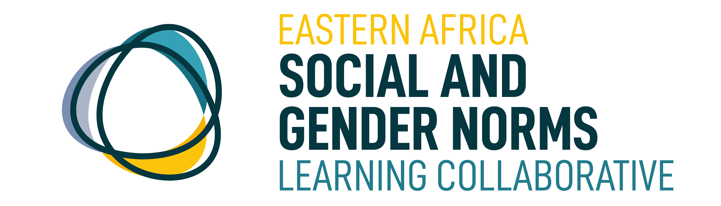




Registration
8:00am – 8:45am
WELCOME TO EALC CONFERENCE
2023 Conference
14 June 2023
Fair Way Hotel
Connect via Zoom

Slide 2
Digitization and the Technology Impact on Gender and Social Norms
Eastern Africa Social and Gender Norms Learning Collaborative
2023 Conference
14 June 2023
Fair Way Hotel
Connect via Zoom

Slide 3



Opening Sessions
14 June 2023
Fair Way Hotel
Connect via Zoom

Slide 4
Welcome Remarks and Introduction to Eastern Africa Social and Gender Norms Learning Collaborative
Dr. Aramanzan Madanda
14 June 2023
Fair Way Hotel
Connect via Zoom

Slide 5
Welcome by
Principal Investigator
Aramanzan Madanda, PhD
Eastern Africa Learning Collaborative (EALC) Annual Conference
14th to 15th June 2023, FAIRWAY HOTEL – Kampala Uganda

Slide 6



EALC Hosts
CARE International in Uganda
In partnership with University of California San Diego
With funding from Hewlett Foundation
        Makerere University School of Women and Gender Studies

Slide 7




Host
Global Learning Collaborative (2016)
Nigeria
(2020)
East Africa (2020)
Francophone (2018)
Southeast Asia
(2020)
Host
Funder
Funder
Host
Funder
Host
Funder
Host
Funder
School of Women & Gender Studies
9 Country Coordinators
Notes:
The Nigeria LC is part of a broader, global community working to advance social norms practice which includes regional networks in West and East Africa and South Asia.
The Global LC was founded in 2016 , after two years, members recognized the need to more fully engage researchers/program implementers at the regional and country level. Today, in addition to the Nigeria LC there is a CoP in West Africa, an East Africa Learning Collaborative launching this month. The newest LC is hosted by Project Concern International and Ashoka University.

Slide 8
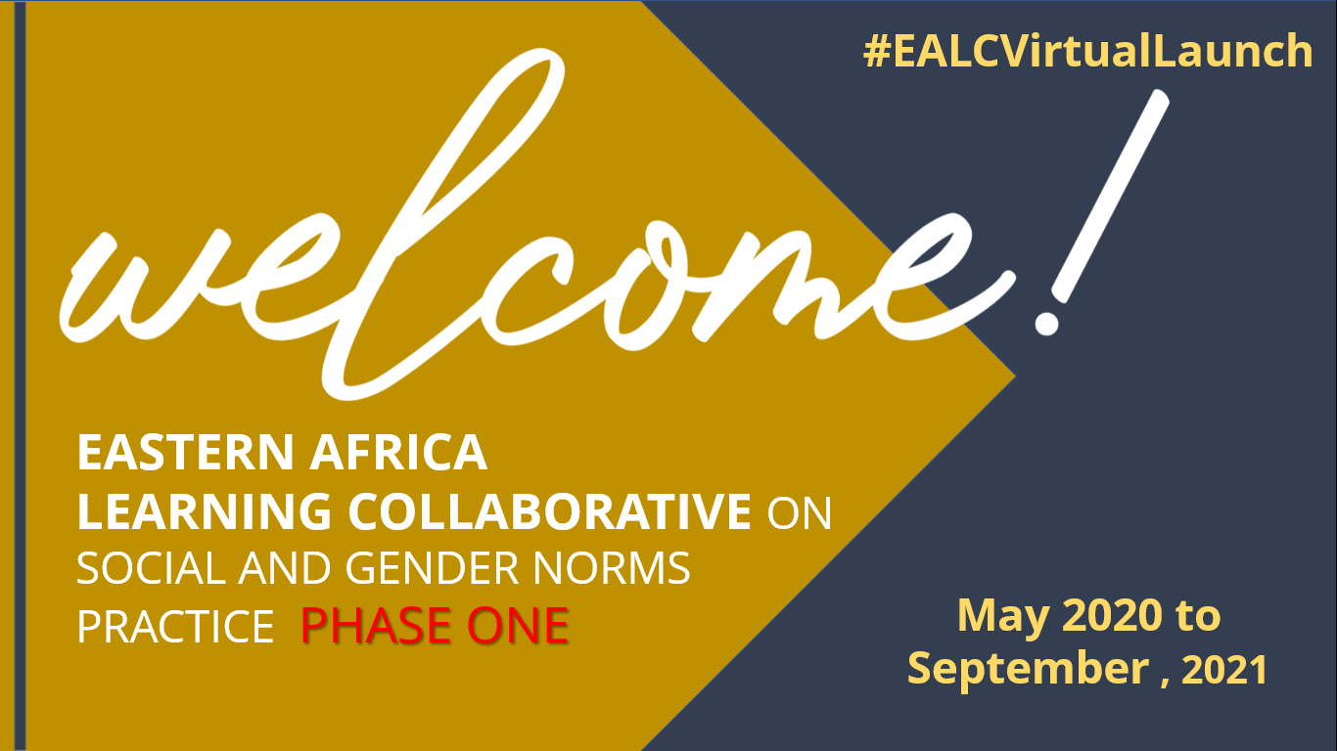
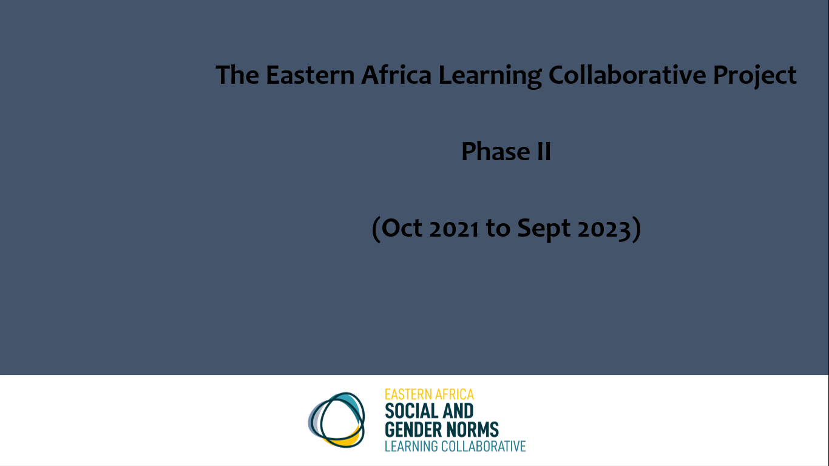
EALC 2020 to 2023

Slide 9
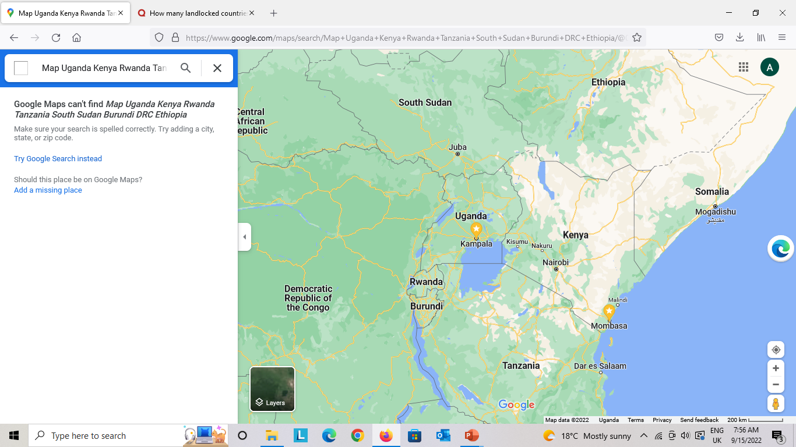
The goal of EALC Phase 2:
Consolidate the EALC as a regionally led community of practice which fosters learning and collaboration through secure, effective virtual, hybrid, and in-person platforms to advance social norms practice.
  Generate, disseminate and utilize social norms evidence, approaches, and resources.
  Improve norms programming
  Effectively advocate on inequitable social and gender norms.

Slide 10
Outcomes of Phase II
Consolidated formation of the EALC
Increased equitable participation in EALC platforms
Strengthened collaboration - implementers, researchers, advocates, evaluators, donors and government, national to global levels
Increased generation, sharing and use of resources & evidence
Strengthened capacity to measure and monitor social norms shifting.
Capacity of East African universities to research and train on norms theory and programming
Advocacy on inequitable social and gender norms.
Notes:
CU and the SWGS will establish an Oversight Committee consisting of senior representation from Makerere University, CU and EALC members from across Eastern Africa
CU and the SWGS will continue to bring together EALC participants through virtual meetings and learning events using tools such as Microsoft Teams, Zoom and WhatsApp.

Slide 11
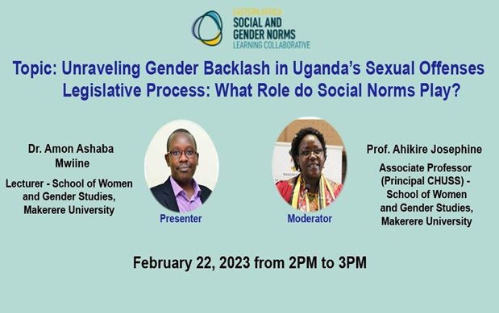

Key Engagements
Launch of Phase II - May 2022
Weekly, Bi-Weekly and Monthly Engagements - National, Regional and International, Thematic interactions
Monthly Engagement with the CCCC – Cross Community Coordination Committee - South Asia, Nigeria, Francophone Africa, EALC and Global LC
Webinars, thematic meetings, Global Events/Conferences
Sub Granting – 4 Sub Grantees in Phase 2: ACFODE, Fidelitas, LOSCO and Kisakye
Playbook on Online Security

Slide 12
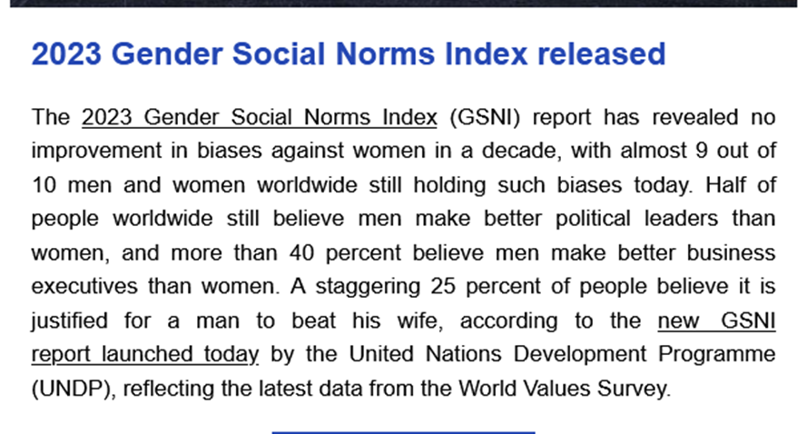

Key Gaps and Outlook
Making the EALC truly “Eastern African”
Potential Merger with Agency for All
More work…

Slide 14
Opening Remarks - Mr. Apollo B Gabazira
Country Director, Care International Uganda
14 June 2023
Fair Way Hotel
Connect via Zoom

Slide 15
Opening Remarks – Prof. Sarah Ssali
Dean School of Women and Gender studies, Makerere University
14 June 2023
Fair Way Hotel
Connect via Zoom

Slide 16
Keynote Address
Ms. Paulina Chiwangu
UN-Women Representative
14 June 2023
Fair Way Hotel
Connect via Zoom

Slide 17
Presentation and Invitation of Minister
Mr. Aggrey David Kibenge
PS - Ministry of Gender and Social Development (MGLSD)
14 June 2023
Fair Way Hotel
Connect via Zoom

Slide 18
Official Opening of EALC Conference
Hon. Betty Amongi Akena
Minister of Gender Labour and Social Development
14 June 2023
Fair Way Hotel
Connect via Zoom

Slide 19
Health Break
10:15am - 10:25am
14 June 2023
Fair Way Hotel
Connect via Zoom

Slide 20
PRESENTATIONS ON
RESEARCH ON TECHNOLOGY &
SOCIAL NORMS
Day 1: Research Sessions
14 June 2023
Fair Way Hotel
Connect via Zoom

Slide 21
Ivan Odongo
Technological Advancements and Changing Social Norms in Uganda
14 June 2023
Fair Way Hotel
Connect via Zoom

Slide 22
Technological Advancements and Changing Social Norms in Uganda
Impact of Digitization on Gender and Social Norms
Presented by Ivan Odongo

Slide 23
Introduction
Background of the study
Research objectives
Research questions

Slide 24
Literature review
Technological advancements and their impact on society
Social norms and their influence on behavior
Existing studies on technology and social norms in developing countries
Gender roles and norms in Uganda

Slide 25
Methodology
Research design
Data collection methods (surveys, interviews, focus groups)
Sampling techniques and sample size
Ethical considerations

Slide 26
Technological Landscape in Uganda
Overview of digital infrastructure and connectivity
Penetration of mobile phones and internet usage
Access to technology across gender and socio-economic groups

Slide 27
Technology Adoption and Gender Norms
The influence of technology on traditional gender roles
Changes in work patterns and economic empowerment
Education and digital literacy gender disparities

Slide 28
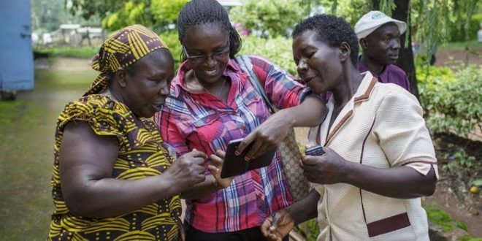
Technology Adoption and Gender Norms

Slide 29

Technology Adoption and Gender Norms

Slide 30
Social Dynamics and Technological Impact
Social media and online platforms: Effects on social interactions and relationships
Cyberbullying and online harassment: Gendered experiences
Virtual communities and identity formation

Slide 31

Social Dynamics and Technological Impact

Slide 32
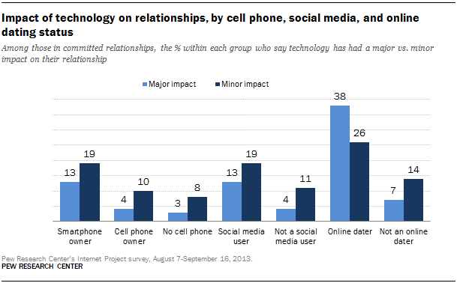
Social Dynamics and Technological Impact

Slide 33
Challenges and Opportunities
Cultural resistance to technological change
Addressing the digital gender divide
Policy implications for bridging the gap between technology and social norms

Slide 34
Results and Findings
Summary of key findings from the research
The findings will provide insights for policymakers, development organizations, and civil society actors to develop strategies and interventions that leverage technology for positive social change, address gender disparities, and promote inclusivity in the digital era in Uganda.

Slide 35
Implications for Policy and Practice
Recommendations for policymakers, development organizations, and civil society actors
Leveraging technology for positive social change
Addressing gender disparities in the digital era

Slide 36
Future Research Directions
Suggestions for future research opportunities and areas of exploration;
1. Exploring the long-term impacts of technology on social norms and gender dynamics in Uganda, considering factors such as generational shifts and the sustained influence of digital platforms.
2. Investigating the intersectionality of technology, social norms, and marginalized groups in Uganda, examining how technology can be leveraged to promote inclusivity and address the specific challenges faced by women, LGBTQ+ individuals, and other marginalized communities.

Slide 37
Conclusion
This research highlights the need for a nuanced understanding of the interplay between technology and social norms to navigate the opportunities and challenges presented by technological advancements.
By leveraging technology in a gender-responsive and inclusive manner, Uganda can pave the way for a more equitable and empowered society.

Slide 38
Dr. Raji BA
Mr. Amoloye A.O
Mr. Adeniyi A.I
Comparative Jurisprudence on Gender Equality: Exploring Innovation and Technology
14 June 2023
Fair Way Hotel
Connect via Zoom

Slide 39
Charlene Kanyali
Care International Uganda
Effective programming models towards digitising social norms
14 June 2023
Fair Way Hotel
Connect via Zoom

Slide 40
Effective Programming Models Towards Digitising Social Norms
14/06/2023

Slide 41
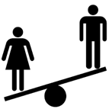


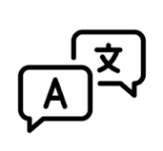



Background
Gender Digital Divide Drivers
The Gender Digital Divide
The digital gender divide hinders women's empowerment and access to a life free from violence and poverty.
Uganda household survey data (2019/2020) shows a 13.64% gender gap in phone ownership, with 64.6% of women owning phones compared to 78.4% of men.
Barriers to phone usage include lack of knowledge (64% of Ugandans) and high equipment costs (50%).
GSMA reports an 18% gender gap in mobile ownership and a 16% gap in internet usage.
Addressing challenges requires access to affordable devices and digital literacy skills, especially for women and girls in low-income communities.
Limited device access
Unequal gender norms
Digital skills gaps
Low literacy rates
Limited relevant
or accessible content
Unreliable network access / stability
Affordability

Slide 42
CARE’s STRATEGY
The Approach
Collaborating with Village Savings and Loan Associations (VSLAs) as a low-cost pathway to closing the gender digital divide.
Build strategic partnerships with the private sector and INGOs to help CARE deliver devices and training to VSLA groups.
Recognizing the lack of access to relevant content for women and girls and partnering with FinTechs and innovators to provide localized and useful content.
Integrating digital literacy curriculum and toolkits into existing programs that address social norms and gender dynamics.
Engaging men and boys

Slide 43
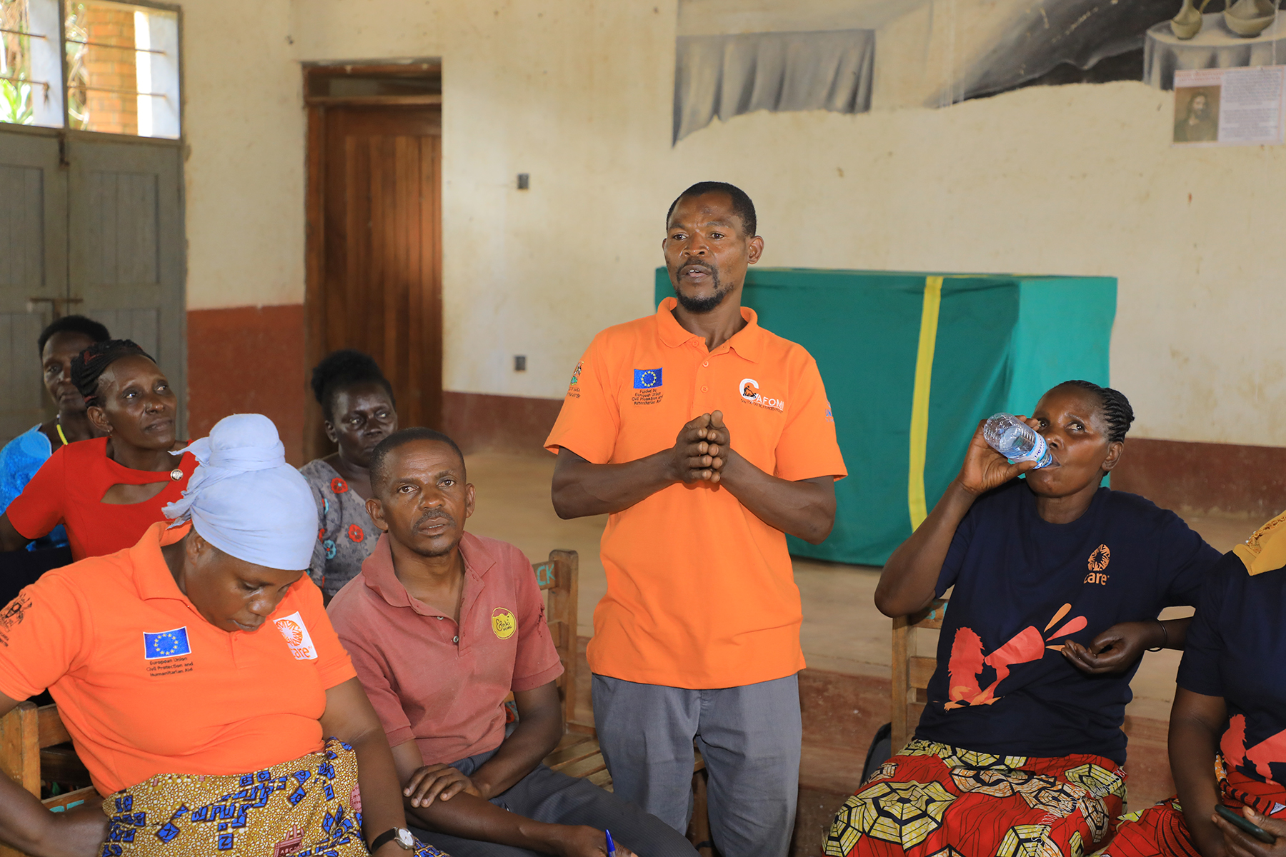

Engaging Men and Boys
PLACE
PHOTO HERE.
GO TO VIEW > SLIDE MASTER >
SHAPE FORMAT > SHAPE FILL >
PICTURE > BROWSE FOR PHOTO >
INSERT > PICTURE FORMAT >
CROP > FILL > ADJUST IMAGE
SIZE AND PLACEMENT >
DELETE THIS TEXT!
Sensitizing men and gatekeepers about the benefits of women's device ownership and usage.
Involving men and boys as committed agents for equal technology usage.
Promoting gender equality and positive masculinity.

Slide 44
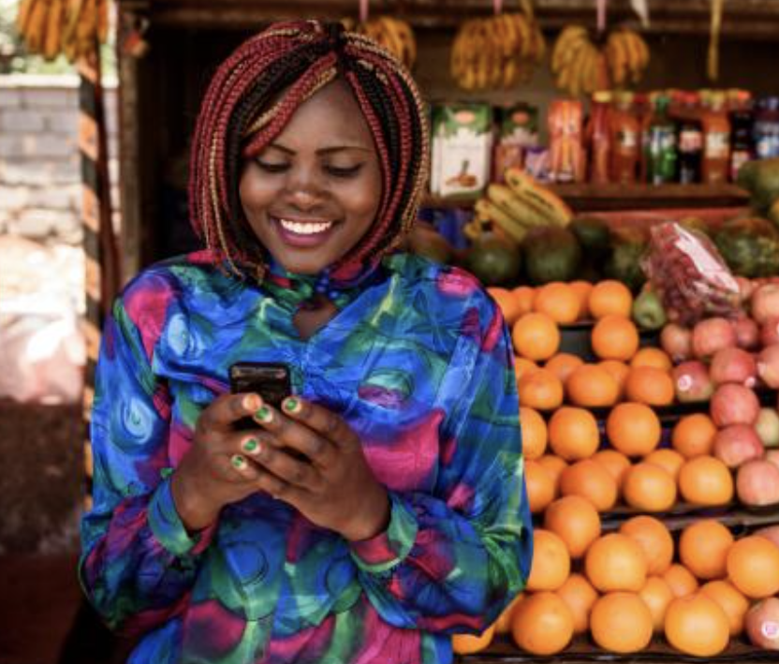
Multi-Stakeholder Partnerships
Collaborating with Mobile Network Operators (MNOs), FinTechs, and Financial Service Providers (FSPs).
Addressing barriers to digital access and literacy for women and girls.
Promoting inclusive digital ecosystems for social and economic change.(Chomoka and access to phones)

Slide 45
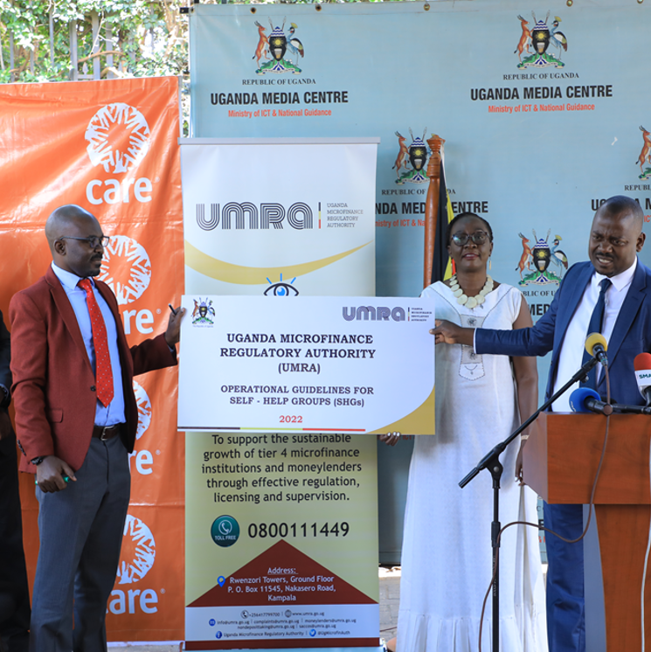
Collaboration and Awareness
PLACE
PHOTO HERE.
GO TO VIEW > SLIDE MASTER >
SHAPE FORMAT > SHAPE FILL >
PICTURE > BROWSE FOR PHOTO >
INSERT > PICTURE FORMAT >
CROP > FILL > ADJUST IMAGE
SIZE AND PLACEMENT >
DELETE THIS TEXT!
Strengthening existing systems through collaboration with governments, development organizations, civil society, and the private sector.
Raising awareness about the benefits of digital technology with a focus on equity, access, and usage.
Involving academia, women-led organizations, and local leadership in data collection, progress monitoring, and generating recommendations

Slide 46
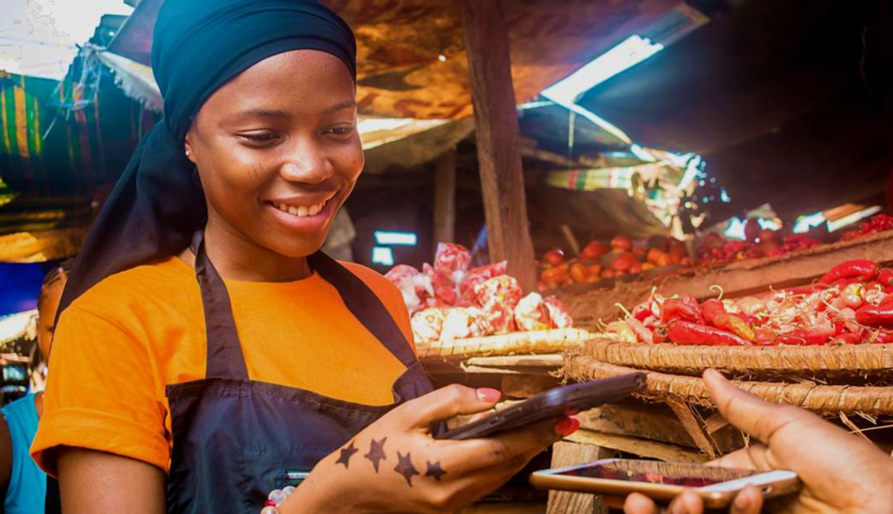
Impact Measurement and Dialogue
Measuring impact, sharing lessons learned, and generating evidence on effective practices.
Informing future programming and funding decisions.
Examining how technology contributes to broader programmatic goals.
Image credit: i_am_zews / Shutterstock

Slide 47
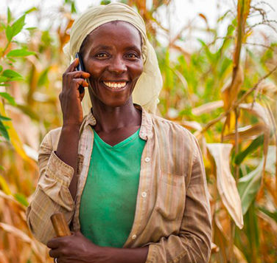
Thank you!
Photo credit: https://paymentsafrika.com/

Slide 48
Questions & Answers
14 June 2023
Fair Way Hotel
Connect via Zoom

Slide 49
Polycarp Okeyo
Kisumu Shinners Organization
Technology and Social and Gender Norms among Adolescent Girls and Young Women in Western Nyanza Regions
14 June 2023
Fair Way Hotel
Connect via Zoom

Slide 50


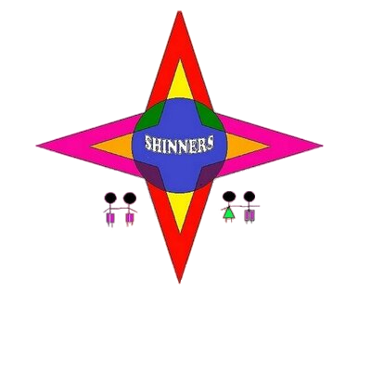
DIGITALIZATION AND TECHNOLOGY IMPACT ON GENDER AND SOCIAL NORMS.
Technology Impact on Social and Gender Norms
among Adolescent Girls and Young Women in Western Nyanza regions.
Author: Polycarp Okeyo,
Kisumu Shinners Organization
+254721557634

Slide 51

CONTENTS
01.
02.
03.
04.
INTRODUCTION
METHODS
RESULTS
CONCLUSION

Slide 52
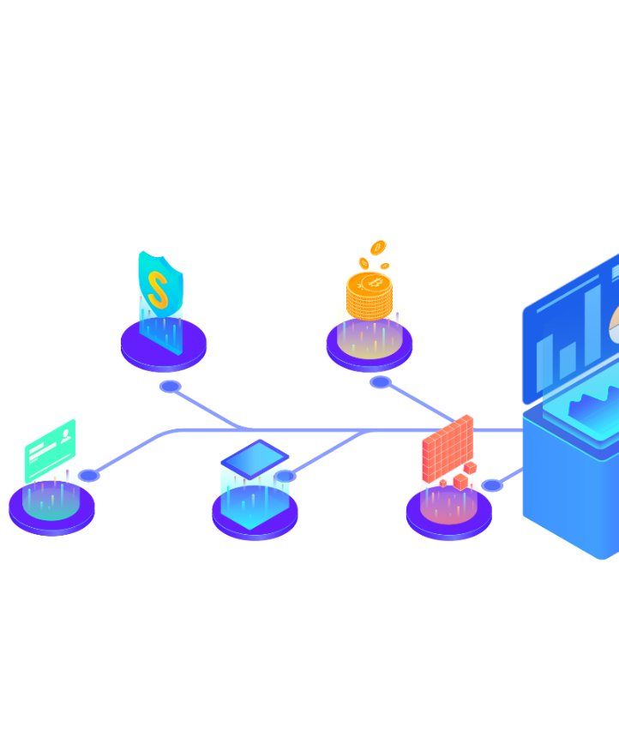

01.
INTRODUCTION
The COVID-19 pandemic has accelerated a global digital and data-driven transformation, with more people online for work, leisure, and learning. More time online means increased opportunities for virtual connection, but also poses new and unique challenges.
Nowadays, a large share of our communication and interaction is mediated via digital technologies ,especially among the young people.

Slide 53

Digital technologies are a powerful driver of gender equality,
giving women and girls new information, opportunities, and resources.
But the digital gender divide persists, in part because of social and gender norms and deep-rooted gender stereotypes. This means that many women, especially those from developing countries, face continued challenges in accessing and making use of digital technologies.

Slide 54

The rates at which girls and young women are learning to code continue to trail those of boys and men.
Globally women make up only
of the STEM workforce, and are less likely than men to have an education in science and tech-related fields.
29%

Slide 55


02.
METHODS
The study was done in Kisumu County, both in urban and informal settlement of the region.
Data were collected in 2022 from 600 Adolescents Girls and Young Women (AGYW) aged 12–25 years.
We estimated the proportions of these groups reporting ever Owned a Smartphone or use, ever had access to internet, ever attended a computer class lessons, Multivariable regression analyses were performed to identify factors associated with technology awareness.

Slide 56

03.
DATA COLLECTION
3.1 Tools Pre-Testing
Kisumu Shiners’ organized a one day pre-test of data collection tools to ensure that the interview guides are understandable, consistent and that the language captures the actual information that is needed (from English to Kiswahili and vice versa).
This pre-test exercise were done after training of the research team and were conducted in Sub Counties in Kisumu County.

Slide 57
3.1 Actual Data Collection
Literature Review
Review of published and unpublished literature on normative change work around AGYW Digitization and Technology Impact on Gender and Social Norms” and issues in Africa and Kisumu in particular.
Review materials were obtained through:
a) Databases including Google Scholar, Science Direct, and JSTOR, using keywords and a combination of search terms.

Slide 58
3.2 Actual Data Collection
Literature Review
b) List of references and citations from relevant documents and learning collaborative websites and
c) Consultation with and or referral by other past similar research and program experts and study advisory committee members on known documented AGYW interventions that contain a norm change component.

Slide 59

3.2 Actual Data Collection
Literature Review
Eligible materials were reviewed in full and relevant information on norm shifting interventions/programming were extracted in an excel spreadsheet for analysis. Information abstracted included a summary of norms that lead to Digitization and Technology Impact on Gender and Social Norms among AGYW in Kisumu County.

Slide 60

3.2 Actual Data Collection
Case Study Documentation
Three case studies describing best practices in norms shifting interventions addressing Digitization and Technology Impact on Gender and Social Norms issues in Kenya were documented. The case studies focused on AGYW lived experiences in relation to Digitalization and Technology and its impact on Gender and social Norms.

Slide 61
3.2 Actual Data Collection
Qualitative data
25 Key informant interviews will be conducted to explore participant knowledge and perceptions on norm change for AGYW people in Kenya [with focus on Digitization and Technology Impact on Gender and Social Norms, their proposed interventions and recommendations for normative change work in Kenya.

Slide 62

04.
SELECTION CRITERIA
4.1 Study Population and Eligibility Criteria
Participants for this study were selected purposively and they included key stakeholders and members of AGYW communities across the study areas. The following criteria were used in selecting key informants, materials for literature review and case studies;
4.2 Eligibility criteria for key informants
Willingness to participate
Being knowledgeable in AGYW work
3. Literature on norms focusing on AGYW issues
4. Literature focused on the African region

Slide 63
04.
SELECTION CRITERIA
4.3 Eligibility criteria for case studies
Entry point: i.e. norms shift targeting institutions, individuals and communities.
Theory of change and program design- Strategies (including tools) and approaches to AGYW normative change.
Cases with a Gender AND Social Norms approach.
3. Norm shift at sector level (s) e.g. legal, religious, cultural sectors with focus on either reference group and or behavior.
4. Presence or absence of monitoring and evaluation of the normative components of the programs.

Slide 64
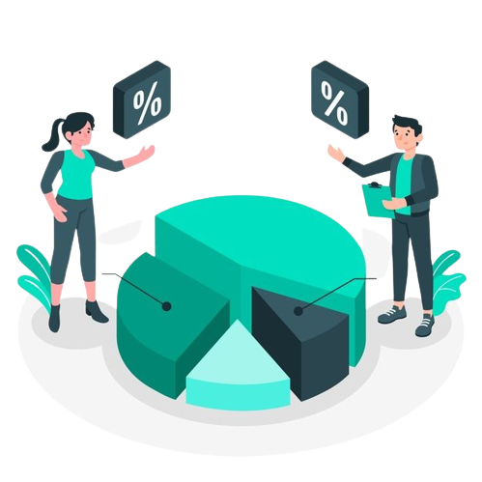

03.
RESULTS
32%
18%
1
2
Use Smartphones
Computer Literate
Out Of 600 active internet users in within 12 Months
Had access to internet in the last 3 months
50%
3
Basic Computing
Knowledge
• lacked smartphones for the past 5 years

Slide 65




AGYW WHO HAD ACCESS TO INTERNET THROUGH SMARTPHONES
n=12
23
Years
19
Years
15
Years

Slide 66

04.
CONCLUSION

Slide 67

03.
CONCLUSION
Our study findings suggest that we need a safe, affordable, and inclusive internet, one that doesn’t fuel harmful gender stereotypes, silence women’s voices, and imperil women’s safety and rights. Equally, we need digital tools to boost women’s participation and leadership in the digital space. It is not enough for women and girls to simply have access to technology and digital skills; they must also become active agents of change to create a safer and equitable digital future for all.
This responsibility falls on all of us--governments, civil society organizations, the private sector, including tech companies, and law nforcement.Without rights-based governance and ethical guard rails, we risk leaving women and girls further behind in the digital transformation.

Slide 68
03.
CONCLUSION
Discrimination,harmful,social norms, the education divide, geography ,and lack of motivation are some of the key factors that impact women’s choices, abilities and opportunities to access and use technology to bridge the gender gap.
COVID-19 has alid bare broad-based gender inequities in the digital space.

Slide 69


THANK YOU

Slide 70
Ms. Judith Atukunda &
Stella Rose Akutui
LANDnet Uganda
14 June 2023
Fair Way Hotel
Connect via Zoom

Slide 71









EASTERN AFRICA SOCIAL AND GENDER NORMS LEARNING COLLABORATIVE CONFERENCE
Technology as a tool for addressing Gender and Social Norms in Uganda
A case for the establishment of a Customary Land Registry for Uganda
14th -15th June, 2023

Slide 72
About LANDnet
LANDnet Uganda engages in research, capacity development and policy advocacy on land, gender, and natural resources management. It envisages a Uganda where its land and natural resources are used productively, efficiently and sustainably for present and future generations. LANDnet’s work is buttressed by four core strategic goal, namely; Enhance Capacity Development for Land Sector Actors; Influence policy and practice through Research; Influence Policy and Practice through Advocacy; and lastly, enhance Democratic Governance and Accountability.
Host of the Women's Land Rights Movement (WLRM)

Slide 73

Background of the Initiative
The unprecedented spread of digital technologiesprovides innovative and efficient tools for meeting the growing land rights advocacy needs for the land sector people, including women.
Culture and tradition are a long- standing phenomenon that has significantly affected the taking on of most land management technologies. Some technology practices are not well-matched with certain communities’ cultures and traditions.
In Uganda, social and gender norms play a significant role
in shaping practices and
land-related dynamics
Technology has the potential
to play a advancing
crucial role in women's land
rights in Uganda. .

Slide 74

The land sector in Uganda is characterized
Innovation has enhanced and on the other hand defeated the advancement of women’s land rights in the country because it
Problem Statement
by entrenched social
norms that perpetuate gender disparities and
naturally excludes several marginalized groups like women whose limited financial means will deprive them of the opportunity to access these innovations.
marginalize vulnerable communities.
Uganda's legal framework recognizes women's right to own land, but cultural norms and
Traditional norms and
practices continue to hinder equitable access to land and reinforce power imbalances. The use of technology for advocacy and policy in the
practices often limit women's access to and control over land. Women are frequently excluded from decision-making processes around land and are often unable to access credit or loans to purchase land.
land sector opportunities challenges.
presents both
and

Slide 75
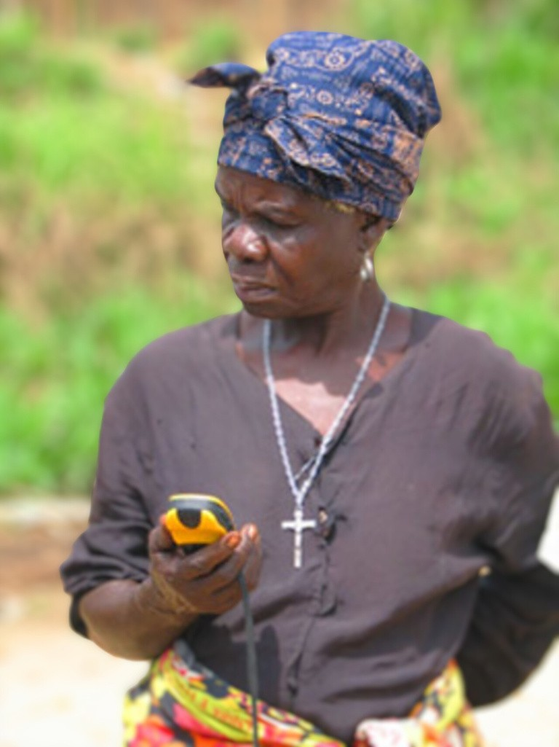

Justification
Technology amplifies marginalized voices, disseminates information on land rights, and creates awareness to challenge harmful social norms. It enables data collection for evidence-
based among
advocacy and fosters collaboration diverse stakeholders. By leveraging
technology, Uganda can effectively challenge and reshape social norms, promote gender equality, and ensure sustainable and equitable land management practices.

Slide 76

To document the technological advances in the land sector.
To review the state of social norms and women’s land rights in Uganda.
To demystify the linkages between technology and women land rights in the wake of social and gender norms.
Objectives

Slide 77

Social norms and Women’s Land Rights in Uganda
Technology within the sector
as employed Uganda land
Summary Of Findings
The Role of Technology in Advocacy and Policy for Social Norms

Slide 78

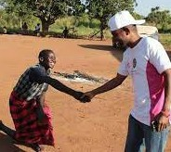

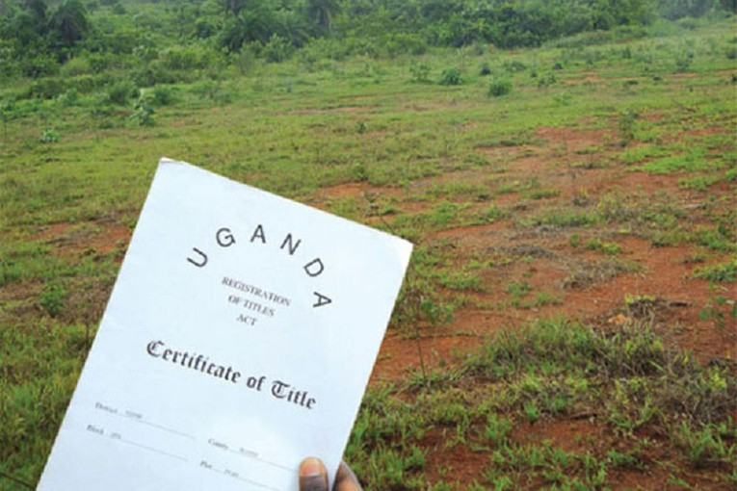
Cont.
The Customary Land Registry: An opportunity to transform social norms in the wake of technological advances.

Slide 79



Opportunities
Ongoing work with customary land registration. Existing legal framework.
Progressive Technological approaches.
Studies already commissioned by LANDnet Uganda and partners.

Slide 80


Challenges
Access and Connectivity. Inclusion and Representation. Privacy and Security.
Digital Divide and Inequality. Resistance to Change.
Accuracy and Misinformation. Sustainability and Long-term Impact.

Slide 81
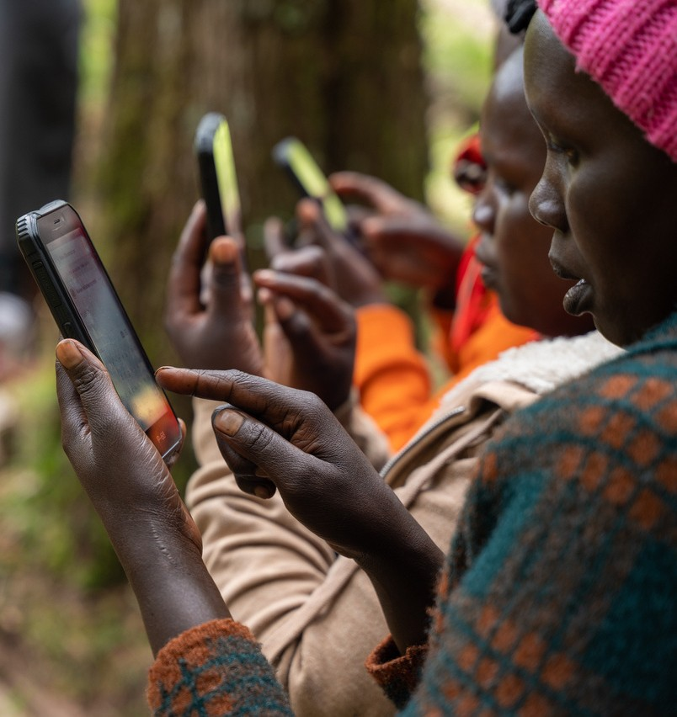

Conclusion
The role of technology in advocacy and policy development for challenging social norms is significant and offers
immense change. individuals
potential for transformative By harnessing technology,
and communities can
disseminate information, amplify marginalized voices, mobilize advocates, gather evidence, promote dialogue, and monitor policy implementation.

Slide 82
Policy Recommendations
Prioritize efforts to bridge the digital divide that is mainly escalated by negative social and cultural norms .
Inclusive and Participatory Approaches. Capacity Building.
Collaborative Partnerships.
Policy Innovation and Adaptation.

Slide 83



Slide 84
Jordana Wamboga & Caroline Kayanja
UCOBAC
14 June 2023
Fair Way Hotel
Connect via Zoom

Slide 85



DIGITIZATION AND TECHNOLOGY IMPACT ON GENDER AND SOCIAL NORMS
Sub-Theme: Gender inclusive digitalization
Presentation By: Caroline Kayanja and Jordana Wamboga
Program Officers- UCOBAC
Email: k.carol@ucobac.org
wambogaj@gmail.com

Slide 86
PRESENTATION OUTLINE
1
Introduction
2
Definition of Key Terms
3
4
5
Impact of Technology
Social Norms Transformative Models
Gender Considerations
Gender Inclusive Digitization
6

Slide 87
Introduction
A brief about UCOBAC
Presentation Objectives
To understand social and gender norms in the context of digitalization
To examine the impact of technology
Social norms transformational models
Recommendations for gender inclusive digitalization

Slide 88

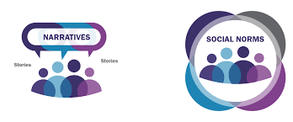
Social Norms
Rules or expectations of behavior and thoughts based on shared beliefs within a specific cultural or social group.
They consist of what we do, what we believe others do, and what we believe others approve of and expect us to do.
Situated at the interplay between behavior, beliefs and expectations.
Learned and accepted from an early age often in infancy.
Held in place by social sanctions for non-adherence and rewards for adherence.

Slide 89
GENDER NORMS
Shared beliefs about the rules and expectations for boys/men and girls/women’s behaviors
OR
Shared beliefs about what appropriate behaviour is for boys/men and girls/women in a given society
Influences how boys/men Vs. girls/women
Behave
Interact
Roles
Power
Spaces to operate – public/private
Resources/ Assets

Slide 90
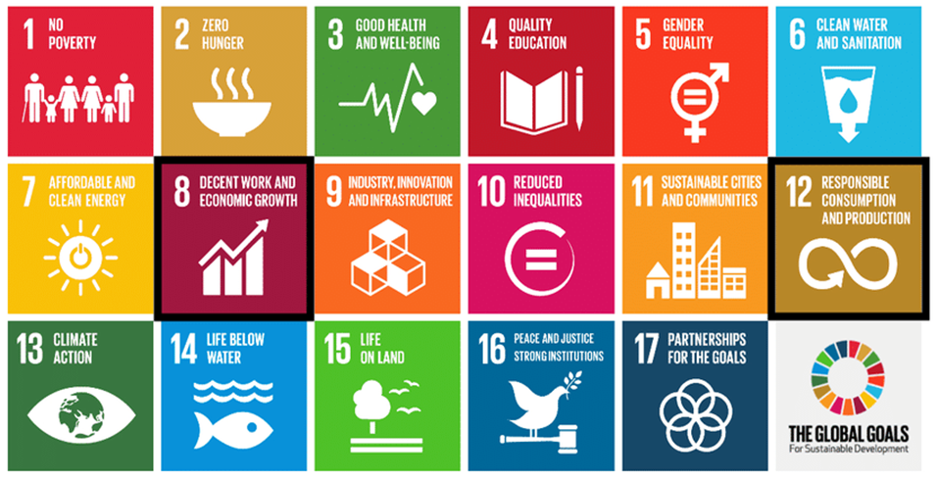
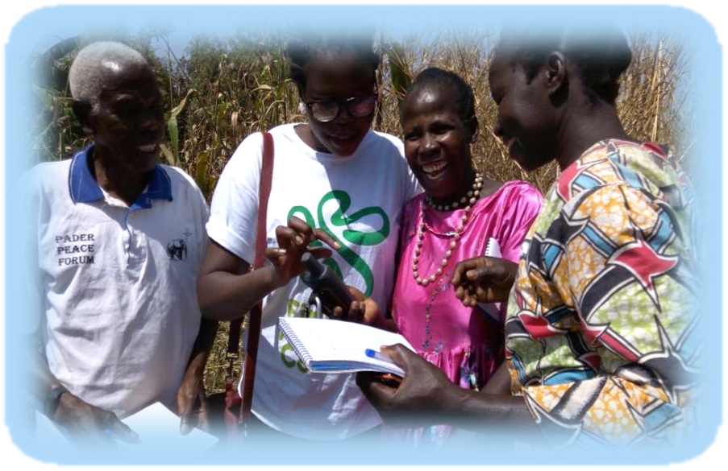
Technology
Technology is the application of scientific knowledge to the practical aims of human life. The word technology can also mean the products resulting from such efforts, including both tangible tools such as tools or machines, and intangible ones such as software.
A driver for the realization of all SDGs (Goal 9c). Significantly increase access to information and communications technology and strive to provide universal and affordable access to the Internet in least developed countries by 2020.
Digital transformation is a human rights issue. – Sometimes access to technology is a matter of life and death.

Slide 91
Impact of technology
Context
The gains and losses
Socio-structural Barriers
A global village introducing new norms on how people behave, interact with each other, relationships, access information and resources.
The impact of Covid-19
Digital divide (The Global System for Mobile Communications (GSMA) mobile gender gap 2020 report, about 393 million women do not have a mobile phone, among which 74 million are in sub-Saharan Africa.)
Privacy
Trust
Misinformation
Exclusion and disconnection
Exposure vs empowerment
Costs
Skills
Norm shifts
Policy environment

Slide 92
SOCIAL NORMS TRANSFORMATIVE MODELS

Slide 93
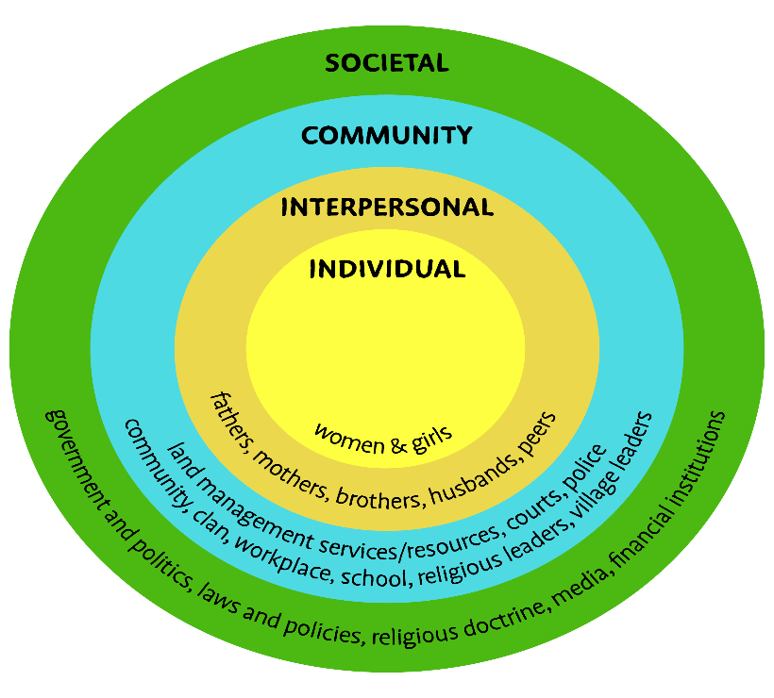
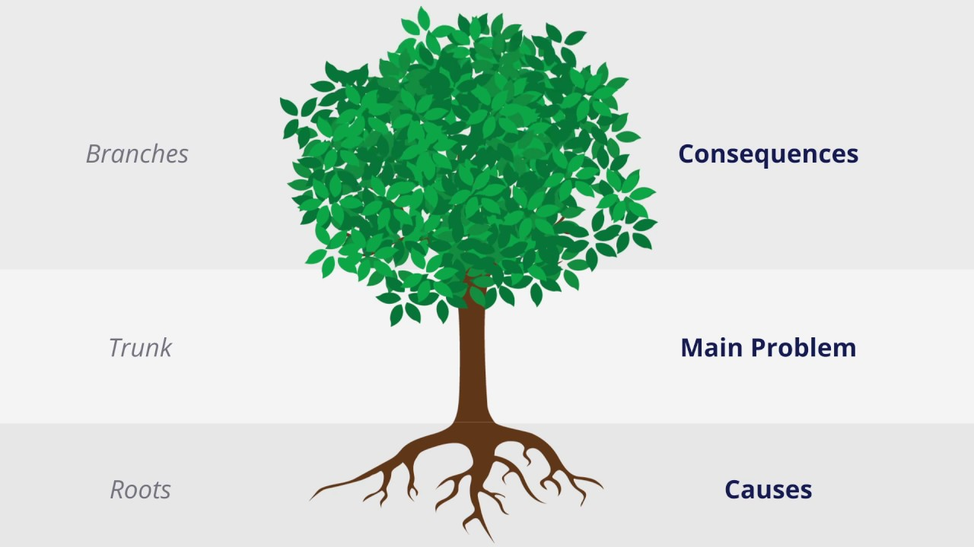
Gender transformative approaches
Ecological model
Problem tree analysis

Slide 94
Lewin’s Change Model
Unfreeze | Change | Refreeze
Recognize the need for change Determine what needs to change Question the ideas, values, attitudes or behaviors Encourage the replacement of behaviors and attitudes Ensure there is strong support for change (Uganda scores highly around Policy regulation (77%) however it is still scoring low on Skills (33%), Innovation (42%) and Infrastructure (51%). Manage and understand the doubts, concerns/ fears | Plan the changes Implement the changes Help or empower communities to learn the new norm Evaluate the gains vs the costs Work with the reference groups | Changes are reinforced and stabilized. Integrate the new norms into the normal way of doing things. The new status quo.

Slide 95
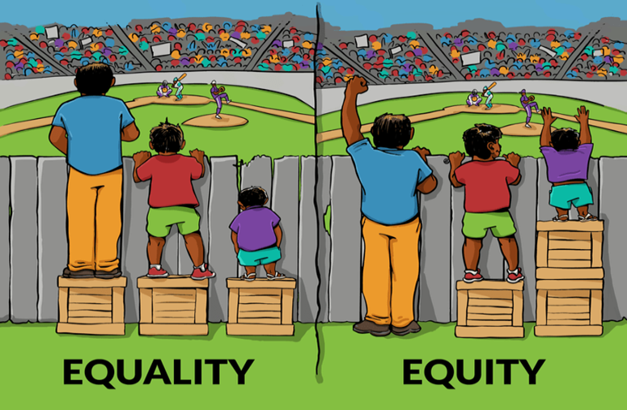
Gender considerations
Equality
Equity
Non- discrimination
Inclusion and Participation

Slide 96
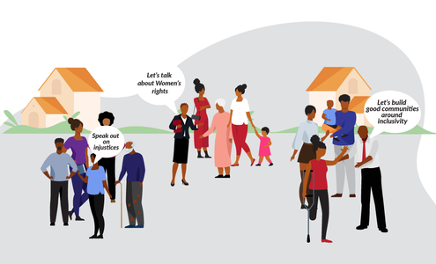
Gender inclusive digitalization
Facilitate a supportive and favorable policy infrastructure or environment.
Enhance safer, context specific and more affordable digital tools and services
Adopting indigenous technology
Intentional Upskilling, on-job learning, mentorship and empowerment (innovation, use, STEM). Men are four more times likely to be ICT specialists than women
Development and adoption of fit for purpose tools.
Male engagement in breaking social and cultural barriers, and perceptions regarding women’s work.
Building partnerships such as financial institutions, tech companies among others

Slide 97


Thank you for listening!!

Slide 98
Questions & Answers
14 June 2023
Fair Way Hotel
Connect via Zoom

Slide 99
Health Break
14 June 2023
Fair Way Hotel
Connect via Zoom

Slide 100
Mr. Ken Otieno- Kelin
Research on Technology and Social Norms: Creating a social norms community of Practice.
14 June 2023
Fair Way Hotel
Connect via Zoom

Slide 101
Mr. Bob Kirunda
Digital Based Evaluation of Social Norms (Tools, Best Practices, case studies)
14 June 2023
Fair Way Hotel
Connect via Zoom

Slide 102
Yes to digitization and technology; BUT Social norms change requires an activism oriented approach!
Some precursor shifts needed to harness digital technology for largescale impact!
Kirunda B.R.K
June 14th 2023

Slide 103
The value of IT and digitization
It makes possible the use of real time behavioral change information,
Allows wider participation,
Eliminates hard to reach population segments,
Reduces the cost of delivery,
Allows speedy information flow and
Allows movement of knowledge and not people.
It is not just WHAT we use to change/transform, but the WHEN, HOW and the WHY of our change/transformation efforts is more important.
Human elements require hard work and some cultural activism and leadership to spur collective action

Slide 104
Activism and social change!
Activism means collective efforts to create change from the grassroots (Activist Handbook).
Social activism is working with other people to bring about a change in societal issues like norms. The word “social” applies both to “society” and to the idea that the activism fosters opportunities for participation.
It relates to the activities where people use information and evidence to address their societal issues, by influencing others and challenging power
Like social and gender norms, activism also thrives through social networks that extend beyond kinship and ethnicity, that remain largely unstructured.

Slide 105
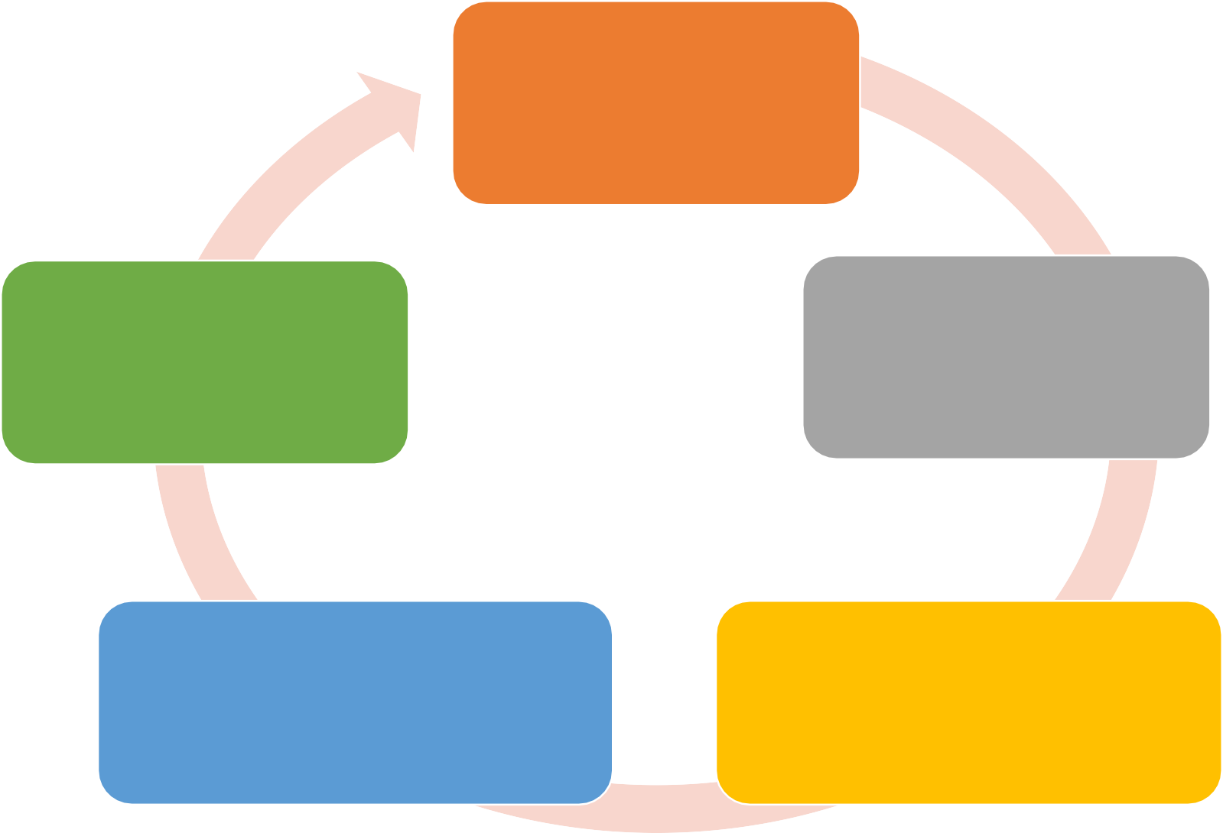
Steps in activism (General guidance)
Step 1: Clarify your cause
i.e. being able to clearly and concisely articulate the problem and the solution
Step 5: Check back in i.e. check back in on your progress, learn adjust and improve
Step 2: Develop a deep understanding of context
i.e. never neglect the
context of your actions.
Step 4: Act i.e. Actions will take many diverse forms, involve varying numbers of people and garner different types of attention. Plan to measure success and enjoy each victory, no matter how small
Step 3: Establish your strategies i.e. consult with others or revise your plan over the course of several days, weeks, or even months

Slide 106
Activism and agency for non-conformance
Passive activism
Survivalist activism
Collective activism
Social movement activism
This type considers the masses as passive, poor, lack ambition, hopeless and superstitious)
This type goes beyond the culture of poverty, thus although severely constrained, they do not wait for fate to determine their lives
This type manifests in collective pressure, protests, struggles, consumption.
This type of activist is one who takes responsibility of their own and others around them. They see themselves as worthy citizens, can rebels or lead, change agents and reformers.
Agency
Low
High

Slide 107
Before program designers and implementers move towards digital and technological means to change social/gender norms, some of the shifts that may be useful to achieve greater impact need to be considered!

Slide 108
Major shifts needed for activism
Shift 1 – From project focus to outcomes focus Shift 2 – From management to mobilization Shift 3 – From expert to explorer
Shift 4 – From delivery to co-creation Shift 5 – From expectations to agency

Slide 109
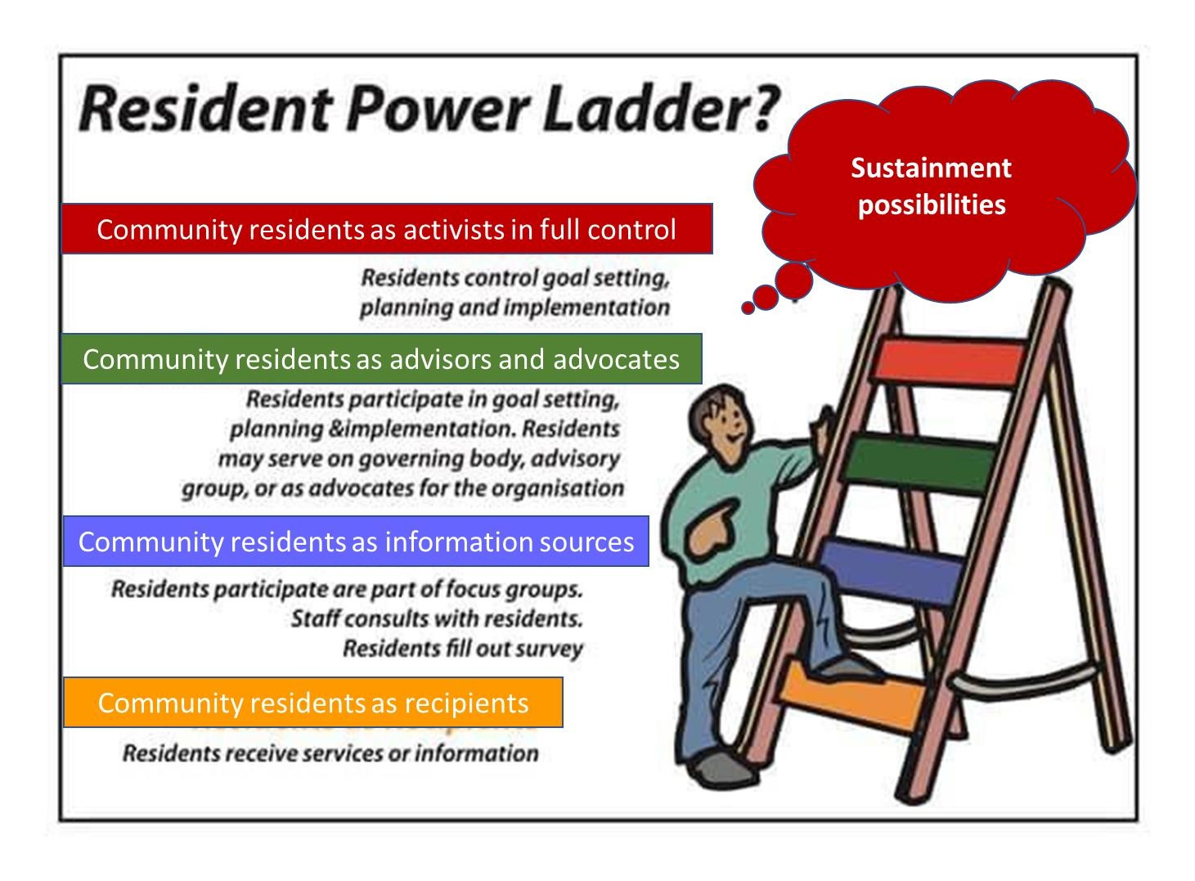
High agency
Low agency

Slide 110
Conclusion
Program designers and implementers should not ignore activism oriented shifts as key pre-cursor ingredients in harnessing digital technologies to achieving social norms change at scale.
Imagining sustained social changes and improvement in people’s lives without their own pressure or direct action seems no more than an illusion. This is so much alive in rural communities that have no or limited individual agency.

Slide 111
Thank you for listening!
Asante Sana

Slide 112
Questions & Answers
14 June 2023
Fair Way Hotel
Connect via Zoom

Slide 113
Aramanzan Madanda
Ms Noreen Nampeewo
Ronald Ogal
Panel Discussion: Experience of Shifting Gender Norms - Actor Voices
14 June 2023
Fair Way Hotel
Connect via Zoom

Slide 114
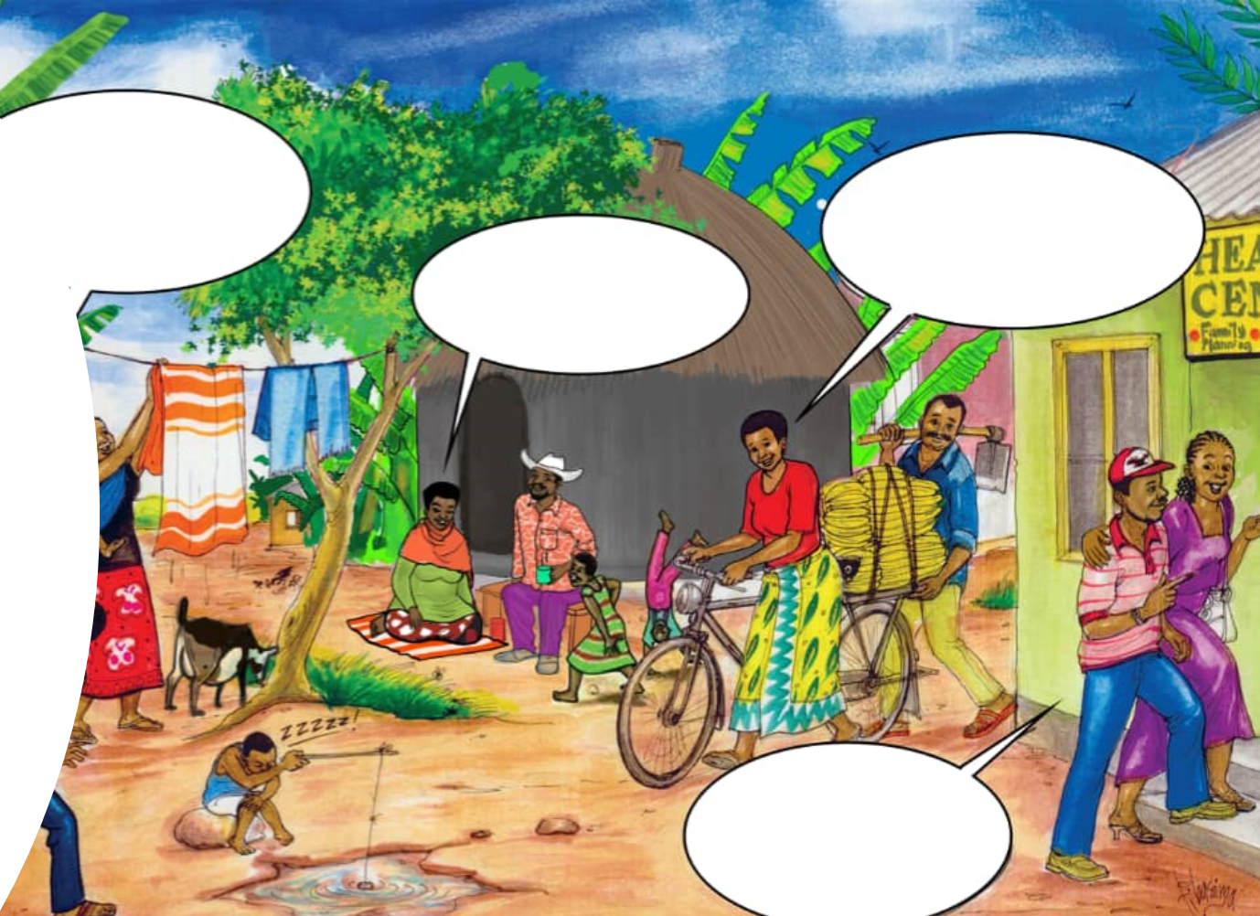
Experience of Shifting Gender Norms: Actor Voices from CARE Uganda
Panellists:
Aramanzan Madanda – Chair
Patricia Avako
Ronald Ogal
Teddy Nakubulwa

Slide 115

What we are covering
Overview
Example model
EMB Effectiveness
Gender norms measurement lessons & adaptations

Slide 116
Overview of Social and Gender Norms work in Care International in Uganda (CUGA)
EALC project brought together practitioners, implementors, evaluators and researchers
Increased understanding of gender norms in existing projects: WAY, WAYREP, DINU, etc.
Inspired design of new projects with a stronger gender norms component – GROW, WVL, ICP, EYE, WAYREP2, WAY2.0, etc.
Improving measurement of gender norms

Slide 117
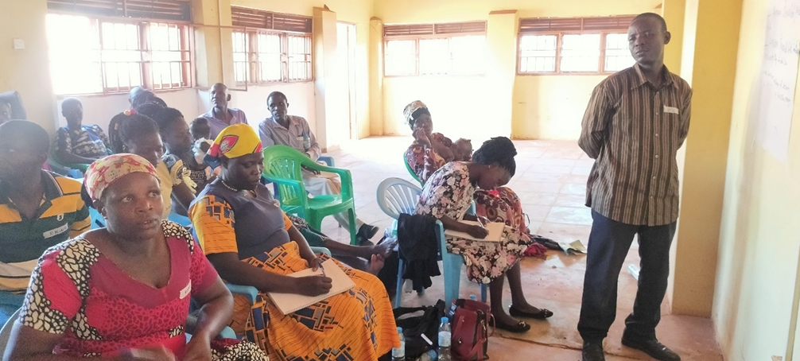
Effective Social Norms Model – SASA!
SASA! Together (Start, Awareness, Support, Action)–A community mobilisation approach designed by Raising Voices..
Dramatic Changes
Increased knowledge and skills of Violence against women/GBV in communities: SASA! Seeks to shift social and gender norms.
Increased confidence in reporting GBV cases – through Community Activism of women and Girls to speak out and seek for services.
What is Sticky?
Rigid cultural beliefs, Corruption, inadequate infrastructure limit quality of services to survivors.
Adequate long-term funding as SASA! Together uses a phased approach – over 3 to 5 years

Slide 118
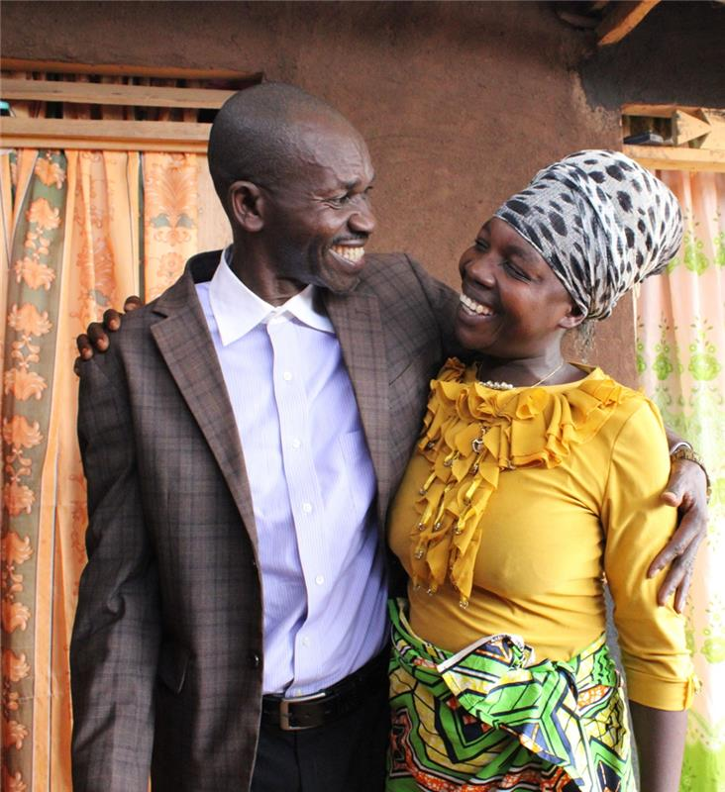
EMB and Gender Norms Shifting
Addressing Knowledge Gaps
Transforming Behaviour
Changes in Gender Norms
Women’s Perspectives
“My husband even reminds me about our women group meetings whenever I forget to meeting date and time” A WLiE group member
I let my wife go for workshops even if they are residential- I do not disturb her” Oola Peter, 28-year-old RMM, Puranga Sub- County, Pader District.
“On a daily basis, we had fights and quarrels in my family. I think my husband wanted to change this situation”. –Spouse of engaged man, Uganda
“I counselled my father to stop drinking and beating my mother. He listened and is now a changed and productive man. I now respect him” Otto Savero RMM Sub-county, Gulu
Notes:
OPENING: Engaging men and boys has been found to be an effective approach to shifting gender and social norms, according to CARE’s experience plus several other sources.
The digital space is controlled by men (Call to engage with men and boys by previous speakers)
Digitalization vs cyber violence
ADDRESSING KNOWLEDGE GAPS: (Gender Socialization, Power dynamics, Restrictive gender/social norms, gender equity, GBV, SRMH)
Knowledge Gaps: Gender equality is not a women's issue, it's a human issue. Engaging men and boys is crucial to breaking down harmful gender norms and creating a more equitable society
Lack of Awareness: Some men and boys may lack awareness about the ways in which gender norms can be harmful, making it difficult to engage them in the conversation.
TRANSFORMING BEHAVIOUR
Positive changes in their own lives, then reach out to fellow men & boys through one-to-one talks and exemplary life.
Transforming gender dynamics on Violence
CHANGES IN GENDER NORMS (Women’s participation in paid work, GBV, Women’s rights on SRH, Women’s participation in leadership positions, Women taking key decisions in the Household, Men participating in household chores)
Benefits: Engaging men and boys in gender norms shifting has numerous benefits.
It can help to reduce violence against women, girls including fellow men and boys when men and boys are taught to reject harmful gender norms and behaviors, they are less likely to perpetrate violence against women and girls.
Can help to promote positive masculinity. By challenging harmful stereotypes about what it means to be a man, we can create more diverse and inclusive notions of masculinity that allow men to express themselves in healthy and fulfilling ways.
Effective strategies focusing on positive messaging that emphasizes the benefits of gender equality for everyone, rather than framing the issue as a women's issue.
CONCLUSION: EMB is an effective approach to shifting gender norms. By engaging them as allies and advocates, we can collectively work towards dismantling restrictive/harmful stereotypes, promoting gender equality, and creating more inclusive and equitable societies.

Slide 119
Gender Norms Measurement
More Focus on program quality Beyond facts and figures:
  to assess gender transformative programing.
Defined gender norms activities, results and indicators at design.
  improved Measurement of social norms changes and impact. (CI and GAPIII indicators)
Gender Transformative MEAL Approaches
  participatory approaches centering women and girls’ voice, knowledge, and experiences in MEAL processes, using social norms measurement tools - SAA, CSC But why, Vignettes, social mapping, etc).
Gender and Power Analysis
  to collect, identify, examine, and analyze information on the different power-holders, social and gender norms, networks, varying needs and roles of men and women, boys and girls to inform project designs.
Adaptive Management and Learning-
  to incorporate lessons

Slide 120
Dr. D Gloria Shajobi Ibikunle
Abuja University Nigeria
Girl Child Enrollment in Technology and Science Based Programs - Causes and Effects
14 June 2023
Fair Way Hotel
Connect via Zoom

Slide 121
Low Girl Child Enrolment In Technology
& Science –Based Programs In Nigerian Universities: Causes and Effects
Dr. Gloria Shajobi-Ibikunle
Snr. Lecturer, Faculty of Law,Ag Director, Center for Gender Security Studies & Youth Advancement, University of Abuja
Chairperson, Sexual Offences Awareness Response(SOAR) Initiative, Abuja
Fellow, Chartered Institute of Administrators(FCIA)

Slide 122
2023 WOMEN’S DAY
The Secretary General of the United Nations, stated that Gender inequality is a question of power. He said; ‘I call for urgent action to equalize power in 3 ways for women & girls’:
Increase their education
Promote their full participation and leadership in STEM.
Create a safe digital environment for women.
Antonio Guterres, United Nations Secretary-General
@ antonioguterres at 67th Session, CSW67 Opening,6 March 2023, New York

Slide 123
INTRODUCTION
Gender inequality refers to practice of discrimination with regard to the unfair treatment against a person based their gender. According to the UN, often women and girls are discriminated against in health, education and labour market resulting in negative consequences that limit their freedom to develop their full potential- a serious barrier to human development (UNDP, 2015).

Slide 124
JAMB ADMISSION BY STATE, BY PROGRAM
(2017 & 2018) NIGERIAN UNIVERSITIES

Slide 125
JAMB ADMISSION BY STATE, BY PROGRAM
(2017 & 2018) NIGERIAN UNIVERSITIES CONT’D

Slide 126
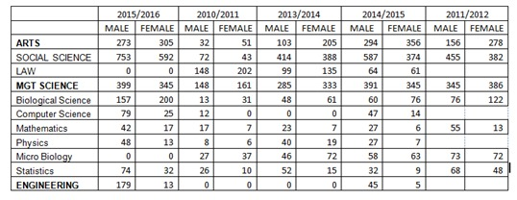

Slide 127
CAUSES OF LOW ENROLMENT
Poor Teaching Skills of Science Subjects In High School
Poor Selection Of Combination Subjects For SSCE Exams
Lack of Timely, Relevant Information At Point of Selection Of Higher Institutions
Poor Performance In Mandatory Subjects In WASC Examinations For STEM Admission To Universities
Low Nos Of Applicants At JAMB Qualifying Exam

Slide 128
Socio-Cultural Norms
Early Marriage, Household Chores, Avoidance of “Masculine” careers, Dropping Out of School For Street trade due to Poverty, Exalting ‘feminine Traits’; (Ibrahim & Bakori:(2004)-
schools push girls to prostitution; make them difficult to control by husbands & parents(Bello et aal:1993)
Wasted investment as girls will marry & go to another family

Slide 129
TABLE 3 NEGATIVE Socio-Cultural Norms
Question | Gombe South | Gombe North | Gombe Central
1.Education of girl-child is useless to the parents since she will be married away | Agree-5% Disagree-95% | Agree-60 Disagree-40 | Agree-30 Disagree-68-
2.Western education encourages immorality among girls | Agree-5% Disagree-90% Undecided-5% | Agree-50 Disagree-45 Undecided-5 | Agree-20% Strongly Disagree-70 Undecided-10
3. Poverty is a cause why some parents do not send their girl child to school | Agree-75% Strongly Disagree-25% | Agree-80 Disagree-20 | Agree-60 Disagree-40

Slide 130
CAUSES CONT’D
Religious Bias- Against ‘Western Education’. Islam dominated areas is associated with low enrolment in school-(Appleleton et all:1990)They prefer koranic education & keeping women in Purdah. If educated beyond primary school, they will not be submissive to their husbands.
Poor Quality Science based Laboratories In High School
Illiterate Parents/Guardians
Poverty

Slide 131
EFFECTS
Low Nos Of Applicants At JAMB Qualifying Exam
Lower Enrolment No for Science Subjects at SSC Levels
Withdrawal of Girl Child –For Early Child Marriage, For Family Business, etc
Poverty

Slide 132
RECOMMENDATIONS
Mentors (Formal & Informal)By Successful Females In Digital/ICT Careers.
Dialogue With Traditional/Religious Leaders On Change In Gender Norms That Reinforce Negative Bias.
Amendment of Criteria that does Not Allow Admission due to lack of credit in Mathematics-Remedial classes should run pari-passu.
Teachers to adopt better pedagogy especially Mathematics(Durojaye et al:2006)

Slide 133


Slide 134
Mr. Wilson Senyonyi
Oxfam Uganda
Impact of COVID-19 on Social Norms and Sexual Violence amongst Refugee Women and Girls in Uganda
14 June 2023
Fair Way Hotel
Connect via Zoom

Slide 135

Technology Bridging Gaps Created by COVID-19 In Reinforcing Social Norms in Selected Settlements of Western Uganda.
By Wilson Senyonyi

Slide 136
Introduction
25% of women in Sub-Saharan Africa have access to technology including internet connectivity (World Economic Forum report 2023)
5% of women as opposed to 8% of men use the internet (UBOS, 2021)
Why?
  cost of access and the high cost to connect is excluding billions from the digital revolution.
the uneven distribution in the access to and use of digital technologies (age, geographical or geopolitical social, or economic factors
Notes:
The World Economic Forum report 2023 indicates that in Sub-Saharan Africa, only 25% of women have access to technology including internet connectivity. 5% of women as opposed to 8% of men use the internet as indicated in a 2021 report by the Uganda Bureau of Statistics. The major barrier is the cost of access and the high cost to connect is excluding billions from the digital revolution. Nearly half of the world’s population is still offline, most of which are women from developing countries. We need global investments to achieve universal access

Slide 137

Introduction Cont.
The pandemic exacerbated the digital divide such as school systems struggling to ensure all students have equitable digital access and opportunities for virtual schooling and on the micro levels where grandchildren are teaching their grandparents how to use Zoom and Facetime to stay in touch during quarantine.
Notes:
The digital divide exists across borders, fields, and generations, impacting virtually every aspect of life. Within the digital realm, the pandemic has increased the digital divide —
COVID-19 has reaffirmed the need to bridge the gaps to access technology but also come up with innovations to create new technologies. However when it comes to refugees especially women and girls the situation is worse as the majority are limited by a number of factors to access technology. These include but not limited to;

Slide 138
Factors Limiting Refugees access to Technology
Increased gender based violence manifesting in cyber bullying, cyber stalking and harassment.
Curtailing people’s rights of enjoying digital space through the application of limiting laws such as the 2022 Computer Misuse Act.
High levels of literacy among refugee women and girls
Inability to own gadgets like smart phones
Confinement of women in the domestic sphere and any access to what is perceived as public information is very limited to women and girls
Perception that technology is promoting moral degeneration and it is difficult to limit what one is accessing including children
Limited movements of women and girls as the majority cannot move away from their confines.
Notes:
A few internet caffes are available in some settlements but the majority are men and boys who move to such places as they are perceived to have “free time” compared to women and girls who all the time must be working at home

Slide 139
Factors Limiting Refugee Access to Technology Cont.
Negative attitude that technology is for the educated and rich people
Limited access to internet
The high costs of internet
Language barrier.
Fears that technology will expose women and girls to the outside world and become big headed
Un equal power relations between men and women. The belief that technology erodes good morals especially among women and girls
Notes:
A lot of information is disseminated in English yet the majority of refugees from DRC speak French (the national language from their country of origin) and other languages including Kinyabwisha, Swahili, etc. In a situation of limited resources it is the men and boys who are prioritized to have access and control on new technologies like smart phones

Slide 140
How has technology bridged the created by COVID-19 in reinforcing social norms?
Men and women changing their attitudes on owning a phone to access information
Innovations such as using Mega phones (mukalakasa/paza Sauti) to disseminate information to all
Youths adopted ways of teaching their peers some basic technology targeting both female and male youths
Access to phones by both men and women to get information especially related to COVID
Easing restrictions of women and girls especially for those that some basic levels of education to access internet cafes and other points of internet
Installation of local public speakers in some trading centers so that all can be reached with information vital to the different communities
Young people teaching their elders to adopt new technologies so that they can keep in touch.
Notes:
This is mainly practiced by close relatives that stay in separate places either within the country or even those here and others outside of the country.

Slide 141
Recommendations
Access to technology and digital literacy are essential components in bridging the digital divide which hinders women’s full participation in the economy, education, and society as a whole.
increased investment in initiatives that equip women with necessary skills and training to use technology effectively.
Training of refugees especially women and girls on new technologies so that they they can embrace, adopt and use them
Enhance digital and media literacy in unprivileged communities amongst the refugee communities with a special focus on women and girls e

Slide 142
Recommendations
Support women refugees with income generating initiatives. An economically empowered woman has choices to make including on which technology to use
Invest in skills building and training and to ensure that people, especially women and girls, are able to use advanced technology.
Enabling access to internet by installing more boosters/antennas to overcome the limited network that exposing women and girls to risks including being attacked especially at night as they search for access internet points like climbing on top of the hills.

Slide 143
Conclusion
Social Norms is not a new issue but is one that has been exacerbated by the COVID pandemic. However, it is important to note that technological innovations created and adopted during COVID pandemic has helped in addressing some of the social norms. We still have a long way to go to act so as to pursue digital inclusion and equity. The digital divide influences everything including mental health significantly, since those left behind feel divided, unprivileged, and lonely. It is important to increase digital literacy and digital access of older adults, persons with disabilities,

Slide 144
Ms Tabitha Mulyampiti
The Rise of Digital Platforms and Its Impact on Women’s Work in Uganda: Assessing Potential Effects of Gender Based Norms
14 June 2023
Fair Way Hotel
Connect via Zoom

Slide 145
Going Digital: the Future of Work for Women and making a case for focus on Gender Norms
Tabitha Mulyampiti
Gender and Social Norms Conference 2023
Digitization and Technology Impact on Gender and Social Norms
14th and 15th June 2023

Slide 146

Outline
Summary of Study Methods
Digital Readiness in Uganda
Sectors with Active Digital Platforms
Digital Platforms: Where are women?
Avenues for Gender norms change
Overall objective is to show the platformisation of future & current work and how a focus on sociocultural and gender norms & how these can curtail women and girls’ ability to benefit from the opportunities offered by the digital transformation is a good starting point

Slide 147
What are digital Labour Platforms?
The emergence of the gig or platform economy is one of the most important new transformations in the world of work.
An important component of the platform economy is digital labour platforms which includes both web-based platforms or location-based (Rani and Furrer, 2019)
the internet becomes a platform for users and businesses to build on (Peoll et al., 2019:3)
work is outsourced through an open call to a geographically dispersed crowd (crowdwork), and location-based applications (apps) which allocate work to individuals in a specific geographical area, typically to perform local, service-oriented tasks such as driving, running errands or cleaning houses

Slide 149
The problem
Assumptions
the ongoing digital transformation will strengthen the position of women in the labour market. More flexible ways of working may make it easier to combine paid work with caring responsibilities
jobs are likely to grow the most in business services, health, education and social services – many of which have been traditionally female-dominated.
Cyberspace is a new gender-neutral arena; a democratizing and emancipatory platform
Gaps
Automation has so far been most common in sectors like agriculture and manufacturing, where men dominate
The structural inequality of opportunity for women in the workplace, severely limit their participation in the design and development of new digital technologies
The impact of digitally-mediated platforms on gender gaps is still unclear.
Stereotypes and gendered spaces, shaped by gender power relations are brought forward––and often magnified––in the workplace

Slide 150
Summary of methods
Design: systematic review of literature supported by primary data
Search terms: “digital labour platforms”, “digital labour”, “labour economy”, “gig”, “platform worker” and “mobile technology”
Search sources: grey literature, websites, & databases—Crunchbase, Owleron-line company documents, Facebook, LinkedIn, Google play store or iOS app store, Zoominfo, Uganda Registration Bureau, newspaper articles and various media reports
Inclusion criteria: describing digital labour platforms being implemented in Uganda; a total of 293 resources of which 48 articles matched
Key informants: Line Ministries—gender, labour, ICT & trade;Private Sector Foundation; Uganda Registration Services Bureau ; Artificial Intelligence Lab; civil society; women’s movement

Slide 151
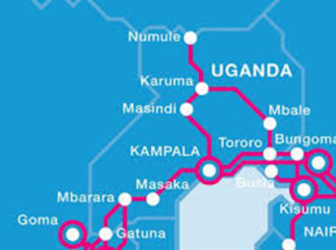
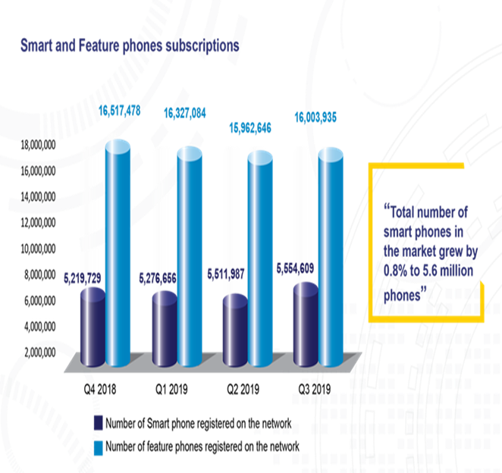
A surge in subscribers
internet penetration is 37.9% & 23m users mobile phone users

Slide 152
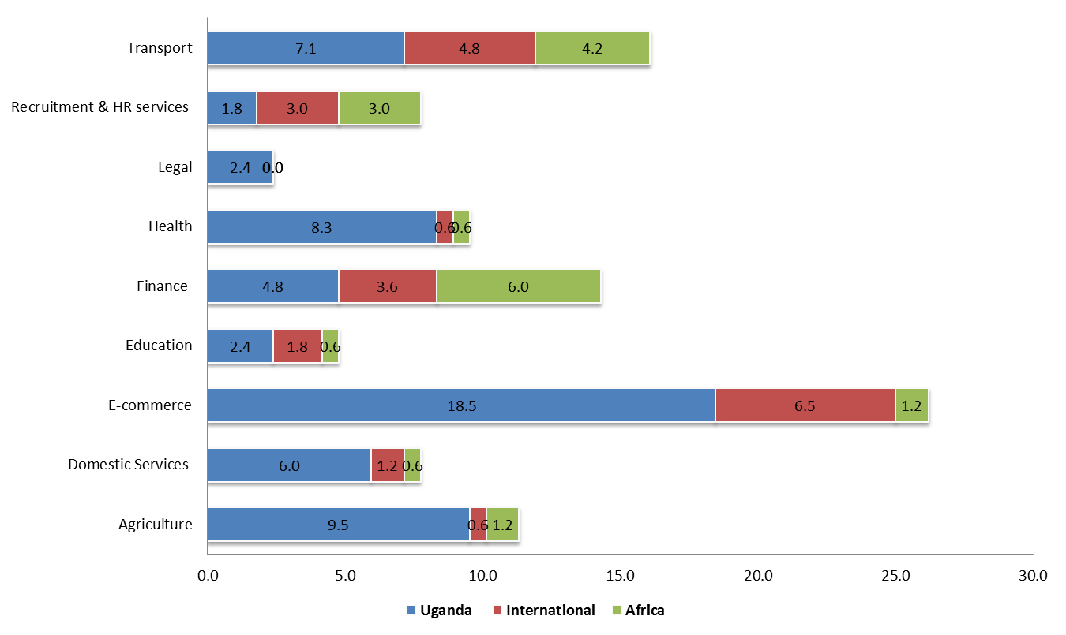
Digital labour platforms operating in Uganda
i
UG has vibrant tech start-up ecosystem supported by 16 active tech hubs public & private

Slide 154
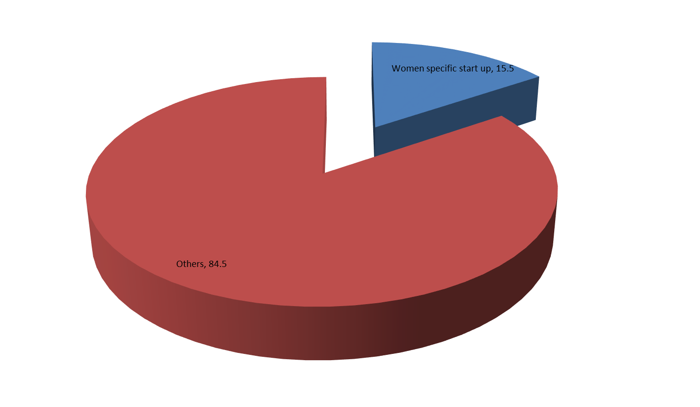
Proportion of DPLs targeting Women
i
Women specific DPLs total 15.5%

Slide 155
Total DPLs targeting Women in Agric
i
About 3M women small holder farmers connect to
VALUE4HER Connect platform supported by African Women Agribusiness Network Afrika; Africa Women Entrepreneurship and Innovation Forum; Alliance for a Green Revolution in Afric
21.1% support women, majority in agribusiness

Slide 156
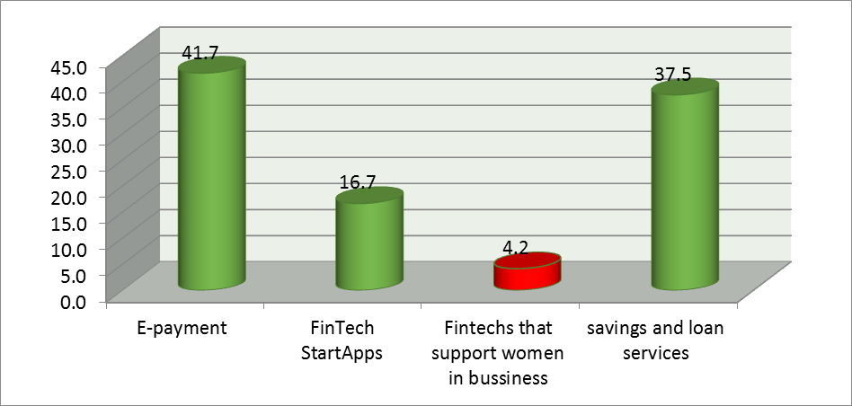
Progress on FinTechs for Women
i
payments were the largest area of FinTech in Uganda, with a transaction volume of UGX 17.6 trillion (~ USD 4.7 billion
60% of FinTechs were native
… at 34.8% women, UG has the highest percentage of women entrepreneurs globally

Slide 157
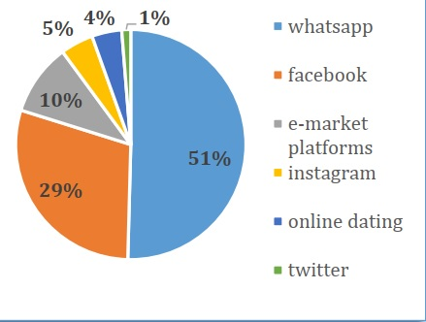
Avenues for gender norms change
women’s access to digital platforms in rural Uganda, WOUGNET (2020) noted that women accessed broadband connections only through their phones (98%) and less by router or modem.

Slide 158
Avenues for gender norm cont’d
Only 2% of women used WiFi and that was when they accessed it from their work places
26% of women obtained money to buy Internet bundles from their spouses and 33% from their own earnings. Study added that husbands detested their wives if they requested them to provide money for buying Internet, which often resulted into violence
The structural inequality of opportunity for women in the workplace, severely limits their participation in the design and development of new digital technologies
Gendered divisions of labour around technology are based in part on equations around masculinity and technical skill. The masculine culture of the workplace is an avenue for women’s under-representation in technological pursuits

Slide 159
Conclusion
The ideas about how digital solutions can solve gender access usage gap is essential. It means that the growth of the digital ecosystem, such as mobile applications, AI, GIS, smart metering, big data analytics and Internet of Things (IoT) devices should offer unique opportunities to further understand gender norms as a barrier for women.
automating existing job roles and the need for women to re-skill into new careers is only possible if we consider gender norms impact

Slide 160
Mr Melch Muhame Natukunda
Financial Inclusion and Policy Advisor
Care International Uganda
Digital Sub Wallets for Increased Financial Empowerment for Women
14 June 2023
Fair Way Hotel
Connect via Zoom

Slide 161
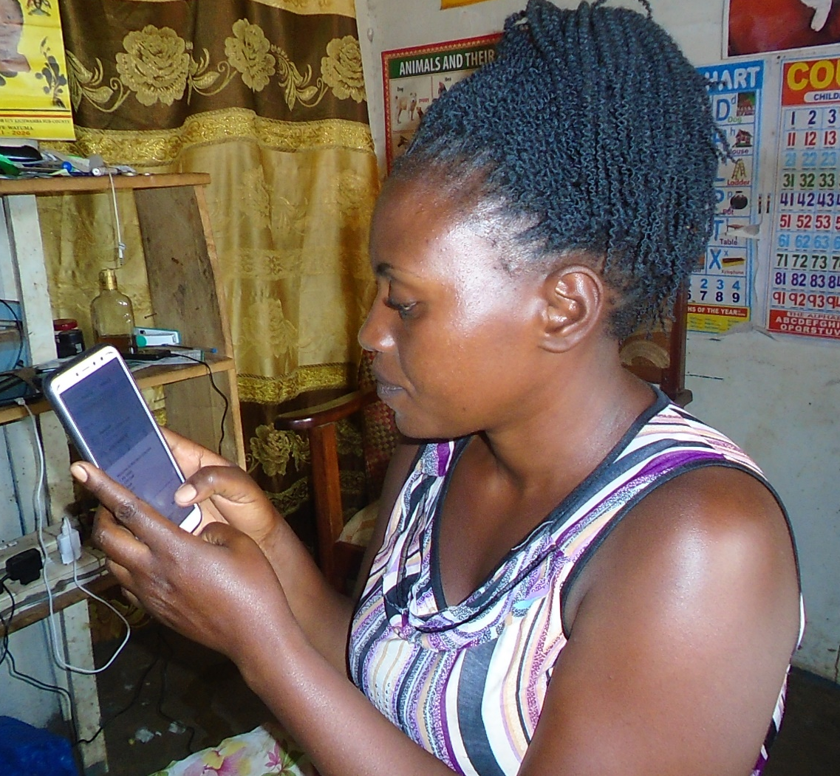
Digital Sub-Wallets for Increased Financial Empowerment of Women
By Melch Natukunda
Financial Inclusion &Policy Advisor
14/6/2023

Slide 162
Rationale
Background
The project design recognized that women’s power over their own finances, as well as their participation in household decision-making were very limited.
Also, there was recognition that women’s experience of empowerment happens in the context of struggle of disempowerment and often requires group solidarity
Need
Thus, the application of both “Gender Light” and “Gender Transformative” approaches

Slide 163
Project Interventions
Entry
Financial literacy at VSLA level
CARE worked with VSLA members(over 70% women). Only existing VSLA group members were targeted.
Support members to develop individual financial goals
Open bank accounts and onboard the Digital platform aligned to sub wallets/goals
Digital Sub Wallet (DSW)
Gender Transformative Household Dialogues (HHD)
Address gender norms and intra-household relations
Conducted at HH level among HH members
Household joint financial planning

Slide 164
Interventions and Research Methodology
Group 1.
Mobile banking with digital sub-wallets and financial education (DSW).
Group 2.
Household dialogue curriculum followed by DSW offering and training (HHD+DSW)
Group 3.
Control group that was comprised of VSLA members but did not receive any of the interventions
Psychometric Scales.
link between women’s own experience of empowerment and the RCT outcomes using established, scientifically validated psychological scales.
Semi-structured interviews
Bank Data.
Random Controlled Trial (RCT) Selected participants were divided into three groups: 1,423 total, 1,112 women with spouses, 213 women – single/widow and 93 men
Interviews

Slide 165
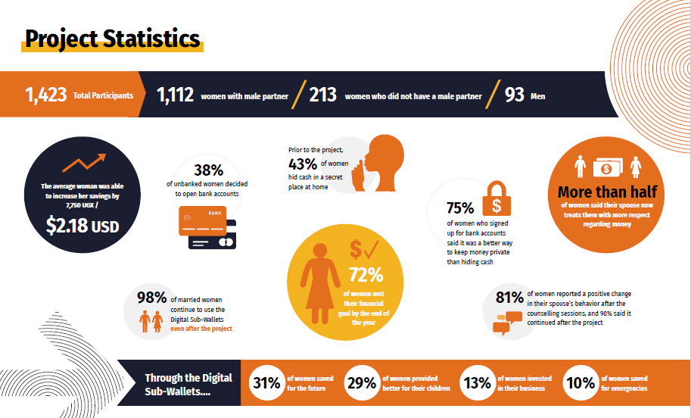

Slide 166
RCT Project Results
Women reported being more confident negotiating with their household members, especially their spouses, and budgeting for their needs as part of a household savings plan.
Women are actively engaged in joint decision-making with their spouses, setting financial goals and having a voice in family decisions.
Financial literacy training has reinforced savings capacity for participating members, from an average of UGX 204,532 ($58) to UGX 278,346 ($80
What Have You Been Able to Do Differently with Money Since the Household Dialogues?
% tage of Married Women in HHD+DSW | Header
Provide better for the children | 29.8%
Put aside money for things that are important to my family | 20.5%
Save for the future | 14.3%
My spouse now treats me with more respect with regard to money than before. | 53%
Other | 35.4%

Slide 167


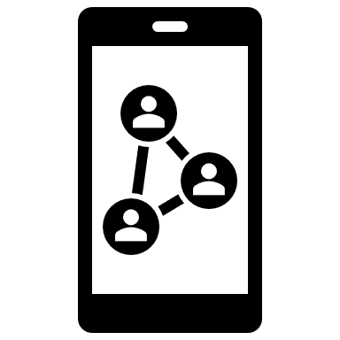


Challenges
Solutions
Use of early adopters especially young women as champions
Targeted one-on-one support especially regarding account activation and initial usage
Introduction of bank agency as an affordable alternative
PostBank recruitment of female workers who could easily bond with the women
Support the establishment of the PostBank Service Centre
Digital illiteracy
Pace of technological development and adoption/uptake overtaking project design/period
Technology challenges: network failure and call-drops
Cost of transactions
Negative gender/social norms especially to those that did not receive HHD

Slide 168
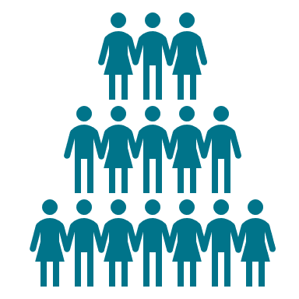

Lessons Learned
Digital solutions are relevant to women, VSLA members and community at large, as long as they’re reliable, and members are empowered and equipped with the knowledge to harness them
Appropriate and relevant financial products that mimic women’s financial needs puts money in the hands of women, formal products whether especially digital increases their control over their financials but combined with household dialogues with power holders/gatekeepers increases and unlocks women’s financial autonomy and demonstrate the greatest change in women’ lives with greater outcomes.

Slide 169
Next Steps
Document the HHD model but also work out strategies on how best to scale the DSW combined with HHD but light
Dissemination of the research findings
Integrating gender light and gender transformative approaches in CARE interventions.
PostBank widening market segment to include girls (18+years)
Postbank expanding product to other branches

Slide 170

Opportunities for EALC

Slide 171


Slide 172
Questions & Answers
14 June 2023
Fair Way Hotel
Connect via Zoom

Slide 173
Join the EALC!
14 June 2023
Fair Way Hotel
Connect via Zoom

Slide 174
Closing Remarks
Prof. Rebecka Lundgren- Global Learning Collaborative- University of California San Diego (UCSD)
14 June 2023
Fair Way Hotel
Connect via Zoom

